Slide 1
Evaluating the General Capital Increase Commitments and the Ten-Year Strategy of the African Development Bank
ECG Spring 2024 meeting – Theme 4
Prepared by:
Madhu MAMPUZHASSERIL
Girma KUMBI
Oswald AGBADOME
Eric YAI

Slide 2
OUTLINE
INTRODUCTION
EVALUATING GENERAL CAPITAL INCREASE (GCI) COMMITMENTS
Objectives, questions and scope
Approach and methodology
Limitations and mitigation strategies
Ratings and Recommendations
EVALUATING CORPORATE STRATEGIES (focus on TYS)
Overview of strategic framework (2013-2024)
Importance of evaluating corporate strategies
Methodological insights – Ten-Year Strategy
Ratings, Lessons and Recommendations

Slide 3
Introduction
SELECTED RECENT CORPORATE EVALUATIONS
General Capital Increases (GCI): Evaluation of GCI-VI and ADF 12&13 commitments (2015); Forthcoming evaluation of GCI-VII commitments (to start in 2024).
Corporate Strategies: Comprehensive Evaluation of Development Results (2016); Evaluations of the Bank’s Development and Business Delivery Model (2019); Ten-Year Strategy 2013-2022 (2022); Decentralization (ongoing); One Bank Approach (ongoing).
TYS
2013-2022
HIGH 5 & DBDM
CEDR EVALUATION 2004-2013
ADF 12 (2011-2013)
GCI-VI
ADF-13 (2014-2016)
GCI-VI and ADF 12-13 EVALUATION
ADF-14 (2017-2019)
2010
2011
2012
2015
2016
2020
2017
2018
2019
2021
2014
2013
2022
2023
2024
DBDM EVALUATION
ONE BANK APPROACH
TYS EVALUATION
2013-2022
TYS
2024-2033
GCI-VII
ADF 16 (2023-2025)
ADF-15 (2020-2022)

Slide 4
Evaluation Questions
Objectives
Scope
Evaluating General Capital Increase Commitments
Draw conclusions and lessons from the implementation of commitments made by Management during the capital increase (GCI-VI) and replenishment of ADF- 12 &13, and make recommendations to improve in each of these areas
Relevance of the agreed commitments to the Bank’s challenges and priorities;
Efficiency of the processes in reaching agreement on a coherent and realistic portfolio of commitments;
Delivery of the commitments (outputs such as documents, establishment of new structures or processes);
Effectiveness of their subsequent implementation
Combine an evaluation of the capital increase (GCI-VI) and replenishment (ADF-12 & 13) processes, delivery and implementation.
Period: 2010-2014
Covering all three processes, it tracks delivery on more than 100 commitments.
ADF delivery period was ongoing at time of the evaluation.

Slide 5
Approach and Methodology
Theory-based approach:
Document and literature review.
Key informant interviews, focus groups, electronic surveys, and case studies.
Use of an expert panel.
Process mapping, review of organizational models.
Benchmarking with other MDBs assumptions, inputs, outputs, outcomes, and impacts, according to its indicative results monitoring framework
Accountability and learning purpose
Clustering the commitments around five areas: (i) policies and strategies; (ii) operations; (iii) resources and financial management; (iv) institutional effectiveness; and (v) results measurement.
Harness intersecting evaluations/studies: Coordinate with two other parallel evaluations (i) policy and strategy making and implementation, and (ii) management of the administrative budget.

Slide 6
Key informant interview
Document and literature review
Approach and Methodology
ADF Replenishment meeting programs and agendas
Papers prepared for the replenishment meetings
Chairman’s summaries of replenishment meetings
Deputies/replenishment reports
Minutes of Bank steering committee meetings
MTRs
Record of GCI-VI meetings
GCI-VI annual reports to Governors, mid-term reviews
Documents related to the delivery of commitments
Semi-structured interviews with a broad range of internal and external stakeholders.
The interview templates were designed to obtain qualitative insights as well as structured responses deploying a rating scale.
Interviewees were selected to ensure adequate coverage of people involved in all three stages of the replenishment and commitment process.
Some internal interviewees were identified based on their broad knowledge of the processes, others because of their deeper involvement in specific areas affected.
External interviewees included a sample of officials from member countries, including ADF and non-ADF members and chairpersons and former senior managers who led the process internally.

Slide 7
Benchmarking
Electronic survey
Expert panel review
Approach and Methodology
Surveys to seek the views of:
The ADF deputies and their alternates or advisors; and
The Executive directors and their advisors.
Each questionnaire targeted and addressed areas that are specific to each group.
Response rate was low (31-32%).
Several elements of the evaluation utilized benchmarking with peer organizations.
Process/cycle characteristics (length, number of meetings, location of meetings, number of papers prepared, elapsed time);
Number of commitments;
Coverage of commitments;
Financial resources mobilized, including size of donor contributions; and
Monitoring and reporting arrangements.
The choice of benchmark organizations: those that are the most comparable (WB, AsDB, IADB, IFAD).
All GCI-VI, ADF-12 & 13 commitments were assessed by an expert panel, which looked into:
Realism of specific commitments and their timelines;
Diagnosis of the underlying challenges;
Alignment with the priorities of the Bank;
Clarity with respect to the intended change; and
Extent to which commitments are at a strategic level.
The expert panel was composed of independent experts with related previous experiences.

Slide 8
Limitations
Mitigation
Limitations and mitigation strategies
Unavailability of some documents.
Inadequacy of cost data for the evaluation period.
Turnover of key donor representatives, executive directors, and staff and managers, in light of the time elapsed since ADF-12 and GCI-VI.
Low survey response rates.
Lack of implementation and outcomes data
Triangulation of evidence sources: The report makes clear what lines of evidence support the findings presented and where there is insufficient evidence to draw definitive conclusions.
Clustering of commitments around 5 areas to improve consistency and reporting on outcomes.
Harnessing on other parallel evaluations to investigate and fill gaps.

Slide 9
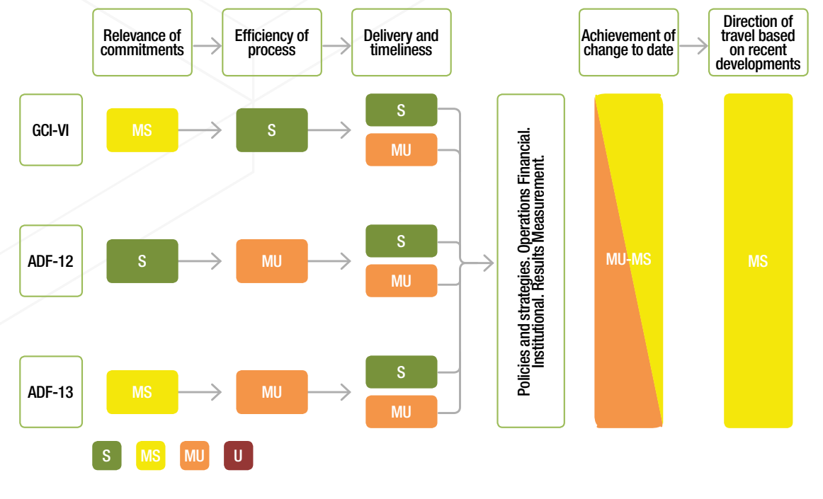
Evaluation Ratings

Slide 10
Recommendations
For both ADF and any future GCIs:
Focus on fewer and more strategic commitments, with realistic timelines and estimated costs for delivery.
Enhance monitoring and managerial accountability for effective performance and results in terms of continued implementation, not only one-off deliveries.
For the ADF specifically:
Simplify the process.
Seek early Board ownership of commitments.
Management’s Response to Recommendations: 1: Agreed; 2: Agreed; 3: Agreed in part; 4: Agreed.
With Action Plans for Implementation.

Slide 11
AfDB Strategic Framework 2013-2024
EVALUATING CORPORATE STRATEGIES
TYS 2013
High 5s
2016
DBDM
2016
OBA
2020
TYS 2.0 2024
TYS 2013-2022 (2013)
Long term strategy with a focus on inclusive and green growth for Africa's transformation.
Lays out the roadmap for achieving “The Africa We Want” by 2023.
Aim at achieving substantial impact by deepening the development of infrastructure, regional economic integration, private sector development, governance, and accountability.
DBDM (Development and Business Delivery Model) 2016:
Introduced to improve the Bank’s efficiency and effectiveness in delivering its TYS priorities.
Enhances operational effectiveness and organizational efficiency by decentralizing and moving closer to clients.
Ensures strategic alignment across all operational activities, prioritizing country-specific needs and agile response to changes.
One Bank Approach 2020
Clarifies organizational model and streamlines AfDB functions, roles/responsibilities across HQ and regional/country offices.
Enhances operation quality with in-depth technical knowledge and quality control.
Prioritize client delivery through Business Delivery Units and aligns diverse units with shared objectives for collaboration and results.
High 5s (2016)
Accelerate TYS with 5 key goals: Energy, Food, Industry, Integration, and Quality of Life.
Align with SDGs for broader impact.
Strategically allocate resources for targeted projects. Set and track progress with clear KPIs through a revised RMF.

Slide 12
IMPORTANCE OF EVALUATING CORPORATE STRATEGIES
EVALUATING CORPORATE STRATEGIES
Thorough evaluation of strategies like TYS and DBDM are crucial to evolve management practices and prepare new strategies.
IDEV has undertaken a systematic evaluation approach through its three-year work program.
Evaluations follow the implementation cycles of most strategies (TYS) or respond to specific requests of governing bodies (DBDM).
These evaluations aim at providing evidence-based recommendations, enhancing learning and accountability, and ensuring continuous stakeholder engagement on key policies and strategies
Evaluation of the implementation of the DBDM (2019)
Evaluations of Organizational reforms in the AfDB (2023-2024) / Ongoing
High 5s (2016 – 2022)
TYS (2013-2022)
Decentralization Program (2015-2023)
One Bank Approach (2020-2023)
DBDM (2016-2018)
Evaluation of the implementation of the TYS in 2022

Slide 13
TYS: Objectives & Purpose
Evaluation Methodology
Methodological insights – Ten Year Strategy Evaluation
Purpose:
Provide an independent assessment of TYS implementation.
Offer lessons and recommendations for the next Ten-Year Strategy (2023–2032).
Objectives:
Accountability: Assess the TYS's relevance, effectiveness, and implementation efficiency over the past decade.
Learning: Draw lessons from the TYS implementation to inform future strategies.
Scope:
Covers TYS implementation from 2013 to June 2022.
Includes the High 5s Agenda, RMFs for 2013–2016 and 2016–2025, and the DBDM as key elements.
Focuses on the effectiveness of the TYS as a programming framework and the Bank's overall institutional performance and delivery quality.
Exclusions:
Does not assess the achievement level of TYS's overall objectives (Inclusive Growth and Green Growth).
Evaluation Basis: Theory-based, leveraging a reconstructed Theory of Change for the Ten-Year Strategy (TYS).
Mixed Methods for Validity: Utilized both quantitative and qualitative approaches for comprehensive triangulation and validation.
Criteria Assessed:
Focus on relevance, coherence, effectiveness, and efficiency.
Impact and sustainability criteria excluded due to evaluability and data concerns.
Portfolio Review :
Analyze time series of RMF indicators (2013-2016, 2016-2025) to assess TYS effectiveness and efficiency.
Collect and analyze additional data on AfDB portfolio composition (2005-2021).

Slide 14
Limitation and Response
Evaluation Methodology
Methodological insights (contd.)
Synthesis of Evaluative Knowledge:
Leverage existing IDEV evaluations, PCREN and XSREN for a strong evidence base.
Focus on effectiveness, efficiency, relevance, and coherence of the TYS.
Consultation Strategy:
Individual interviews with AfDB staff and partners.
Focus Group Discussions (FGDs) across stakeholder categories.
Surveys targeting relevance, coherence, and efficiency criteria.
Selected case studies for in-depth analysis on effectiveness and beyond.
Benchmark TYS against policies and strategies of other development organizations.
Data Variability: Inconsistencies in AfDB data sources.
Response: Collaborated with relevant departments for data verification and reconciliation.
Evaluation Timeline Mismatch: Evaluative documents not aligning with TYS timeframe.
Response: Prioritized evaluations within TYS period, acknowledging timeline constraints.
Lack of TYS-Focused Statistics: Missing detailed statistics by TYS priorities.
Response: Utilized available sectoral and High 5 data, interpreting with respect to TYS goals.
Survey Participation: Low response rate from RMC surveys.
Response: Enhanced analysis with additional interviews to offset survey limitations.

Slide 15
TYS Eval Ratings, Lessons and Recommendations
Ratings:
Relevance: Satisfactory
Coherence: Satisfactory
Effectiveness:
As programming framework: Partly Unsatisfactory
Delivery: Satisfactory
Efficiency: Satisfactory
Lessons:
Adding new priorities leads to confusion, disruption, misalignment.
Explicit TOC can avoid logical gaps and confusion.
Alignment of RMF and TYS is crucial for strong results measurement
Matching project classification and operational priorities enables alignment & performance.
Rationalize the suite of policies and strategies for clarity and efficiency.
Recommendations:
1. Ensure a robust design for the new long-term Strategy.
2. Improve the effectiveness of the new long-term Strategy by ensuring that the Bank aligns its operations with the priorities laid out in the Strategy.
3. Strengthen monitoring, evaluation, and reporting by improving institutional mechanisms and coordination.
Management’s Response to Recommendations: 1: Agreed; 2: Agreed; 3: Agreed.
With Action Plans for Implementation

Slide 16
Thank you!
Keep in touch with us
Address
IDEV
AfDB, CCIA Building
Abidjan, Cote d’Ivoire
Contact Info
Email: idevhelpdesk@afdb.org
Telephone
Office Phone: +225 27 2026 2841
Website
https://idev.afdb.org/
Twitter
@evaluationafdb

