Slide 1
Harvesting Knowledge: The Art and Craft of Evaluation Synthesis
ECG Spring Meeting
13 March 2024
Maya Vijayaraghavan, IED/AsDB

Slide 2
Overview
Definition
Typology & Audiences
Examples

Slide 3
Definition
Evaluation synthesis captures evaluative knowledge and lessons learned from various existing evaluations. It aggregates and distills evidence to draw more informed conclusions (and sometimes recommendations) related to a particular topic or question.

Slide 4
Typology of evaluation synthesis
Two types of evaluation syntheses produced by IED:
Less labor and time intensive: e.g., Learning lessons, Synthesis notes
More labor and time intensive: e.g., Systematic reviews, Evidence and Gap Maps, Annual Evaluation Review

Slide 5
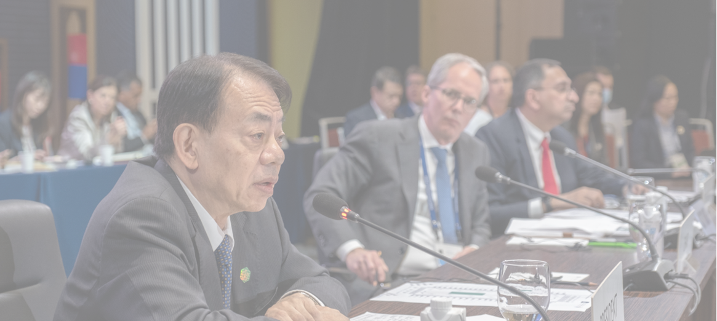
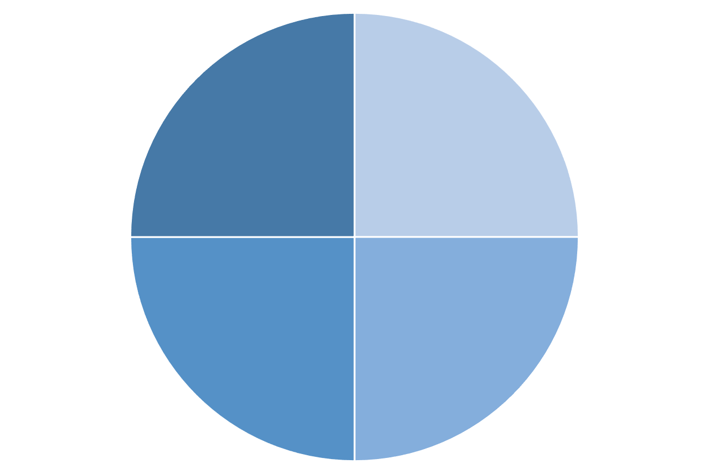
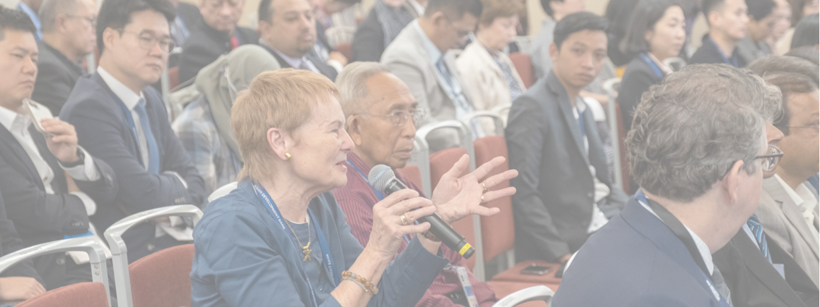
Strategic Engagement with Stakeholders Right Knowledge to the Right Audience at the Right Time
ADB Board
Member Countries
Internal audience
External audience
ADB & IED
Development Community
5

Slide 6
Less labor and time intensive - 1
Example: Learning lessons notes for COVID-19
Objective: Quick-turnaround, just-in-time synthesis of available internal and external evidence to inform ADB interventions for COVID-19
Challenges: Paucity of evidence
Audience: Internal and external
Reception by stakeholders: More enthusiastic reception outside the organization. Included in the OECD/DAC synthesis of evidence.
Stats: 1000+ downloads

Slide 7
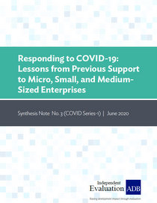
Less labor and time intensive - 2
Example: Synthesis notes on lessons from ADB support to Micro, Small, and Medium-sized enterprises, and lessons from ADB support for Public Financial Management
Objective: Synthesis of evidence from IED evaluations to inform ADB’s response to COVID-19
Challenges: Staff time allocation
Audience: Mainly internal, but of interest to external audiences as well
Reception by stakeholders: Internal audiences consider them to be useful
Stats: Nearly 1000 downloads of each note

Slide 8
More labor and time intensive - 1
Example: Annual Evaluation Review (AER)
Objective: Synthesize results and performance of ADB operations annually
Challenges: Tight timelines each year
Audience: Internal and external
Reception by stakeholders: Highly valued by ADB’s Board of Directors Stats: 1000+ downloads of the 2023 AER, and nearly 5000 for the 2021 AER

Slide 9
More labor and time intensive - 2
Example: Systematic review of the Impact of Access to Electricity on Household Welfare
Objective: Input to the sector-wide evaluation on energy
Challenges: Aligning timelines for the systematic review and the evaluation that they intended to inform; lack of in-house capacity for systematic reviews
Audience: Internal and external
Reception by stakeholders: Mixed reception internally
Stats: 1500+ downloads

Slide 10
More labor and time intensive - 3
Example: Evidence and Gap Map (EGM) on Global Value Chain (GVC) Interventions: Are ADB Projects Aligned with the Evidence?
Objective: Explores the extent to which published evidence on GVC interventions aligns with ADB’s own project activities
Challenges: Lack of in-house capacity to produce EGMs
Audience: Internal and external
Reception by stakeholders: Internal audiences consider this to be a useful product. Too soon to comment on reception by external stakeholders.
Stats: Published in 2024, so not much data available

Slide 11
More labor and time intensive - 4
Example: Evaluation, Influence, Action: How Independent Evaluation Improves ADB’s Development Effectiveness
Objective: Generate evidence on the influence of IED evaluations through case studies of selected evaluations
Challenges: Staff time allocation
Audience: Internal and external
Reception by stakeholders: Some ECG members interested in this approach to assessing influence of evaluations
Stats: Nearly 400 downloads

Slide 12
For discussion
Value addition of these synthesis products
GenAI: Implications for evaluation synthesis

Slide 13
Thank you
Independent Evaluation at ADB
Instagram
LinkedIn
Twitter
YouTube
Website
Email

