Slide 1
Using Evaluative Synthesis lessons from IEG’s experience
ECG meeting London, March 2024
Jos Vaessen, PhD

Slide 2
Evaluative synthesis
Evaluation synthesis: “A systematic procedure for organizing findings from several disparate evaluation studies” GAO (1992)
Evaluative synthesis is defined more broadly

Slide 3
Evaluative synthesis
Figure 1: Sources of Knowledge for Conducting Syntheses
WBG Knowledge
Research
Project and Self Evaluations
Data Sources
Evaluations
Structured Literature Reviews
IEG
Knowledge
Validations
Synthesis
Products
Evidence
Gap Maps
External
Knowledge
Learning
Engagements
Existing Systematic Reviews
Source: IEG

Slide 4
Stand-alone evaluative synthesis products
Just-in-time Notes
Evaluation Insights Notes
Project Insights

Slide 5
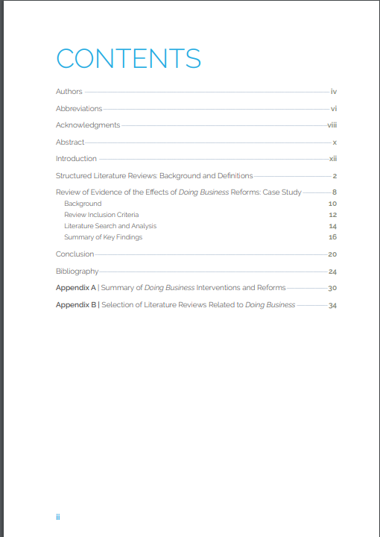
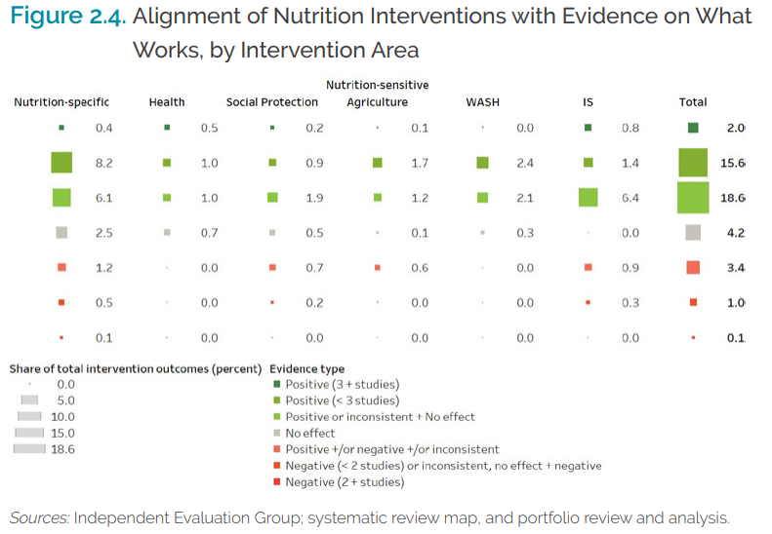
Evaluative synthesis embedded in evaluations
Structured Literature Reviews
Evidence gap maps
Systematic reviews
Content analysis

Slide 6
Methodological building blocks
Conceptual frameworks
Limited portfolio analysis
Text analysis and AI
Systematic review approaches
Narrative review approaches

Slide 7
Key issues
Understanding bias
Matching knowledge to audience
Building on a clear conceptual framework and research design
Using data science effectively and meaningfully

Slide 8
Thank you

