Slide 1
Evaluation synthesis - a “new” approach for an “old” product…
ECG 2024 Spring Meeting
EBRD-IEvD
13 March 2023

Slide 2
Table of Contents
1
Our approach: WHAT & HOW
2
A “challenging” example…
3
What we have learned… and what’s next?

Slide 3
1
Our approach: WHAT & HOW
IEvD Evaluation Synthesis approach: still WIP
Systemic Review
Info Note to inform the Board on specific topics due to internal discussion
Realist
Synthesis
Look systematically across the evidence base (i.e. “SCF series of notes”)
Meta Evaluation
An evaluation
of evaluations,
aggregates
findings from
a series of
evaluations
“Connecting the Dots”
Selected collection of evaluation findings emerging from evaluation work across the development arena

Slide 4
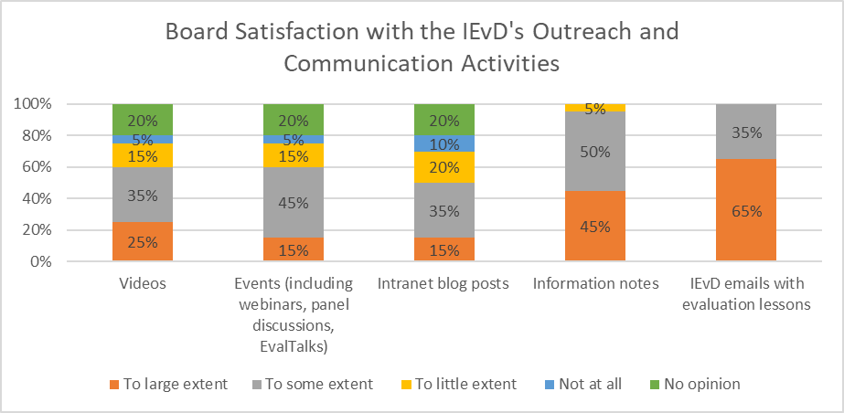
1
Our approach: WHAT & HOW

Slide 5
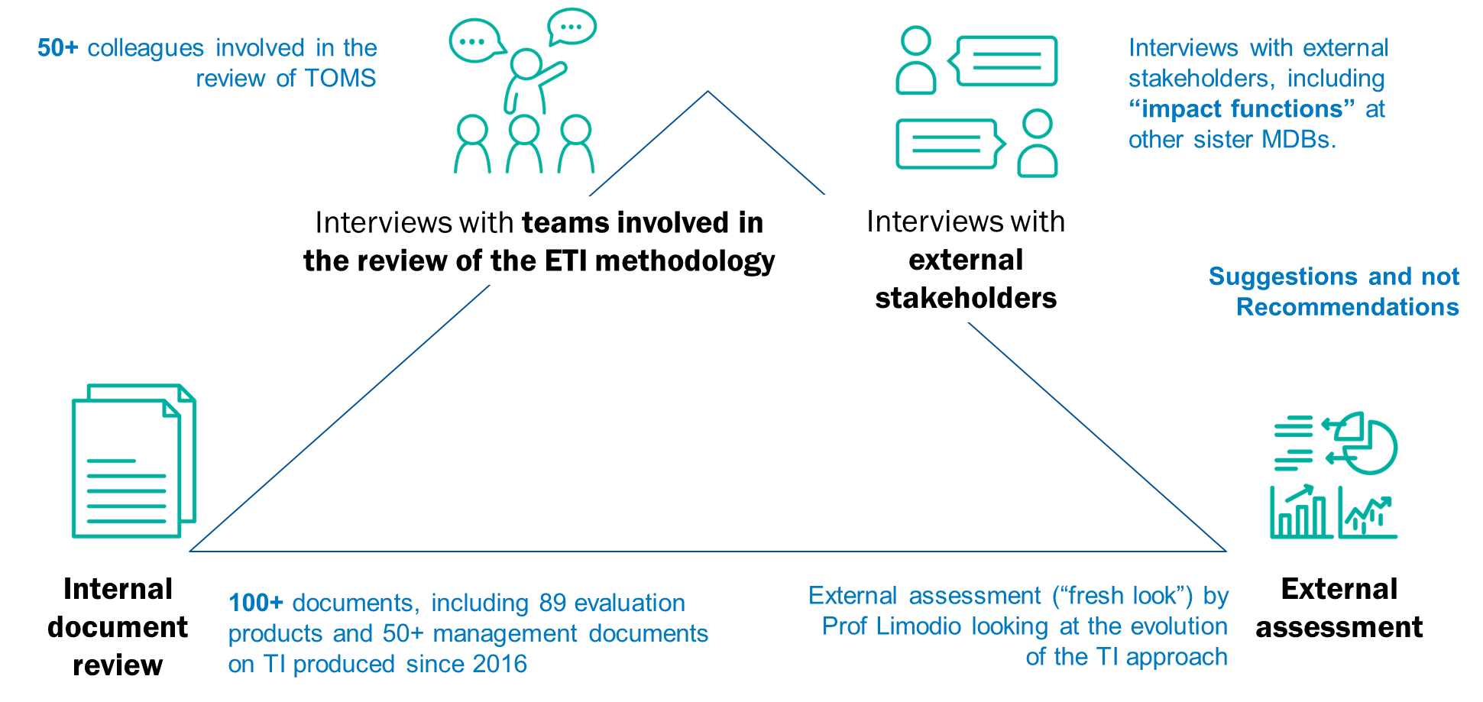
2
A “challenging” example…
A “realist synthesis” with elements of a “meta-evaluation”, aimed at synthetising around 90 evaluation products produced over the last decade

Slide 6
3
What we have learned… and what’s next?
Further strengthen the use of evaluation findings
Promote learning and a deeper reflection of a particular topic
Contribute to decision-making processes in an effective and efficient way
…
Synthesis for the “sake of it”, questionable utility in synthesizing recent evidence
Evaluation evidence outdated by the time of the synthesis
Variability in the quality of evaluation reports
…
What would be new, and concrete, opportunities enabled by generative AI for evaluation synthesis?

Slide 7
Evaluation synthesis - a “new” approach for an “old” product…
EBRD-IEvD
13 March 2023

