Slide 1
ECG Spring 2024 meeting (March 12, 2024)
Advancing the role of MDBs on Green Finance
Carmen Nonay
IEG, Director for Sustainable Development, Infrastructure, Finance and Private Sector Department

Slide 2
Today's agenda
1
Opportunities for Climate Change evaluations
2
IEG’s evaluation on Climate Change Enabling Environment

Slide 3
Opportunities for climate evaluations: Scaling up private climate finance
The private sector is pivotal in climate finance.
Scaling impact requires more than just direct fund mobilization.
Evaluations could ask:
How effective have climate interventions been at creating markets, fostering demonstration and replication effects, and supporting new technologies?
Have interventions adequately considered the fiscal consequences for clients from public guarantees and other contingent liabilities?
Are our efforts on green finance likely to be scalable?

Slide 4
Opportunities for climate evaluations: Just Transition
Greening economies creates both winners and losers, impacting sectors and regions differently.
Supporting the most affected countries is crucial for fairness and to navigate the political hurdles of the green shift.
Evaluation can help to support a Just Transition:
Are we adequately promoting livelihoods and jobs for those harmed by climate transitions?
Are our climate change interventions supporting social inclusion?
Are our institutions adequately considering risk management and tradeoffs through our E&S systems?

Slide 5
Opportunities for climate evaluations: Partnerships and IFI architecture
Climate action has generated a complex network of funds, complicating coordination and burdening clients.
Our evaluation mandates often fall short in assessing these multifaceted challenges.
We could make progress by assessing:
What steps could be taken to reduce fragmentation of climate finance?
How well are we partnering? Are we working as a system?
How well are we managing trust fund architecture?

Slide 6
Opportunities for climate evaluations: Internal corporate tools and incentives
Our institutions are implementing tools, mandates, incentives, and reporting systems to mainstream climate.
But are these fit for purpose?
Our evaluations could ask:
Are our internal corporate approaches to climate effective in generating our goals, and are they efficient?
Are new metrics and reporting systems serving decentralized decision-making needs, or only the demands of the authorizing environment?

Slide 7
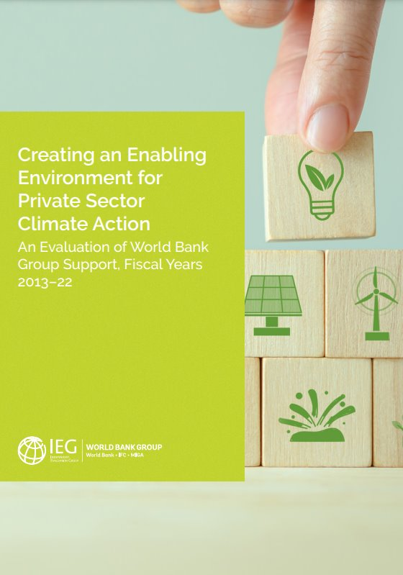
Creating an Enabling Environment for Private Sector Climate Action (EEPSCA)
This evaluation covered the relevance and effectiveness of World Bank and IFC activities that sought to improve the enabling environment for private sector climate action.
Enabling environment refers to the set of laws and regulations, incentives, standards, information, and institutions that facilitate the private sector to invest or behave in ways that reduce GHG emissions or adapt to the current or anticipated impacts of climate change.
The evaluation covered:
268 World Bank lending operations
116 IFC Advisory Service projects

Slide 8
Key findings
Findings
Relevance
Effectiveness
Green finance
Green bonds and global green bond markets
Country Climate and Development Reports (CCDRs)

Slide 9
Creating an Enabling Environment for Private Sector Climate Action (EEPSCA)
Recommendations
The World Bank and IFC should develop and standardize private sector business models for new areas of climate action.
The World Bank and IFC should identify and articulate realistic long-term financing strategies for climate action in relevant country level climate diagnostics, including the CCDR.
The World Bank and IFC should explicitly consider the scalability of private sector climate business models that they support.

Slide 10
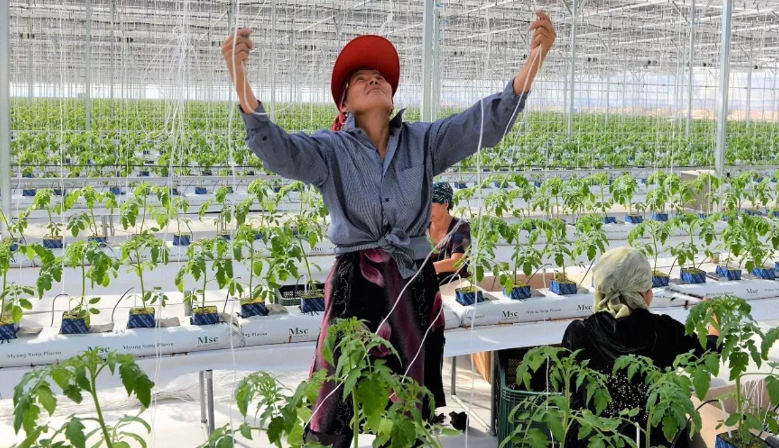
Thank you

