Slide 1

Considering transition of financial intermediaries towards sustainability: the case of the Central American Bank for Economic Integration (CABEI) to become a green financier
How advanced are MDBs on their path to becoming key green financiers: evaluation perspective
Independent Evaluation Office (ODEI)
Andrea Lupiac
José Deras
Luisa Noyola

Slide 2
Environmental and Social Policy Background at CABEI
First formal and systematic considerations to identify environmental and social (E&S) risks in its operations can be traced to 2009.
Set of internal E&S indicators for internal performance, consolidating governance for sustainability, and the strengthening of the FIs, with whom CABEI maintains a contractual relationship to channelizing resources to SMEs.
E&S risk management system (ESRMs) known as SIEMAS within CABEI analyze the process of extending the requirements and commitments regarding sustainability to its FIs, in order to guarantee sustainability in the value chain and promote the universalization of good practices.
90 Financial Institutions (FIs) have been financed for about US$16,357.6 million disbursed for SMEs.
Impact Evaluations of Intermediated Credit have been carried out to measure the results.
Analysis of the gradual integration of environmental and social commitments and the process of influencing its financial intermediaries on the road to sustainability as a contribution to influence the financial system in Central America to a transition towards sustainability.

Slide 3




Financial Intermediaries in CABEI
Distribution of Active Financial Intermediaries by Country
Active Financial Intermediaries to December 31, 2023
Active Financial Intermediaries : 56
Member Countries: 8
Accumulated US$16,357.6 million to FI representing 41% of total disbursements

Slide 4
Transitions to sustainability
Portfolio-level Transitions
Institutional level Transitions
Environmental and Social Risk Management System (ESRMs)
Environmental and Social Management System (ESMs)
(65%)
(13%)
(83%)
(7%)
Adopted: Corporate Social Responsibility (CSR) initiatives, sustainable purchasing, environmental management systems aimed at the operational and administrative activities of the buildings where the IFIS operate and initiatives for the efficient use of resources (water, energy, etc.), among others.
Notes:
Actual transition at different levels

Slide 5

19%
Institutions’ own initiative
50%
MDB’s support (including CABEI)
9%
National legislation
22%
Facilitating environment (including case of Costa Rica)
Factors explaining the observed transitions to sustainability:
the sample of FIs with full implementation

Slide 6

65% of the FIs’ transitions to sustainability with support of MDBs, coincide in having achieved environmental and social risk management systems for the portfolio.
This transition have an important level of attribution given by the contractual labor role that CABEI has incorporated when lending to FIs and the offer of technical assistance.
Findings
It is identified the need for structured capacity building initiatives from MDBs.

Slide 7

The development of structured pilot programmes for Financial Institutions (FI) to close E&S gaps in different regions around the world. The case of CABEI has an accumulated disbursements of US$ 16,357.6 million and it is highly strategic to create capacity building in environmental and social risk management, both in its portfolio and within the institution, so to ensure the implementation of the Environmental and Social Risk Management System by every FI.
Recommendations
It is recommended the implementation of regional programmes aimed at the entire financial system. In the Central American region, it reports an accumulated credit of US$ 188,390.7 million. This programmes should go beyond capacity building, seeking to work with the regulators of each country in the region, private chambers, among others.
7

Slide 8

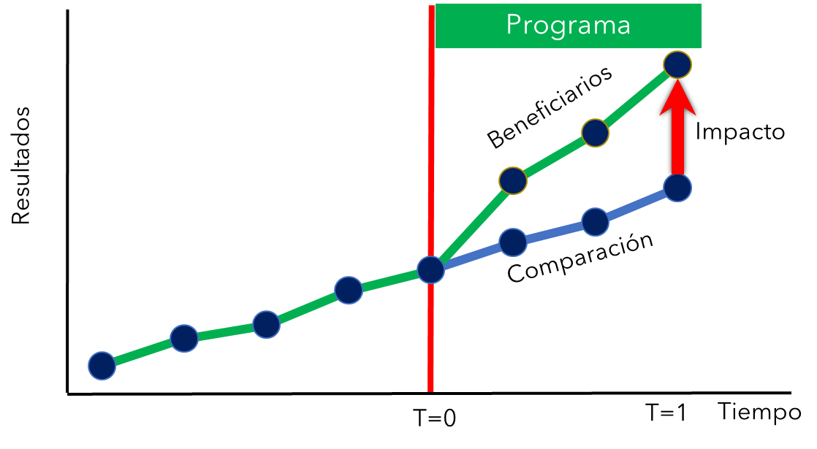
Means to an End
The regional evaluation of CABEI's intermediated credit: Costa Rica, El Salvador, Guatemala, Honduras and Nicaragua.
Quasi-experimental design
AIMS analysis tool adaptation
Evaluation of the impact of microenterprise services
Beneficiaries
Results
Impact
Control Group
Time
What is the impact of (P) on (Y)?
α= (Y | P=1)-(Y | P=0)
It’s important to look at the impacts and prospect green portfolios.

Slide 9
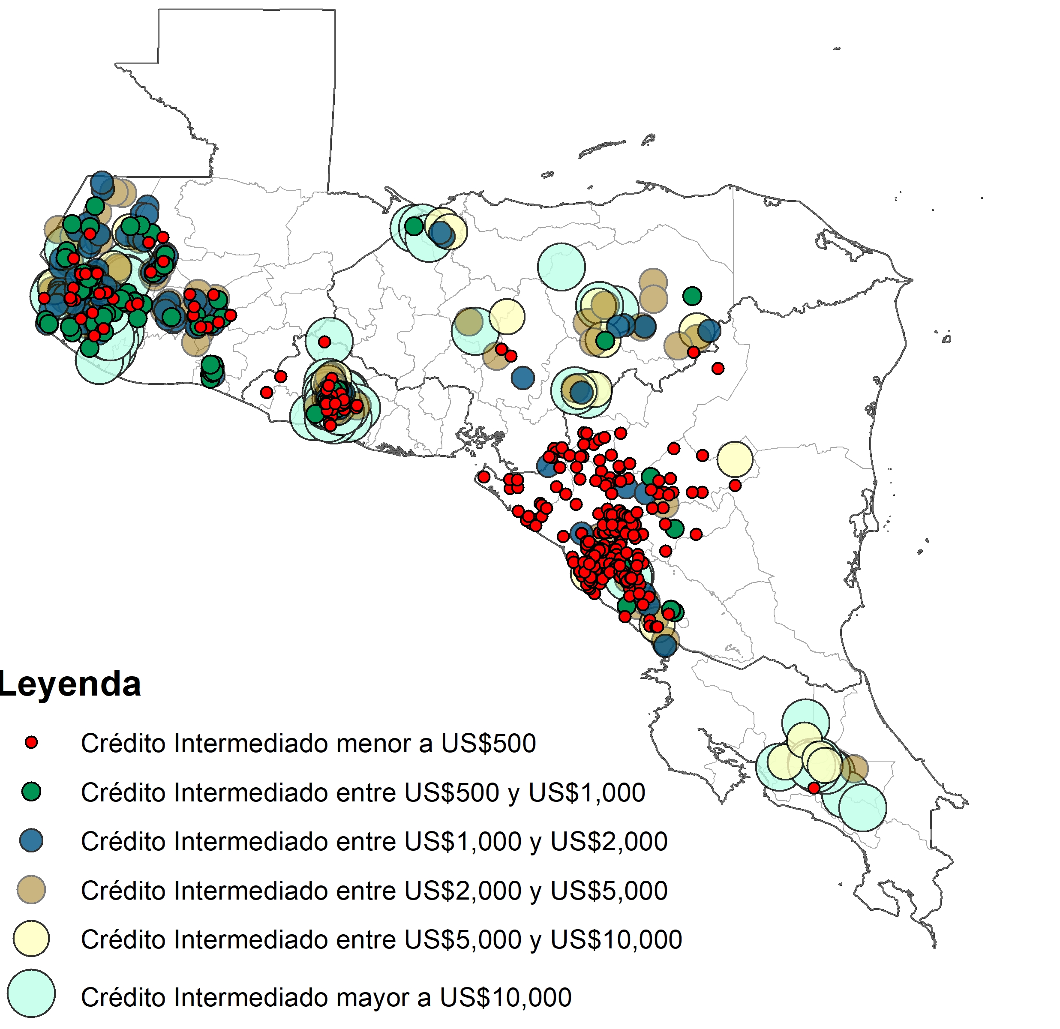
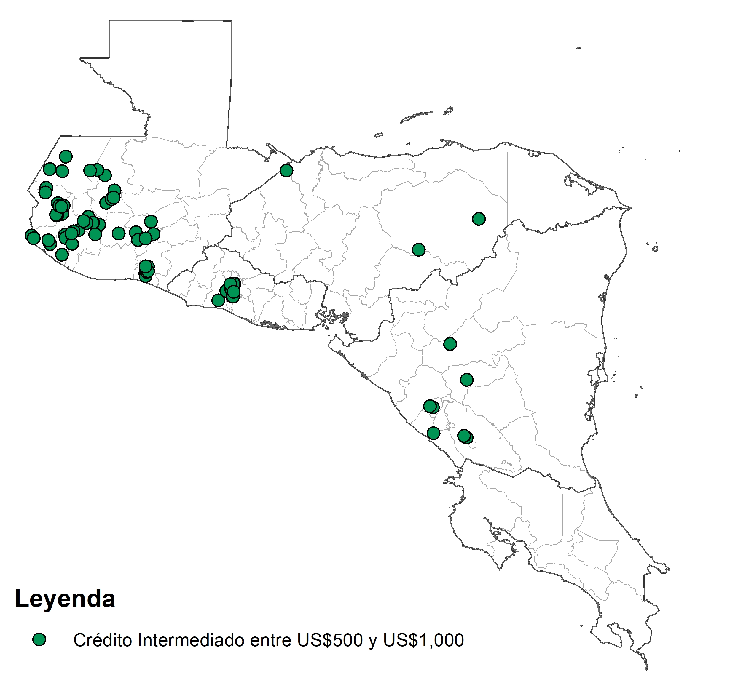
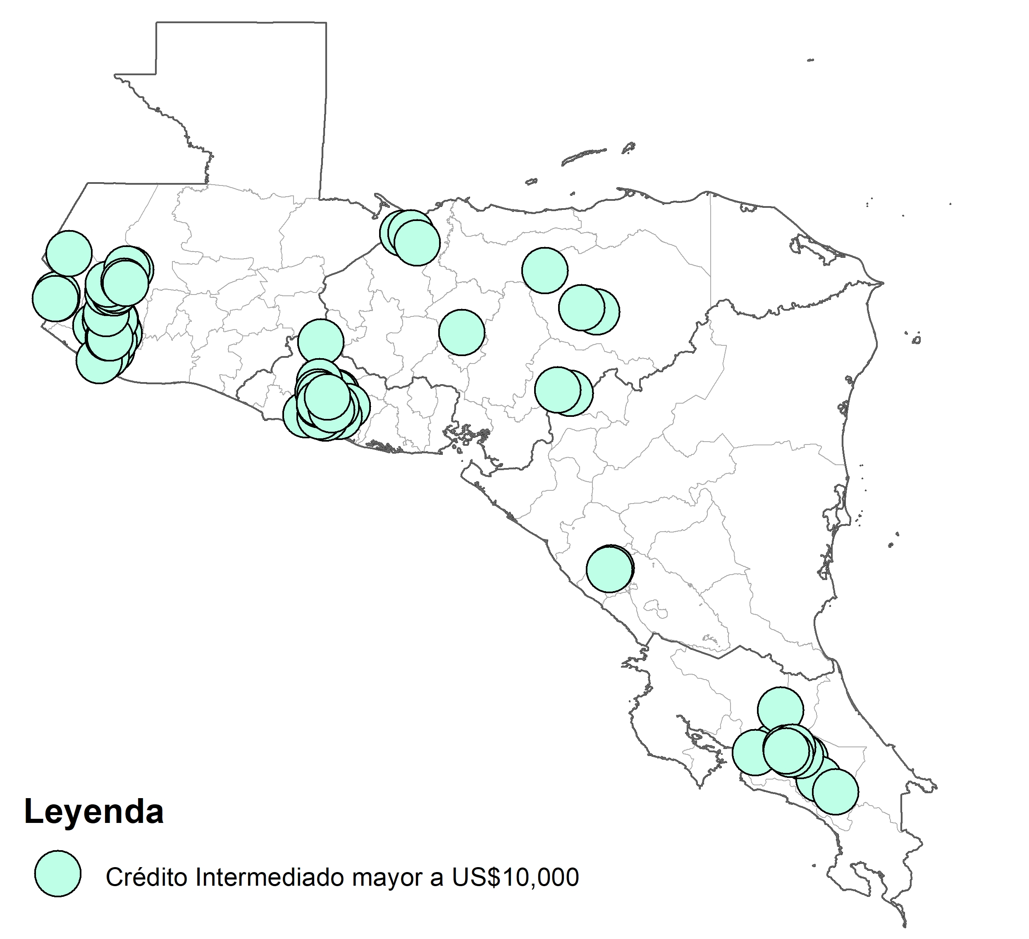
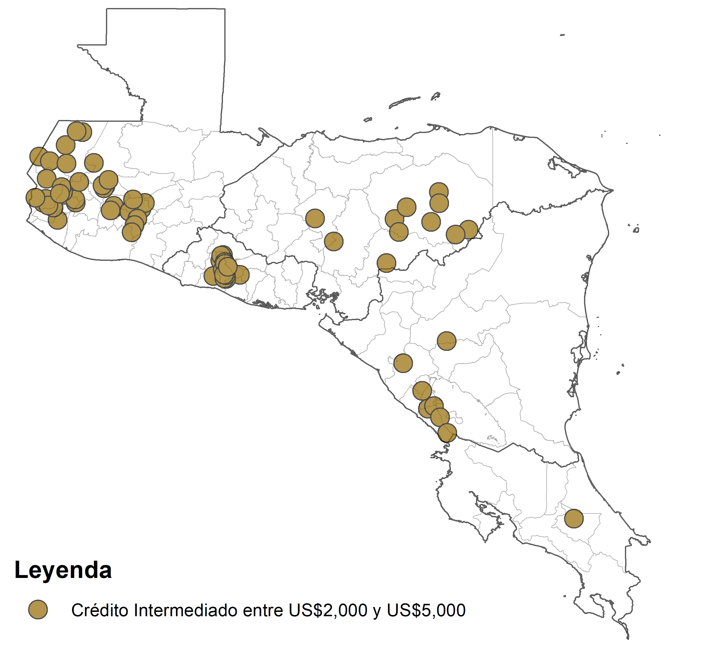
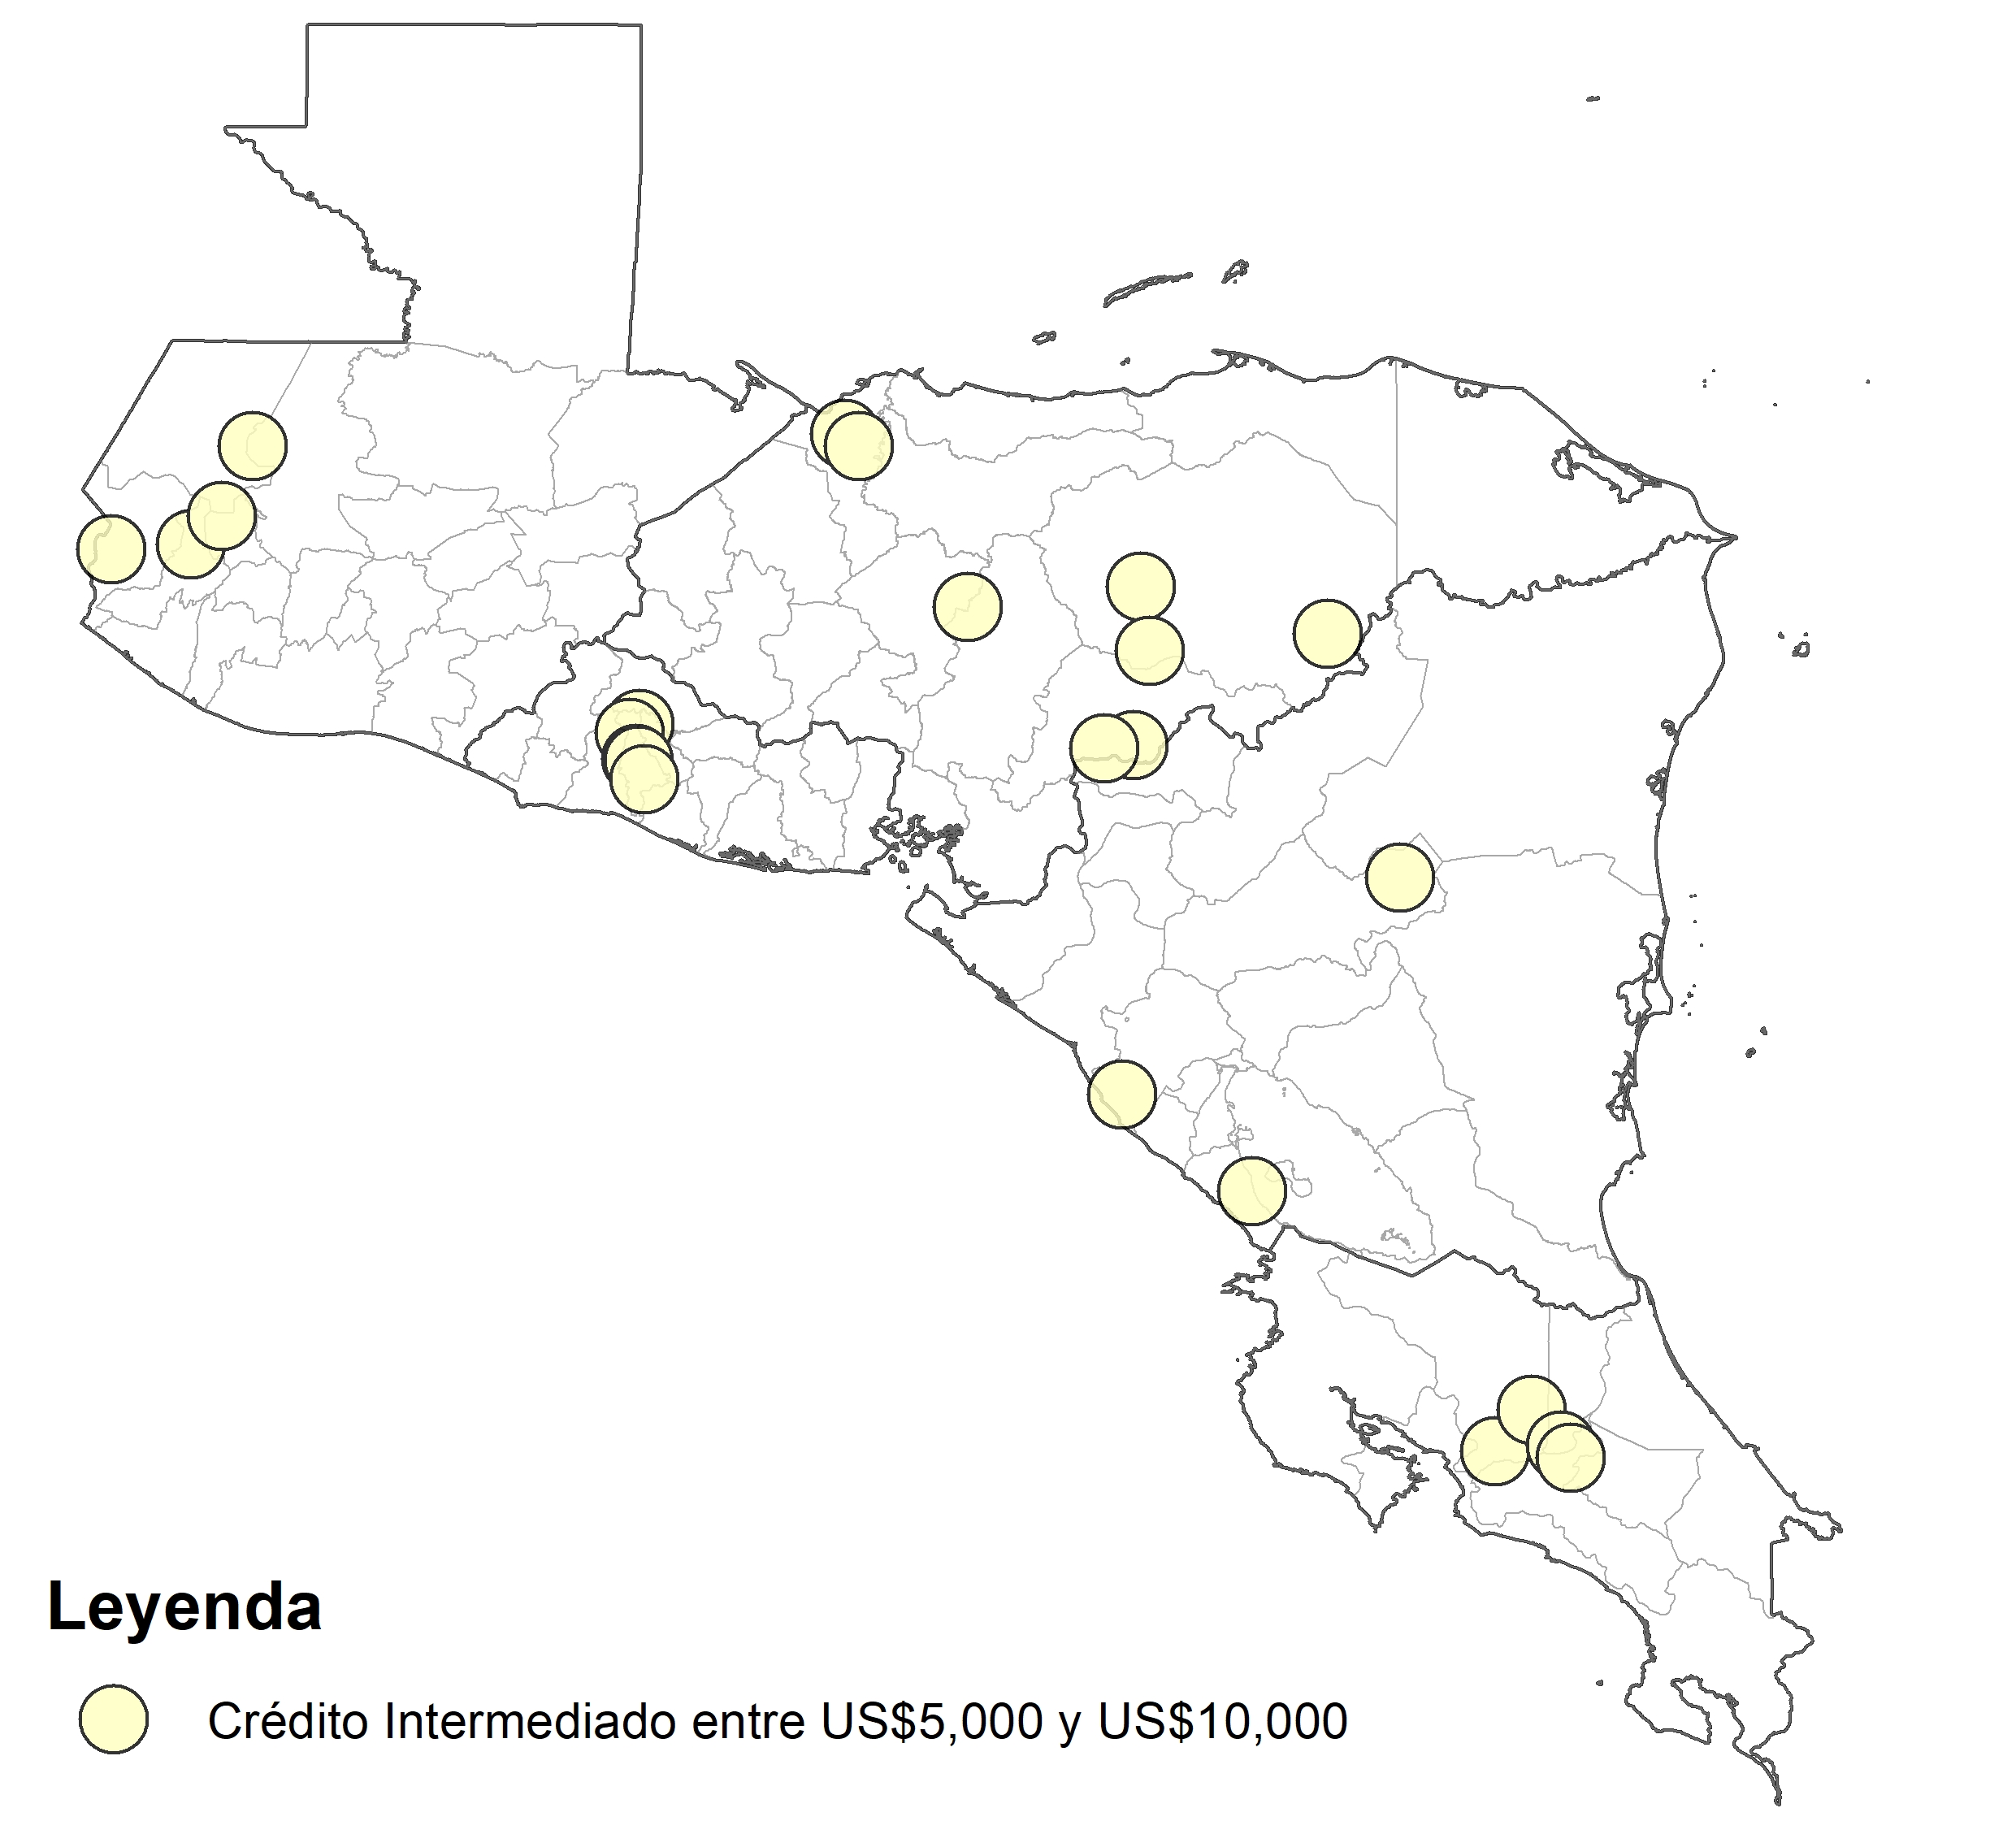
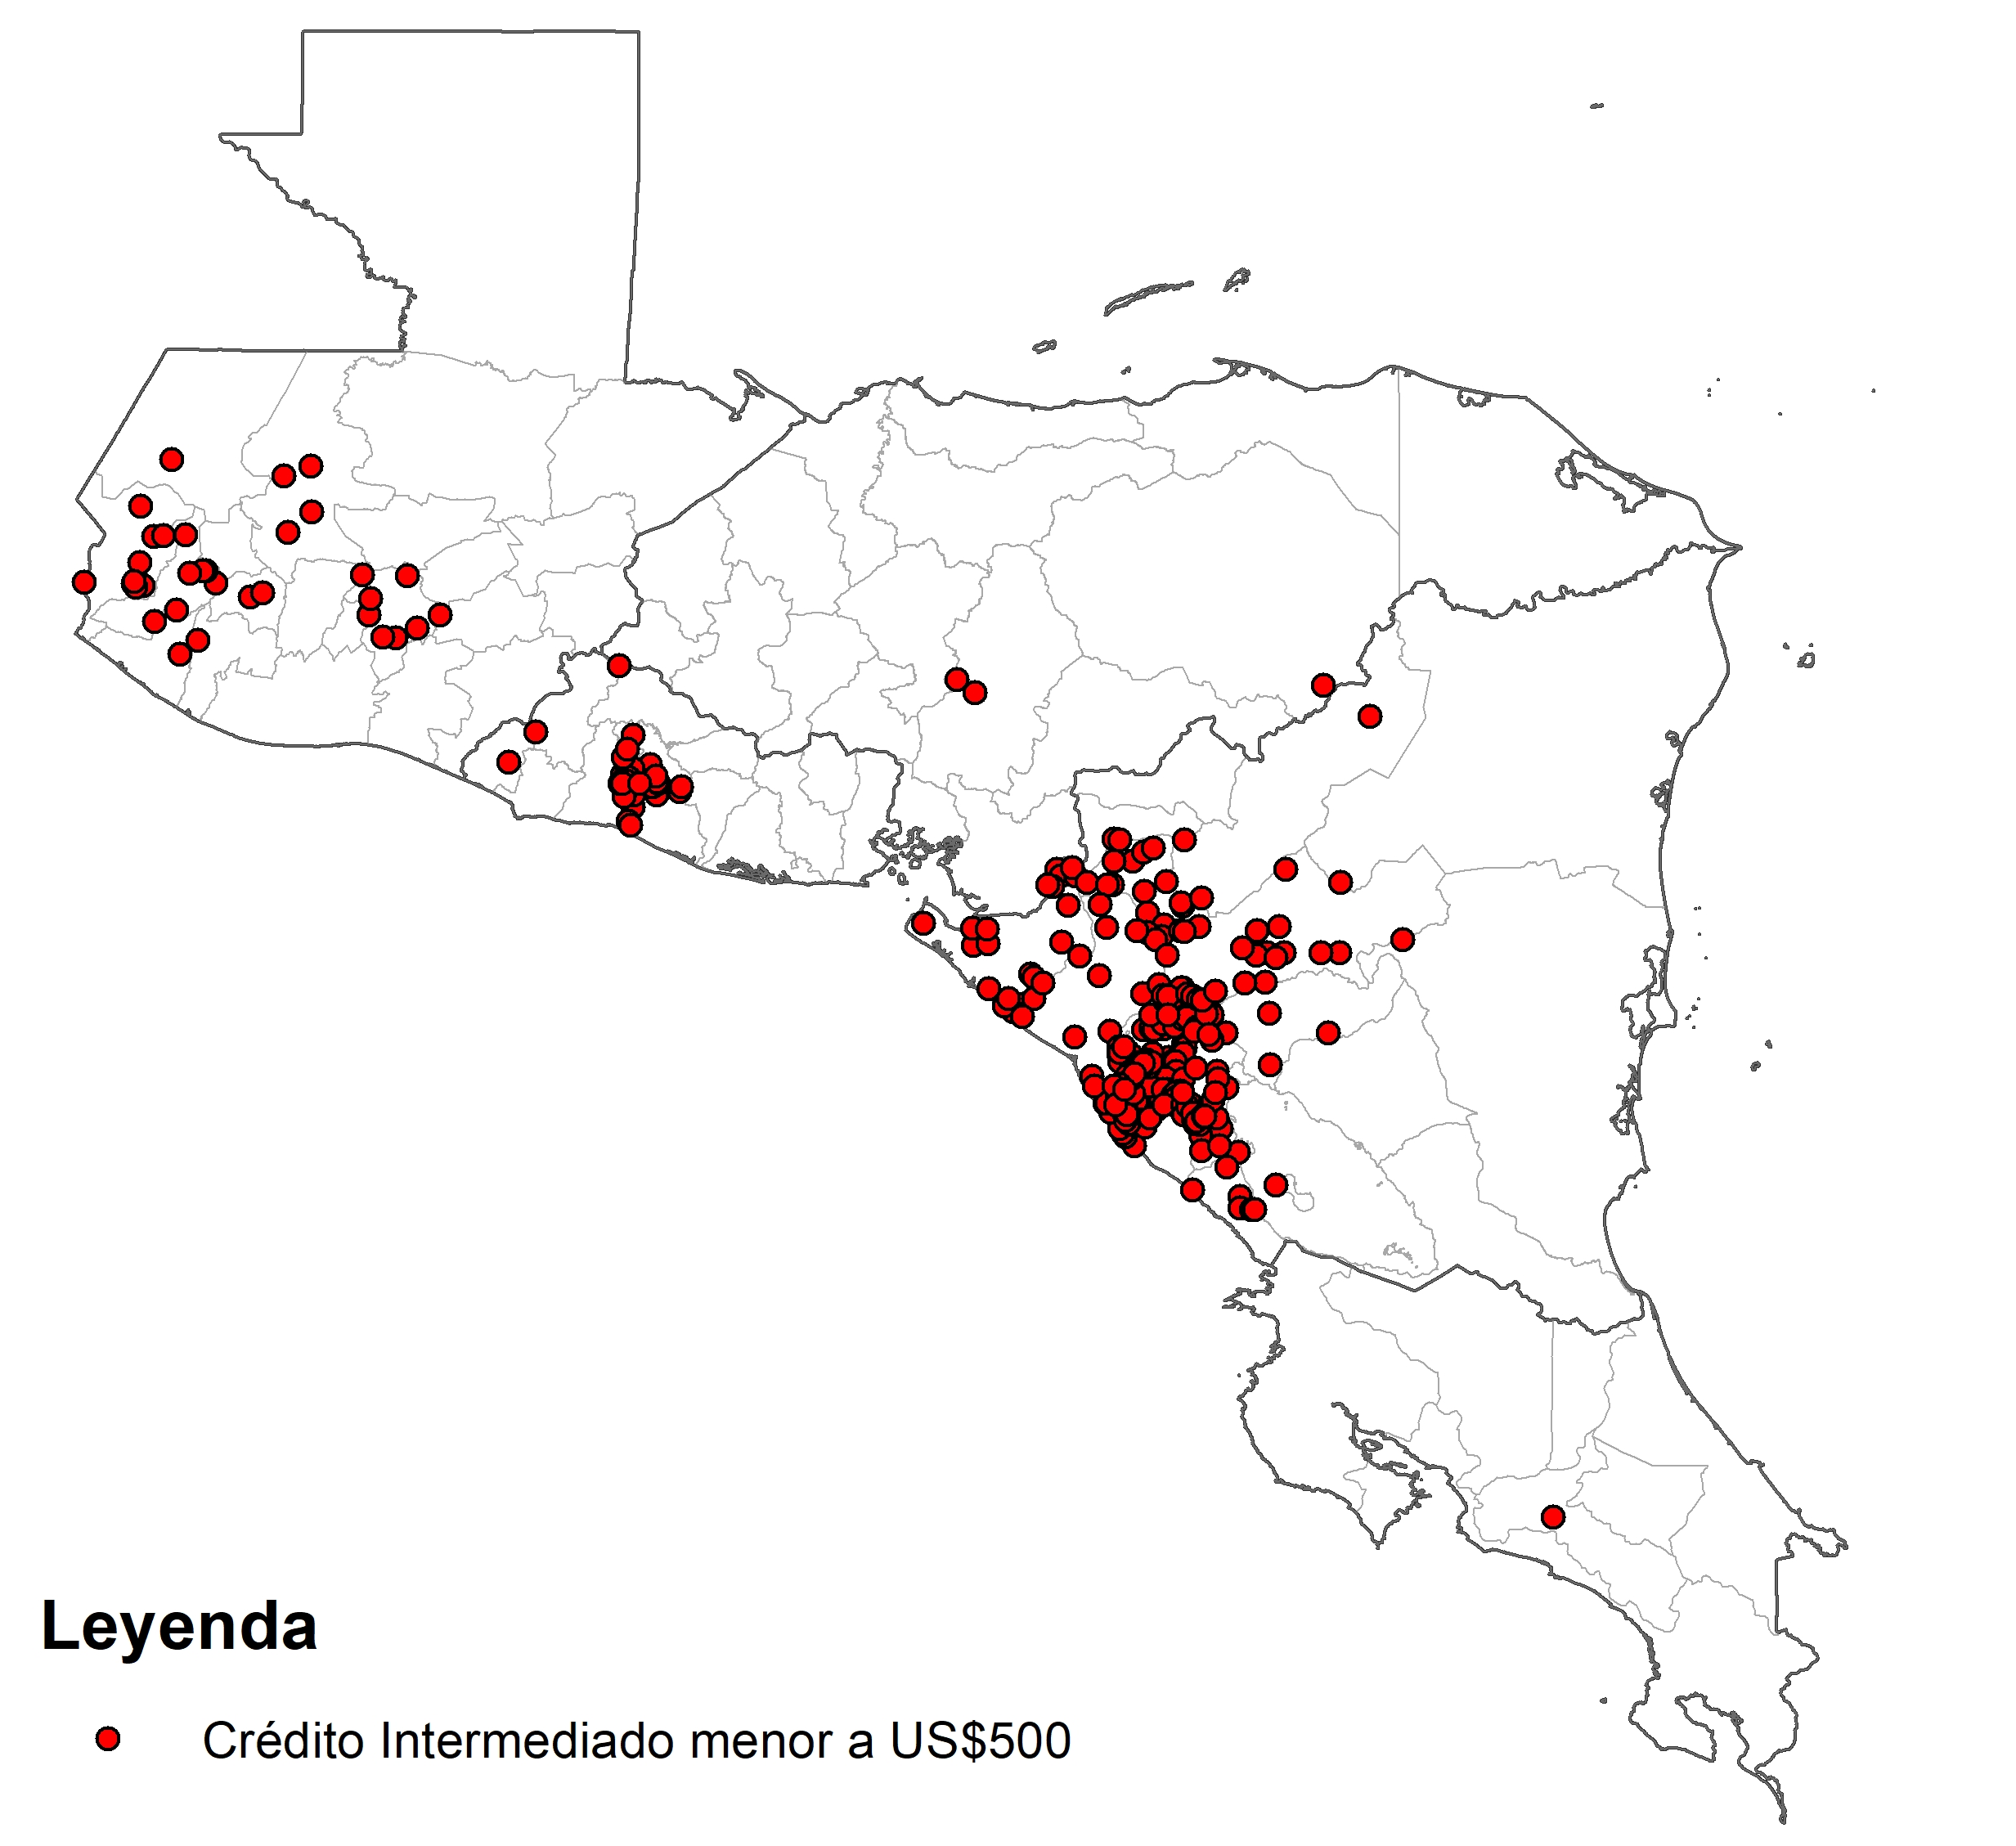
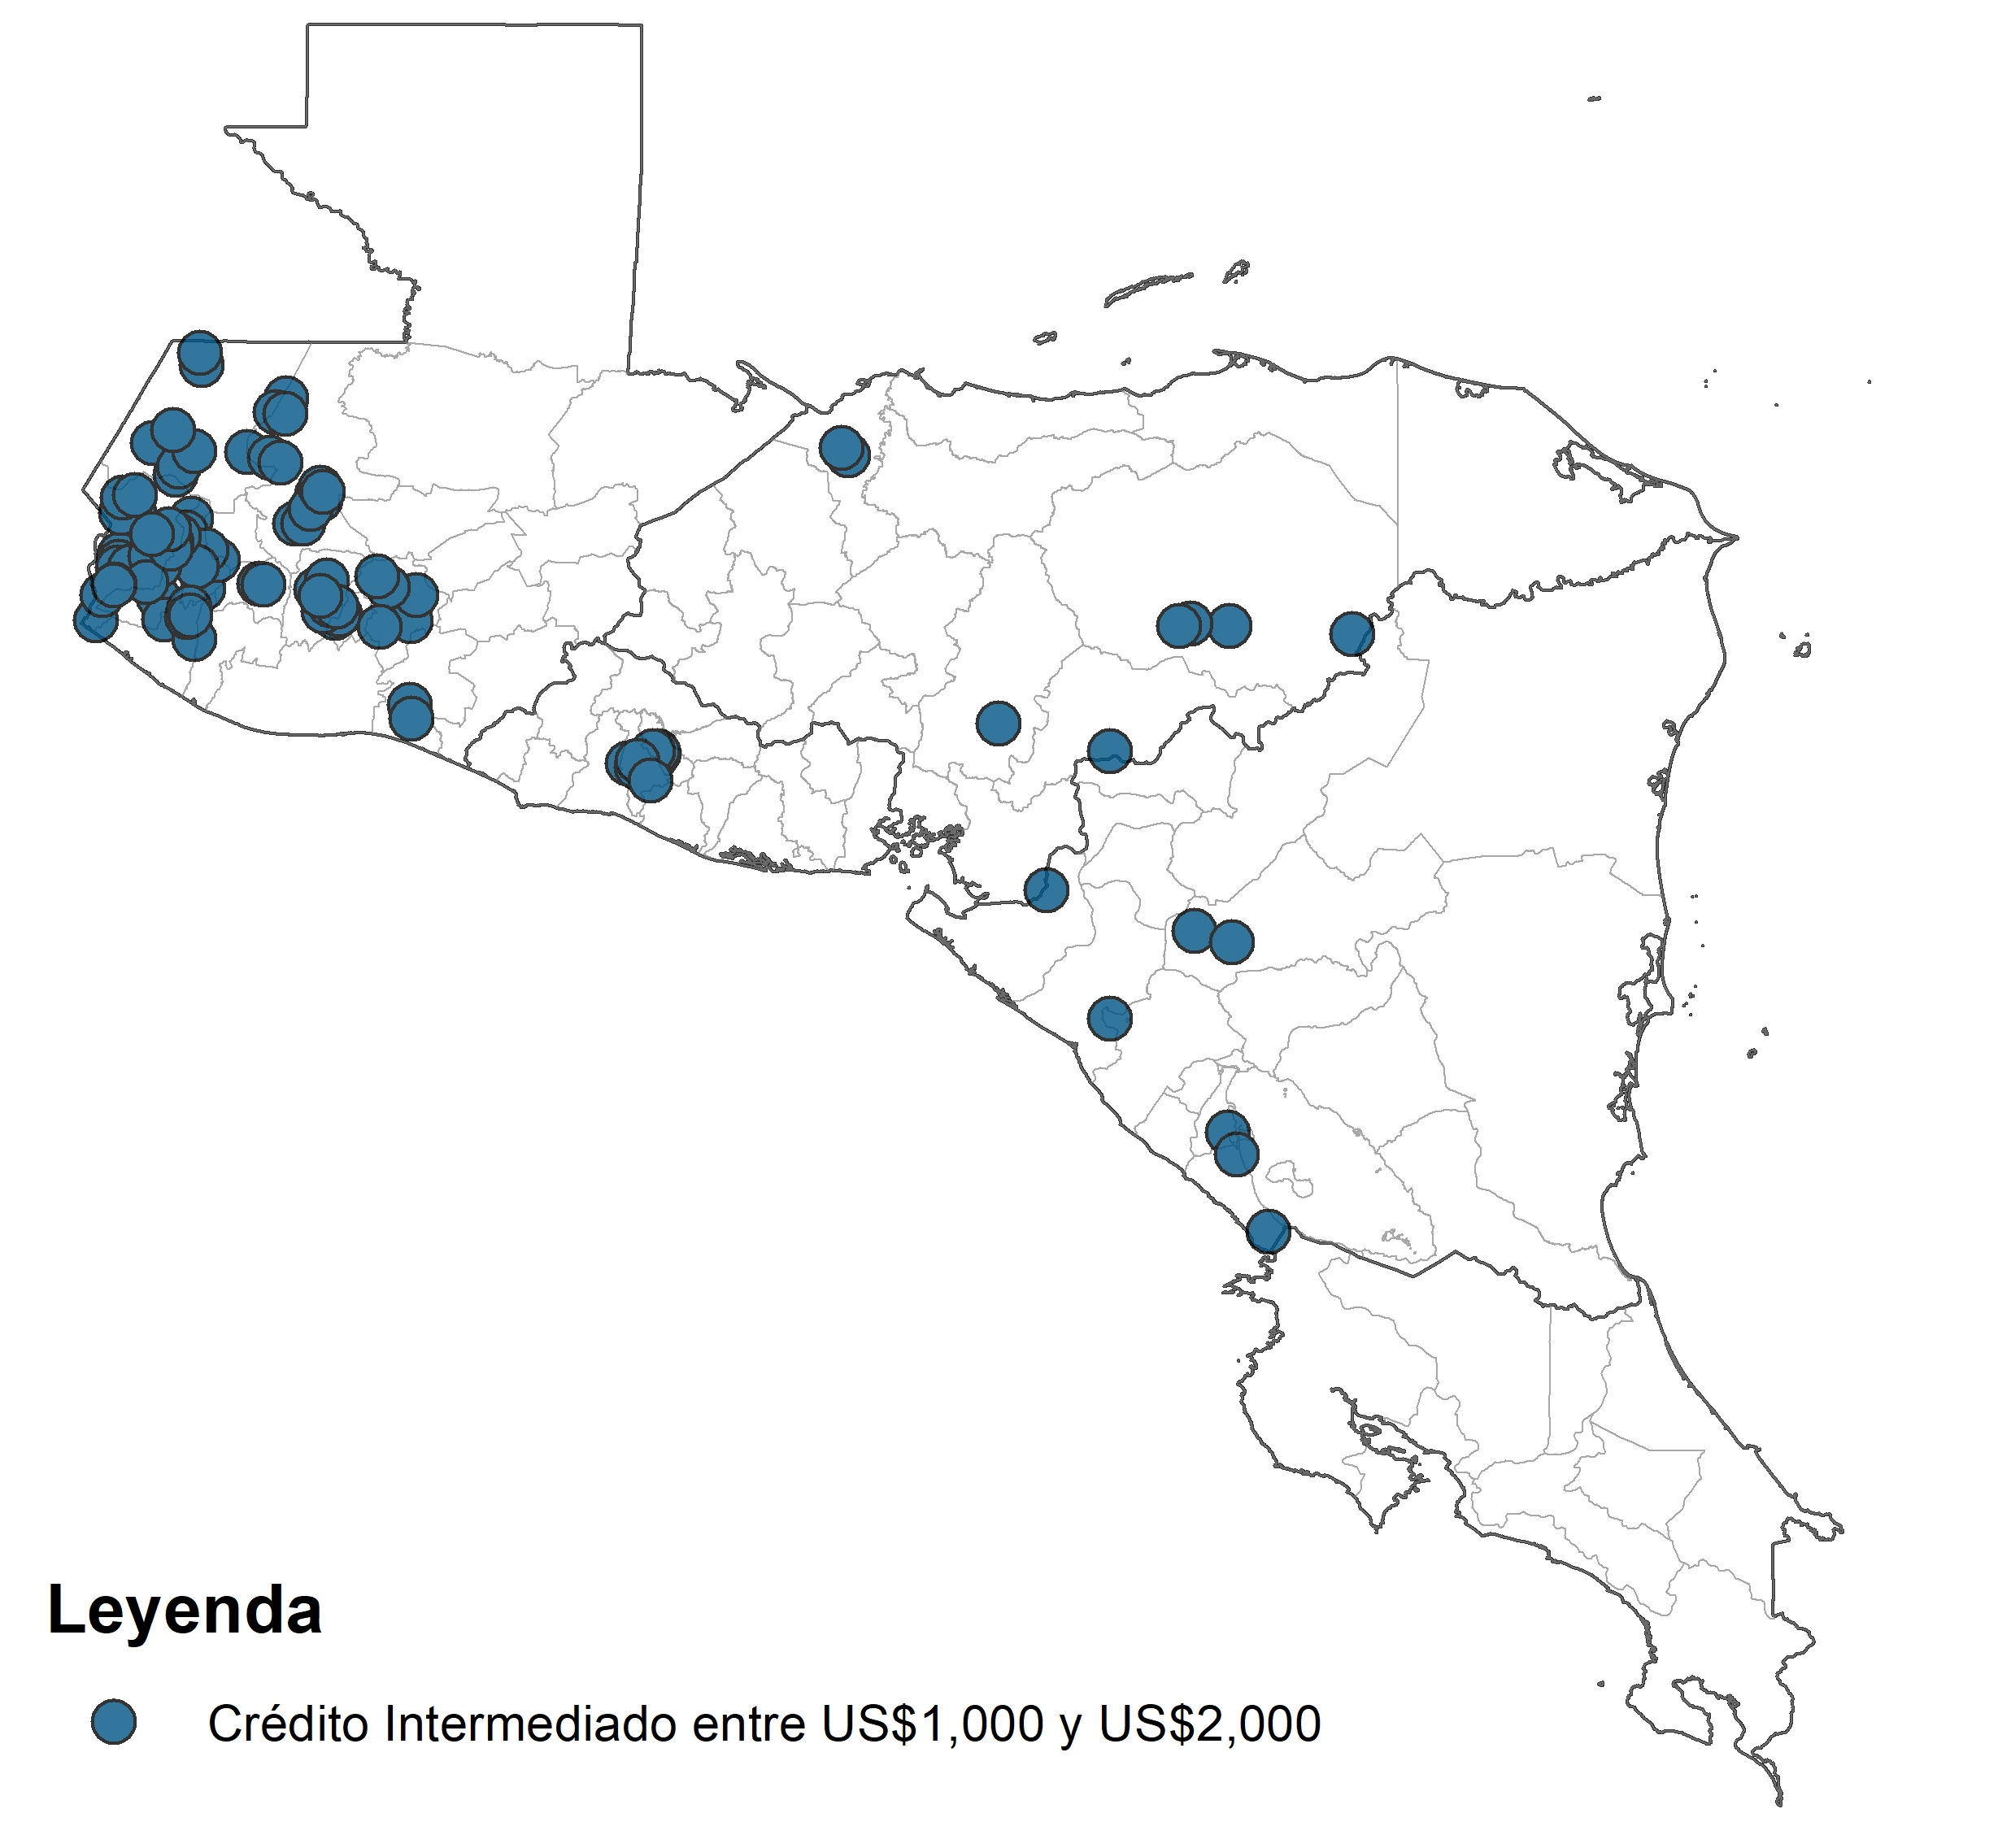
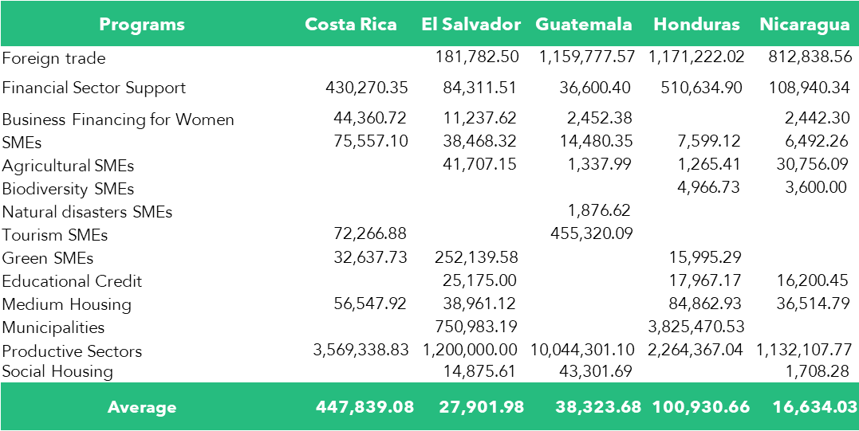
Means to an End
The regional evaluation of CABEI's intermediated credit: Costa Rica, El Salvador, Guatemala, Honduras and Nicaragua.
Disbursements
Less than $500.0
Between $500.0 and $1,000.0
Between $1,000.0 and $2,000.0
Between $2,000.0 and $5,000.0
Between $5,000.0 and $10,000.0
Greater than $10,000.0
Disbursements
Disbursements
Disbursements
Disbursements
Disbursements
Disbursements
Greater than $10,000.0
Between $1,000.0 and $2,000.0
Between $5,000.0 and $10,000.0
Between $2,000.0 and $5,000.0
Between $500.0 and $1,000.0
Less than $500.0
It’s important to look at the impacts and prospect green portfolios.

Slide 10
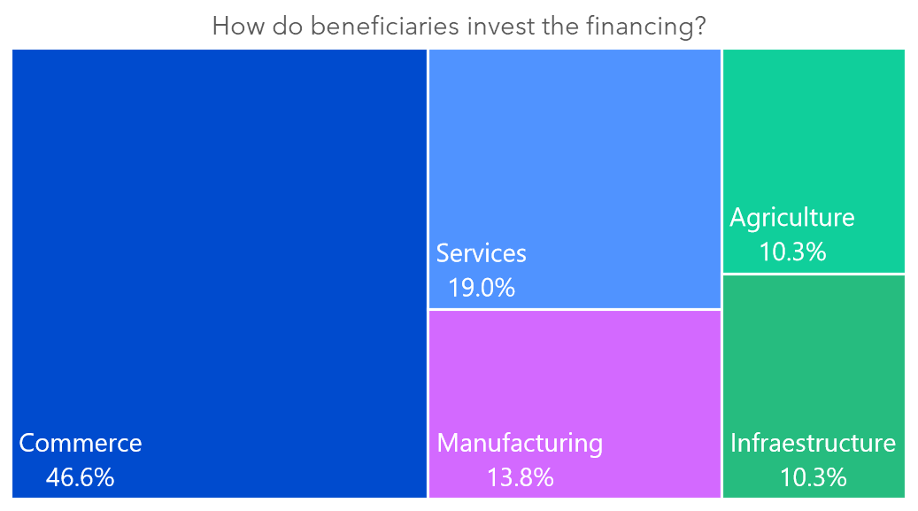
Means to an End
The regional evaluation of CABEI's intermediated credit: Costa Rica, El Salvador, Guatemala, Honduras and Nicaragua.
What is the impact of (P) on (Y)?
α= (Y | P=1)-(Y | P=0)
The results of the probabilistic econometric models report that if the credit is funded with lines approved by CABEI, the effect is positive and the probability that:
  Income increases Δ+9.7%
  Housing quality Δ+2.0%
  Diet (understood as household consumption) Δ+7.0%.
Likewise, the SMEs that received financing are willing to do the following:
Workplace improvements 69.7%
Home improvements 87.1%.
Recommend CABEI credit programs 93.1%
Acquire another financing 75.9%
Use it for working capital 75.0%

Slide 11
MDBs offers different financial instruments for the implementation of actions, for the public and private sector, in favor of the development of its member countries.
To recognize that the role as a second floor for the financial system brings a strategic opportunity due to the powerful replication effect on different economic activities.
Evaluation
Findings
All these transitions that are being identified must be brought to a level of maturity so that the FIs represent a channel to become a green financier in such important sector.

Slide 12
MDBs should work together to analyze the enabling conditions to attract the private sector to become environmentally and socially driven. To archive this, it´s important the understanding of the transitions, the vehicles to accomplish it and it´s scalability.
Recommendation
12

Slide 13
Let's continue moving forward in our transition to sustainability and becoming green financiers in our regions! 🌱
Independent Evaluation Office (ODEI)
Andrea Lupiac
José Deras
Luisa Noyola

