Slide 1
How advanced are MDBs on their path to becoming key green financiers: Evaluation perspective ECG 2024 Spring Meeting
Independent Evaluation Department (IEvD) of EBRD
12-13 March 2024

Slide 2
Table of Contents
1
Context - Are IFI Climate Finance Leaders on paper?
2
Evaluation lens: Resolving the mystery
3
IEvD approach to evaluate the EBRD green agenda
4
Key Evaluation findings for discussion

Slide 3
1
What does the climate solution touch on?
Climate change
Biodiversity loss
Natural Resource Crises
Air, water, soil quality and others
IPCC 2022: The rate of anthropogenic environmental damage is increasing across the planet faster than previously thought.

Slide 4
1
Are IFI Climate Finance Leaders on paper?
MDB’s climate finance commitments increased by 250 per cent between 2016 and 2022, from USD 25 billion to USD 62 billion.

Slide 5
1
Increasing share of commitments in operations
All MDBs reporting under the joint climate finance tracking methodology increased the share of climate commitments in operations approved/signed.

Slide 6
2
How has this been possible?
MDBs are slow-moving institutions:
Bureaucracy - complex decision-making processes
Rigorous safeguarding policies - much needed but cause delays
Technical requirements - lengthy planning processes
Politics - competing interests among member countries
Capacity constraints - human resources, expertise, and funding
How do slow-moving institutions manage to triple their climate finance commitments with a period of six years?
Why did COP27 call upon MDBs to define a new vision and commensurate operational model to adequately address climate change emergency?

Slide 7
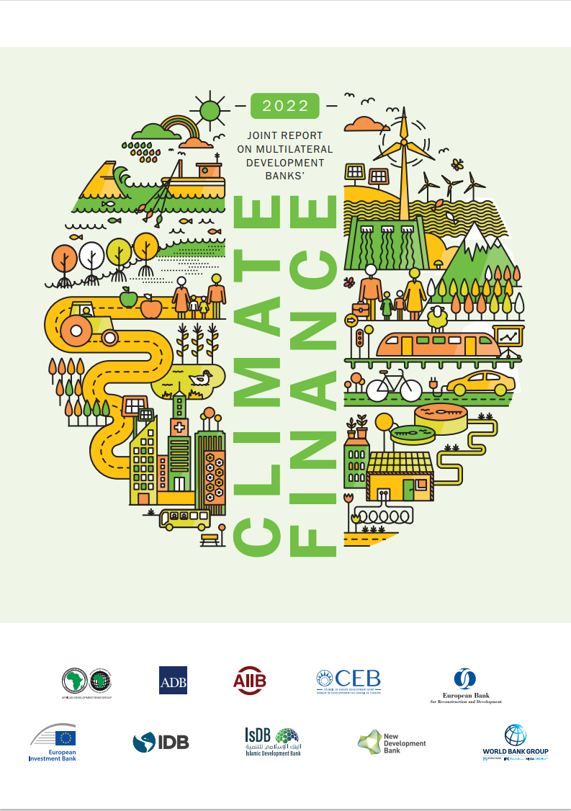
2
Evaluation lens: Resolving the mystery
Is there a gap between reality and reporting?
Is there a gap between reporting and how it is perceived?
Is commitment SMART enough to capture MDBs’ effort in climate finance?
“Data reported herein reflect financial commitments at the time of board approval or financial agreement signature and is therefore based on ex-ante estimations. All efforts have been made to prevent double counting. No revisions will be issued in cases where a project’s scope changes later to either increase or decrease climate financing.”
2022 Joint Report on Multilateral Development Banks’ Climate Finance

Slide 8
2
EBRD Context – A climate finance leader on paper?
Committed to:
promote environmentally sound and sustainable development in the full range of its activities
become a majority green bank by 2025
EBRD scrutinizes each project with respect to its:
Environmental and Social Policy | Climate risk methodology | Paris Alignment methodology | Green Economy Transition Approach | Green Transition Impact methodology
Aims compliance with environmental and social performance requirements | Is the basis of TCFD and ISSB reporting | Aims alignment of EBRD investments with the objectives of Paris Agreement | Is the basis of climate finance reporting for the corporate scorecard | Is the basis of ex-ante assessment of EBRD’s impact on green transition

Slide 9
3
IEVD approach to evaluate the EBRD “green agenda”
Wind Project Evaluation (2024)
Solar Power Operations (2022)
MREL (2024)
Evaluation of GET 2.1 (2025)
Decarbonisation of Built Environment (2024)
Sustainable Infrastructure Operations in ATC (2021)
Transport (2024)
EBRD
Priority
SCF Mid-term Evaluation: Green Deep Dive (2024)
Phase 2. Evaluability of Green TQ (2024)
Green Bonds (2024)
Agribusiness Strategy (2023)
Thematic / Corporate
Green Cities Programme Interim Evaluation (2023)
Phase 1. Evaluability of EBRD’s GET and MRV (2023)
Cluster / Programme
Evaluations delivered
Evaluations to be delivered in 2024
Evaluability

Slide 10
3
State of play – Evaluating EBRD’s green agenda
Evaluation Work Programme
Increasingly includes EBRD interventions that impact environment/climate with a focus on evaluability
But- like in the EBRD - these are in competition with other priorities; digitalisation, gender and economic inclusion and crisis response
Evaluation methodology
Organised around OECD DAC criteria
Attention to implementation of ESP, GET and Green Transition – and their evaluability
Environmental/climate impacts evaluated if these are stated objectives
Organisation learning and accountability
No environment/climate focus (or rating) in self-evaluation system
Mixed uptake of evaluation findings and evidence & continuous IEvD outreach
Usual tracking of management response to evaluation recommendations

Slide 11
4
Evaluation findings- the focus of the 2023 AER
Climate results have not been central to the decision-making process at EBRD
EBRD is the first MDB to introduce a consistent and systematic ex-post Monitoring, Reporting and Verification system (MRV)
However, the MRV comes with important issues:
It does NOT capture green “systemic change”
Coverage is patchy, notably amongst investments supported via intermediated finance.
Questions over capacity to ensure data quality > reporting
Organisational processes for storing and integrating data are nascent
Usage of ex-post green data, either internally or externally, is not clear.
Not yet clear whether the MRV can respond to all donor demands

Slide 12
4
Evaluation findings- the focus of the 2023 AER
The interim evaluation of EBRD Green cities programme found that Action plans suffered from limitations on monitoring.
The agribusiness strategy evaluation found that its Performance Monitoring Framework, including a range of climate related outputs and outcomes, was not helpful for guiding implementation.
The evaluation of Uzbekistan Country Strategy illustrated issues found in Country Strategy Delivery Reviews where results were output limited.
Repercussions in self-evaluation and then validations thereof.
But
The evaluability of EBRD’s green finance confirmed the efforts made to develop the MRV. It offers an opportunity to remedy these issues, though IEvD did point out that the devil is in the detail, and more work is needed particularly on how best to implement the system and use the data effectively.

Slide 13
ECG 2024 Spring Meeting

