Slide 1
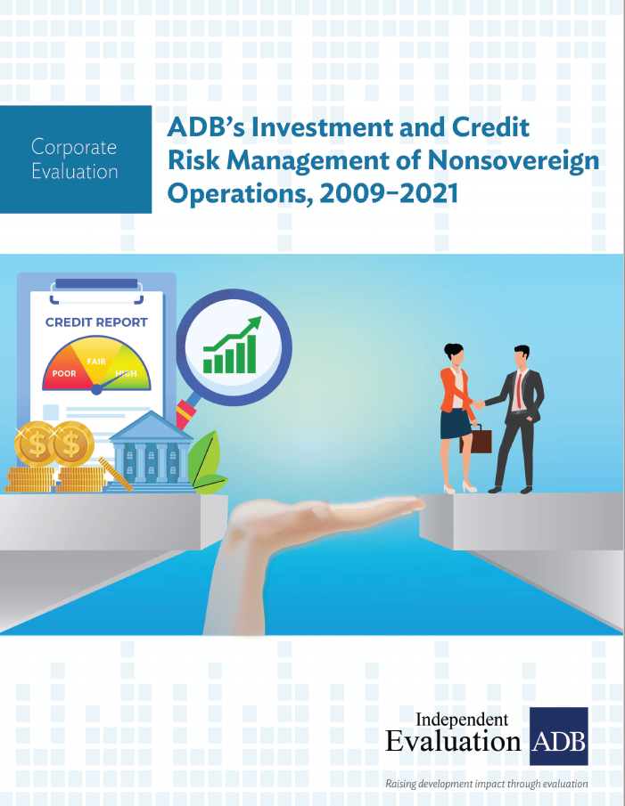
Corporate Evaluation – ADB’s Investment and Credit Risk Management of Nonsovereign Operations, 2009‒2021
ECG Spring Meeting
Theme 1: Evaluations of Private Sector Operations
12 March 2024, London

Slide 2
Motivation and Rationale
Identifying, managing and mitigating investment and credit risk has become much more important at ADB in recent years given the expected increase of its private sector operations in newer sectors and riskier markets.
Managing risk will enable ADB to meet its’ dual mandate of ensuring ADB’s profitability and commercial sustainability while pursuing development impact in its developing member countries.
Investment and credit risk management is even more relevant now given that ADB has increased its lending headroom.

Slide 3
Scope and Coverage
The evaluation focused on assessing the relevance and effectiveness of ADB’s investment and credit risk management of nonsovereign operations (NSO) only and how it has progressed.
It covered 290 committed projects between 2009-2021 across all sectors (infrastructure, financial institutions, agribusiness, and social sectors), and modalities (loan, equities, and guarantees).
It reviewed the evolution of credit risk over the evaluation period and incorporated the various changes over time (organizational, policies, processes, and systems).
It conducted over 100 stakeholder consultations (with staff and clients), three country missions, two staff surveys, and a comparison with MDB peers and commercial entities.

Slide 4
Key Findings
ADB’s key objectives for investment and credit risk management for NSO were largely achieved during the evaluation period. The AAA credit rating has been maintained. Non-performing loan (NPL) indicators are comparable to MDB peers.
The risks that ADB is willing to take in NSO can be better defined. Clear operational guidance is needed, especially when it comes to fulfilling ADB’s development mandate.
ADB does not sufficiently utilize key quantifiable indicators to better assess and align NSO risk and investment performance. There are indicators being tracked by other MDBs and commercial lenders that could be adopted.

Slide 5
Key Findings
Processing times have improved but are still long. Due to lack of data and appropriate tracking system, the evaluation was not able to identify the leading processing bottlenecks for delays.
Although agreement on market pricing among relevant ADB teams has improved, clear guidance for NSO transaction pricing is not available in a comprehensive document. Clarity on expected pricing for debt transactions is limited.
Improvements and mainstreaming of ADB’s Management Information & IT systems have been considerably delayed. Discussions have been underway for over 10 years. ADB has yet to implement a fully integrated end-to-end online risk management system.

Slide 6
Usefulness
IED provided the following six recommendations to Management to address each of the findings (all but one were accepted).
Clarify ADB’s willingness to take on more risks in NSO through the dissemination of differentiated risk guidance frameworks.
Introduce new and shared quantifiable key performance indicators to align incentives for its operations and risk teams.
Improve its processes and identify the key bottlenecks for transaction approval delay and deal mortality.
Set clear guidelines for operations teams for pricing nonsovereign transactions.
Update, agree upon and operationalize ADB cost recovery pricing model for NSO.
Fully implement and mainstream its management information and IT systems.

Slide 7
Thank you.
Independent Evaluation at ADB
Facebook
LinkedIn
Twitter
YouTube
Website
Email

