Slide 1
Counterfactual impact assessment – some lessons from the evaluations of EIB’s intermediated support to SMEs
ECG Spring Meeting 2024 - Theme 1: Evaluation of private sector operations / programmes with an impact lens
Notes:
NOTA: title slide background image replaceable according to topic:
Move aside the gradient picture
Delete/replace the underlying picture, and move back the gradient, which needs to be on top

Slide 2
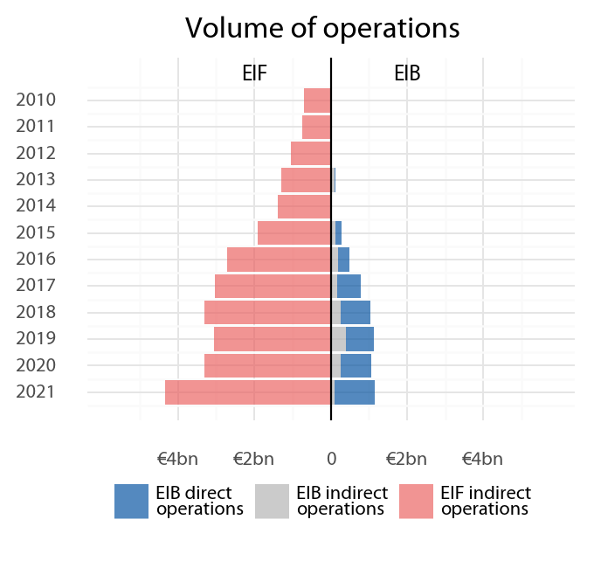
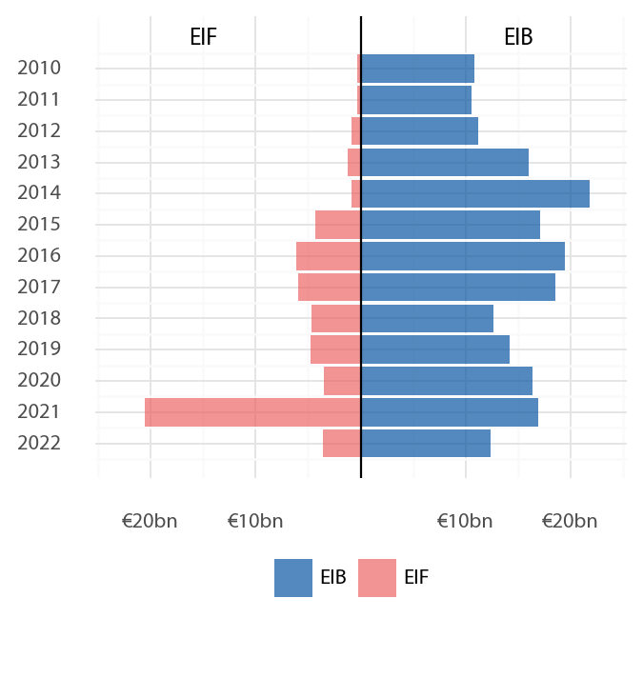
Two evaluations on the EIB Group’s SME and mid-cap support within the EU
ABS subscriptions
Direct loans to mid-caps
Direct venture debt
Private equity funds
Lending products
Venture capital
funds
Growth capital funds
Selective debt funds
Credit guarantees
Equity support
Targets chiefly innovative, young SMEs/mid-caps.
Intermediated through funds (except venture debt)
Group level (EIB & EIF)
Within the EU, from 2010
Signed volume: €33 billion
Debt support
Targets the entirety of SME (and mid-cap) population.
Intermediated via financial institutions (except direct loans)
Group level (EIB & EIF)
Within the EU, from 2010
Signed volume: €270 billion

Slide 3
How did we look at impact?
Existing EIB Group counterfactual studies
Earlier counterfactual analyses by EIF Research and Market Analysis, and EIB Econ.
Covered equity, venture debt, lending, guarantees.
Quasi-experimental (typically propensity score matching with diff-in-diff.)
Positive effects on employment, investment, turnover, survival etc., mixed results on returns.
Impact is heterogeneous across SME types, geographies, across the cycle and products.
A new counterfactual analysis for (indirect) equity
New analysis to complement EIF studies .
Similar methodology, but a different counterfactual compared to earlier studies.
EIF equity (VC/PE) support has similar impact to fully private equity investors.
Stronger impact for early-stage private equity (venture capital, growth capital).
The scale of peak impact on employment and investment
Other data sources
Survey of final beneficiaries (for equity operations).

Slide 4
What counterfactual?
It is often ambiguous what is the relevant counterfactual
For debt operations: no loan, a loan with different conditions etc.
For equity operations: no private equity, fully private equity.
The relevant counterfactual is not always clearly defined from the objectives/intervention logic.
We usually know very little about the control group
Control group typically selected from corporate datasets like Orbis, based on financial/corporate metrics
Did the firm in the control group have a viable project to financeat all?
Did the firm apply for a loan elsewhere?
Did the firm have loan applications rejected before?
Central credit registry information could be useful for a more thorough analysis of impact
Could help establish if beneficiaries were financially constrained.
Improves the selection of the right control group

Slide 5
Can no result be a good result?
Doing better, or doing more?
Private sector operations often address financing gaps, and the often to scale up the limited supply of private funding.
At the same time, agency problems associated with public support may result in such interventions less impactful than fully private financing.
Delivering the same impact as fully private funding is a good result.
Example: Evaluating the impact EIF interventions on the venture capital market
EIF is one of the major suppliers of venture capital (VC) funding in the EU – co-investing alongside private partners.
Existing counterfactual studies of EIF interventions used ‘no VC funding’ as counterfactual.
Our evaluation aimed at testing the suitability of the EIF intervention model in delivering impact, therefore we used an alternative counterfactual: ‘fully private VC funding’.
We found no significant difference between the economic impact (employment, innovation, investment) of EIF-funded VC and fully private VC.
This confirmed the suitability of the EIF model to mitigate the agency problems associated with public intervention on the venture capital market, and to be able to scale up VC funding without mitigating its impact.

Slide 6
Impact… so what?
Quantitative impact studies are useful to confirm the beneficial effects of an intervention, but often cannot shed light on how to fine tune them.
While counterfactual methods can confirm or reject the impact of an intervention, evaluations are generally expected to deliver constructive feedback.
Often data is not available at the necessary level of granularity to compare the impact of different product varieties.
In addition, the selection into treatment is not necessarily random when comparing the effects of two product types/varieties, which limits the causal interpretation of the results.
Complementary information are often necessary to provide insight into how to improve the programme.
Triangulation is necessary.
In particular, survey of final beneficiaries have been useful in assessing the impact – yet the causality question also arise for them, too.

Slide 7
Thank you for your attention
a.gereben@eib.org
https://www.eib.org/en/about/accountability/evaluation/index.htm

