Slide 1
Evaluation of AfDB Private Sector Interventions with an Impact Lens: IDEV’s Methodological Approaches, Key Findings, Challenges and Lessons
Rufael Fassil
ECG, 12 March. 2024

Slide 2
Outline
Findings Challenges & Lessons
Background
IDEV’s Approach
Issues for Discussion

Slide 3
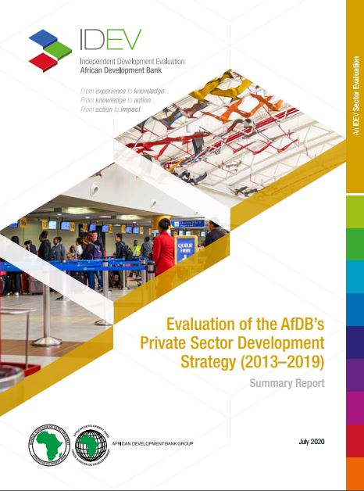
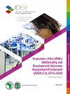
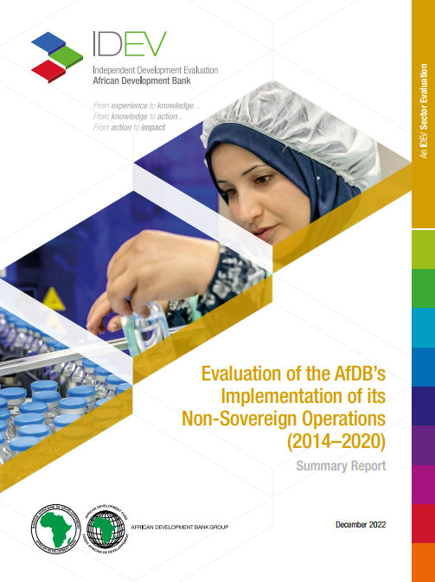
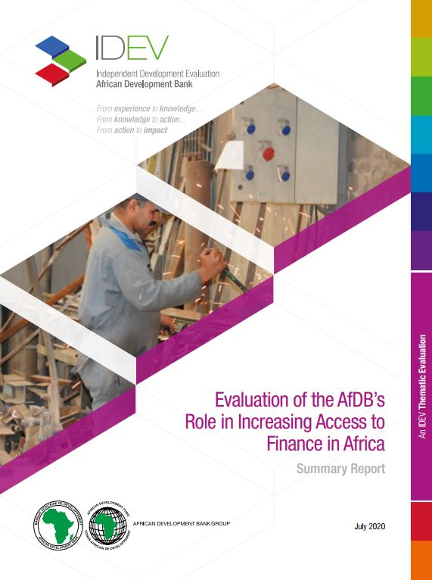
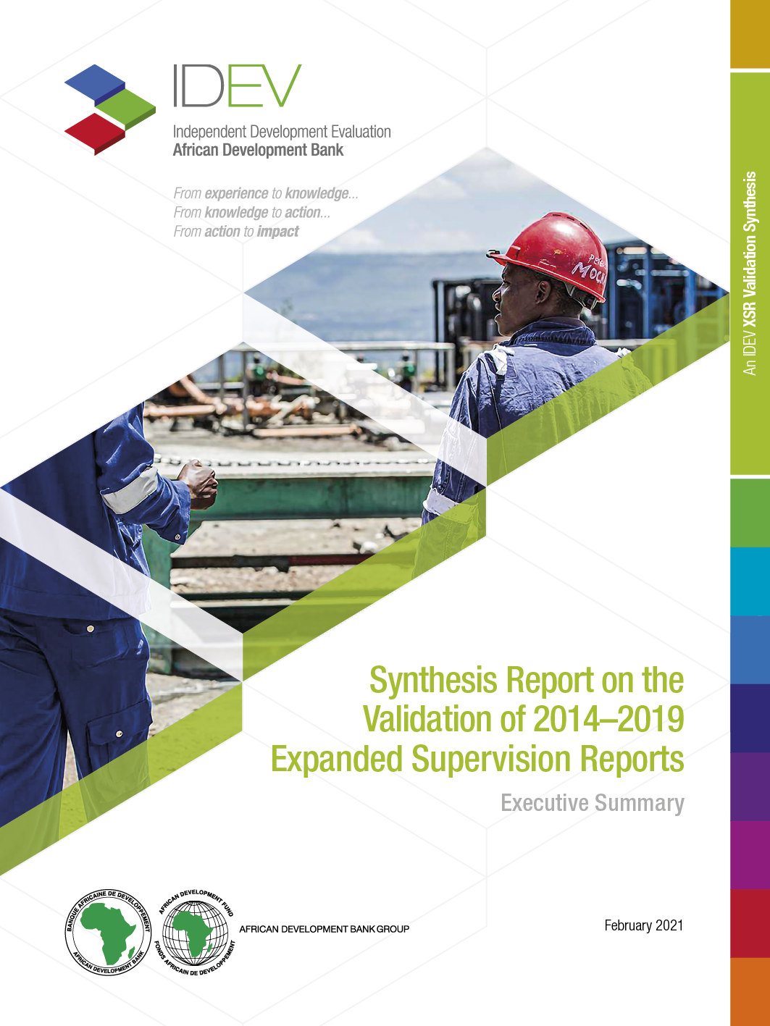
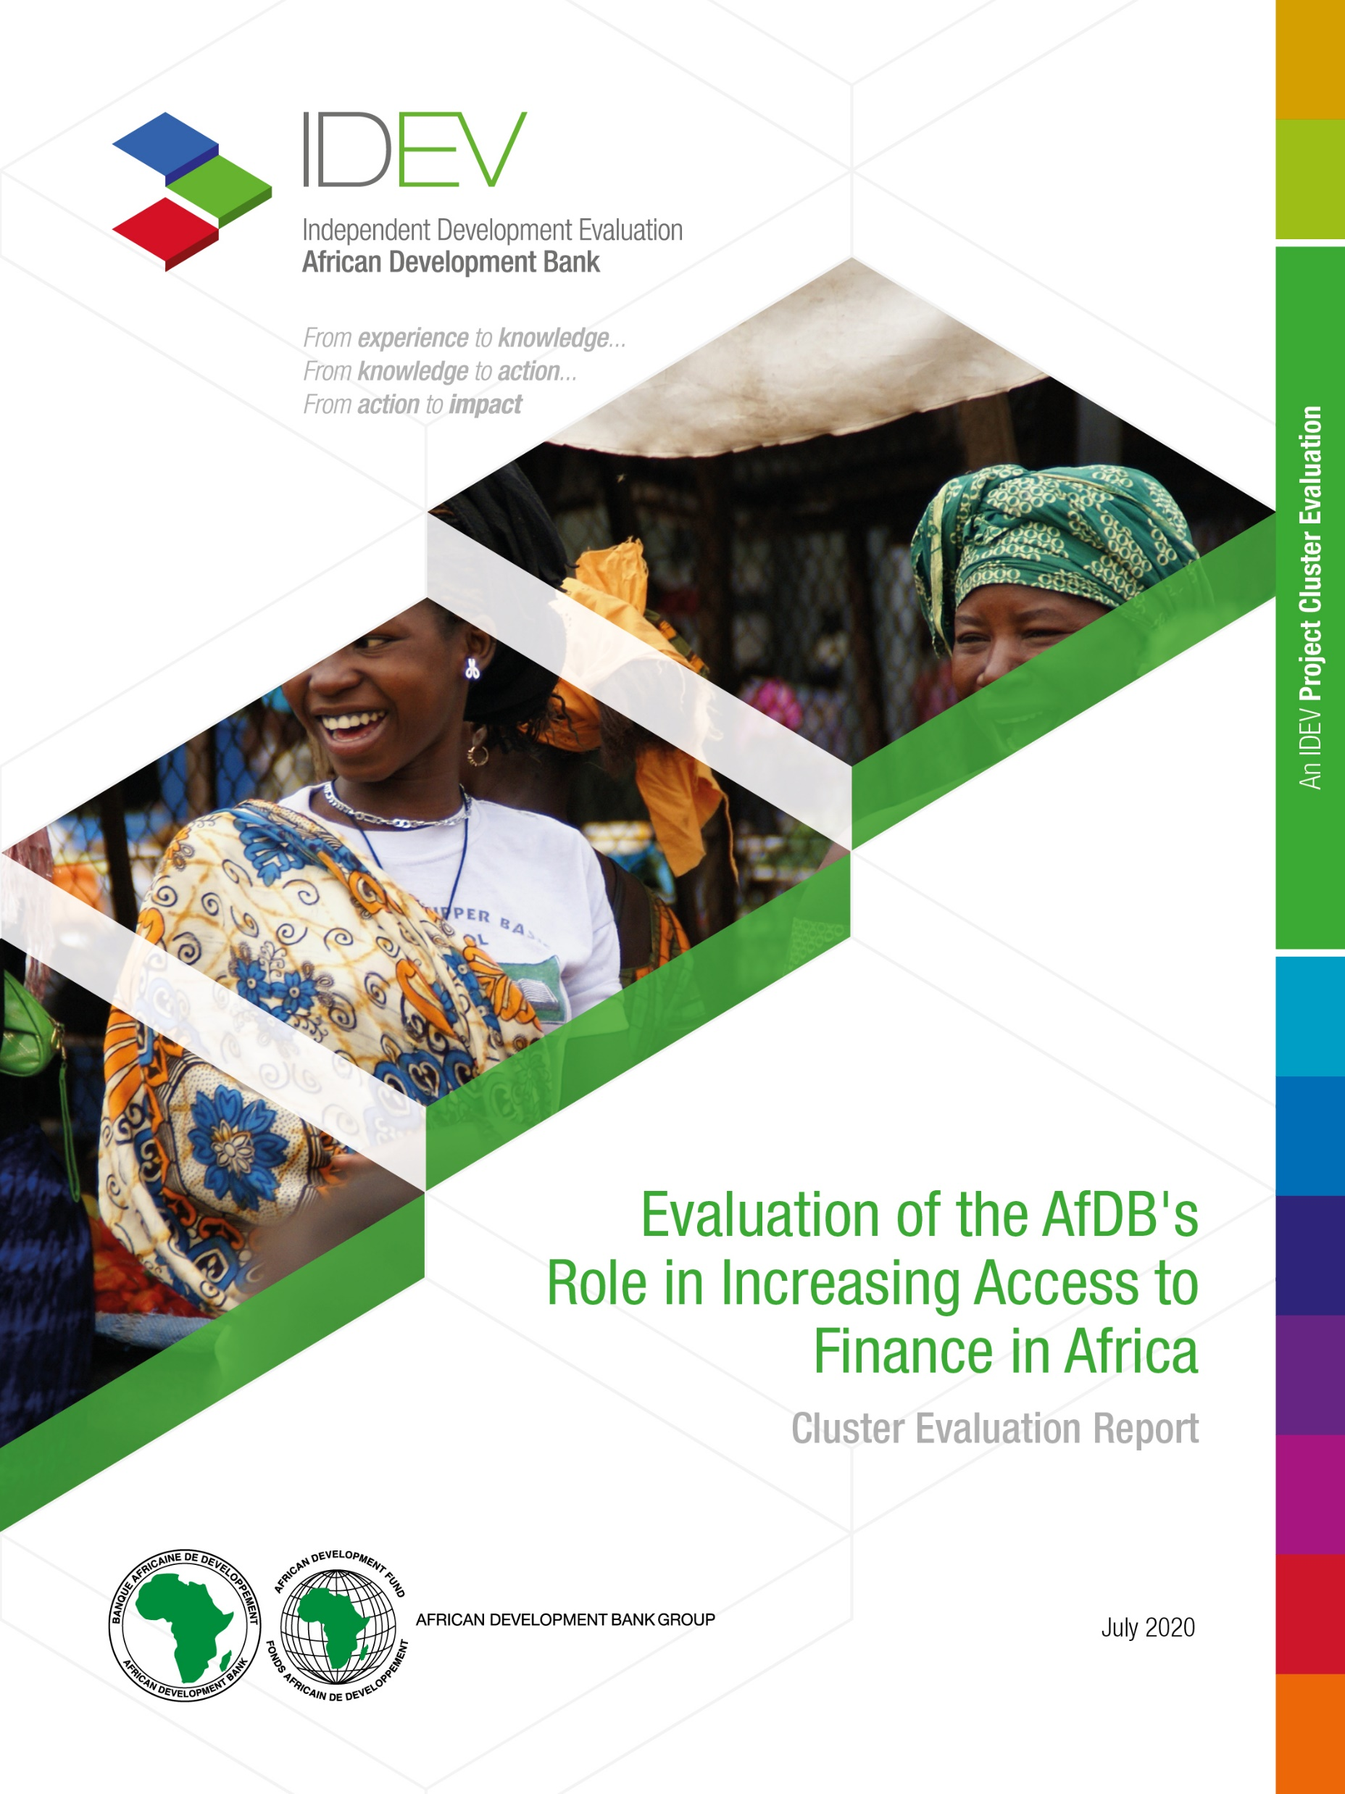
Major private sector related evaluations completed
2020
2021
2022
Evaluation of the AfDB’s Private Sector Development Strategy (2013-2019)
Evaluation of the AfDB’s Ex-Ante Additionality and Development Outcomes Assessment Framework 2.0
Evaluation of the AfDB’s Implementation of its Non-Sovereign Operations (2014-2020)
Evaluation of the AfDB’s Role in Increasing Access to Finance in Africa - Thematic Evaluation
Synthesis Report on the Validation of 2014-2019 Expanded Supervision Reports
Evaluation of the AfDB's support to its Regional Member Countries in Response to the COVID-19 Pandemic
Evaluation of the AfDB’s Role in Increasing Access to Finance in Africa - Project Cluster Evaluation

Slide 4
Private Sector Interventions in the AfDB
AfDB’s private sector financing operations started in 1990’s with direct investments in support of private entrepreneurs and private equity.
The Bank continues to be a key player in developing private equity investment as an asset class in Africa. The committed portfolio of equity investments has grown steadily from $71 million in 1997 to $2 billion at the end of 2020.
The main PSD challenges in Africa: (1) weak investment climate (policy, law, regulation and institutional); (2) deficiency in economic infrastructure, particularly energy, transport and ICT; (3) limited financial intermediation and access; (4) mismatch between workforce skills and business needs; and (5) weak corporate governance –corruption risk
AfDB identified PSD as one of the five Bank’s operational priorities (High 5 on Industrialization). Under this priority, the Bank focuses on four key areas, namely:
Advisory services and institutional support to improve the business environment, and to strengthen the quality and effectiveness of public administrative services to enterprises;
Investments in infrastructure and skills development;
Support for value-chain links and clusters, particularly in agribusiness and extractive industries; and
Support to private enterprises through investments and institutional support
AfDB signed 469 PS operations totaling $16 billion between Jan. 2013 - Dec. 2019, but the share of the private sector remained below 30 percent of the Bank’s total financing. In 2020 there were no NSOs due to reallocation of funding to COVID-19 response.
Partnership
Notes:
As of year end 2021, NSO accounts for 24 percentage of total operations (commitments).

Slide 5
Private Sector interventions in the AfDB
The AfDB’s PSD space: AfDB Finance private sector and eligible public sector companies, financial institutions, and projects in strategic sectors:
Interventions through the Public Sector (sovereign operations window) to influence the Private Sector
Direct interventions in partnership with the private sector (non sovereign operations window)
Blend interventions
Partnership
Notes:
window aims to implement the Bank’s vision for private sector development by improving the business environment, developing quality socio-economic infrastructure and supporting private companies, particularly for implementing transformative projects and those with a strong positive impact on youth and women

Slide 6
Methodological Approach
Approach
Key Evaluation Questions
Methodology
The methodological approach of PS interventions assessment depends on the evaluation questions and objectives of the evaluation with respect to, either to support the implementation of reforms, or to contribute to the acquisition of goods and services, although the difference between the two is not significant.
To what extent is the Bank appropriately programming, designing and managing its PS interventions to maximize development impact?
What is the evidence regarding private sector interventions performance, particularly for the Bank in the priority areas of operations?
Looking forward, how can the Bank enhance the effectiveness of PS interventions, including helping it to achieve the High 5s?
Evaluations tend to be guided by:
The Bank’s Independent Evaluation Policy,
The international evaluation criteria,
The Evaluation Cooperation Group Good Practice Standards for Private Sector (ECG 2011) Operations.
Evaluations are theory-based and use mixed methods (quantitative and qualitative).
Evaluations are often informed by six main lines of evidence:
Desk review (including XSRENs),
Stakeholder interviews,
Online surveys,
Country Case Studies,
Benchmarking with comparator institutions, and,
Contribution Analysis

Slide 7
Findings
Interventions are relevant but there is scope for improving relevance of its design
D
D
D
Delivery of outputs has not always resulted in improved outcomes/impacts
Mixed results on effectiveness but particular challenges in reaching SMEs
The quality of the results chain: logic and clarity; adequacy of activities; relatively high ambition of country programs; SO-NSO linkage; instrument mix
The Bank did not fully understand the balance of sectors and instruments that would best support the needs of target groups of private sector beneficiaries (e.g., SMEs).
Lack of clarity in delivery responsibilities and institutional arrangements
D
D
D
Measuring impact is challenging
Organizational changes within the Bank impacted program delivery and results
Difficult to measure for half of the NSO portfolio which is provided through financial intermediaries due to insufficient information regarding the impact on the private sector (e.g. issues in segmentation and targeting, and lack of gender-relevant development outcome indicators)
PSD operations generally and NSOs in particular resulted in challenges in the smooth implementation of the PSD Strategy
DBDM- there was lack of clarity regarding PSD which caused confusion and encouraged competition between Bank entities for scarce resources and decision-making authority

Slide 8
Challenges
D
D
D
Data Availability and Quality
Methodological Challenges
Attribution
Reliable data on impact is crucial for impact assessment, but in many RMCs, data can be scarce, outdated, or of poor quality (e.g. lack of gender-relevant development outcome indicators beyond sex-disaggregated data).
Developing robust methodologies that can accurately capture the multifaceted nature of development impacts remains a challenge
Determining the direct effects of interventions amidst numerous external factors can be complex
D
D
D
D
Incorporating distributional
effects
Long-Term Impact Measurement
From internal to external validity
─ lessons
Diverse Contexts
Some impacts, particularly in sectors like infrastructure, may take years to materialize and be difficult to measure in the short term
RMCs’ economic, political, and social environments are highly diverse, which can make it difficult to apply a one-size-fits-all approach to capture the development impact
Notes:
Data availability and quality. Beyond a robust results framework & M&E system that is focused on outcomes integral part of the life cycle of PSD interventions, the monitoring capacity of countries/clients & the availability of timely and reliable data are of paramount importance to ensure interventions’ responsiveness to needs and demonstrating its anticipated impact on poverty reduction & sustainable growth

Slide 9
Lessons
Collaboration & Multi-level support
Ex-ante scrutiny & learning from ex-post
D
Integration of Operations
The effectiveness of medium to long-term structural reforms requires adequate collaboration among DPs, multi-level and sustained support (e.g., financial support with active engagement in policy dialogue and provision of relevant complementary technical support). Also, ensure additionality and complementarity.
Impact of operations is influenced by learning from ex-post, due diligence and quality of the design including the logic of the intervention and by complementary inputs such as analytical work, policy dialogue and TA.
Strengthening the linkages between sovereign and non-sovereign operations can enhance the overall impact of the Bank’s interventions
D
D
D
Ensuring an adequate trade-off between financial viability and development outcomes
Focusing more on the “development” part of development outcomes
Innovative risk mitigation instruments
Expanding the deployment of innovative risk mitigation instruments to attract more private sector investment is crucial for scale and impact
Expand the deployment of innovative risk mitigation instruments to attract more private sector investment for scale and impact
Giving greater attention to projects’ distributional effects, and the extent to which the transaction serves under-served segments of the market (e.g. SMEs) is key to maximize dev. impact.
Notes:
Beyond a robust results framework, the monitoring capacity of countries and the availability of timely and reliable data are of paramount importance to ensure interventions’ responsiveness to country needs and their effective delivery and reporting

Slide 10
Some Issues for Discussion
How to deepen and enhance methodological approaches of Impact-oriented evaluation of private sector interventions within the ECG network? Whether the ECG’s GPS for Private sector operations (2011) is still fit for purpose/relevant in responding to current and future evidence demand?
How to better understand the public-private interface for maximizing development impact ?

Slide 11
Thank you
Keep in touch with us
Address
IDEV
AfDB, CCIA Building
Abidjan, Cote d’Ivoire
Contact Info
Email: idevhelpdesk@afdb.org
Telephone
Office Phone: +225 27 2026 2841
Website
https://idev.afdb.org/
Twitter
@evaluationafdb

