Slide 1

ECG Meeting
January 14-15, 2016
Meeting Report

Slide 2
Session Overview
In its June 2015 meeting, the ECG began a formal conversation on developing its vision. In its January 2016 meeting, the group advanced that dialogue and moved closer to solidifying its vision.
Context
The ECG had struggled for a number of years in its efforts to define a vision. Several reasons accounted for that, five of which will are noted below.
The group experienced vision drift. Vision Drift is the phenomenon that occurs when an organization fulfills, in reality or perceptually, an earlier mandate that defined its vision, but fails to find a new energizing purpose to drive a new vision. At its conception, the ECG had a clear mandate. It was to create ways in which the work of its members could be harmonized so as to meet the needs and expectations of donors. In its first decade, the group fulfilled, at least to some extent, that vision. However, it did not successfully define a new vision to replace the old and has consequently drifted for a number of years into various activities designed to meet immediate needs, but which were not driven by a unifying vision or purpose.
There was disagreement among the members as to the group’s fundamental and primary orientation. Some members wanted the group to maintain an internal orientation focused on meeting the needs of its members. Others wanted the group to have an external orientation and to become a platform for speaking directly to a wider audience on various issues of global importance. This tension eventually created an impasse that prevented the group from successfully reaching an agreement on a desired future.
The ECG did not have a clear shared perspective of the larger ecosystem of which it was a part or of its place in that system. Without that understanding, it was difficult for the group to create a vision that was neither too broad nor too narrow, but was appropriate to its unique space in the larger system.
Akin to the third matter, confusion existed from mingling the role of the ECG, the roles individual members in their parent institutions, and the role of the parent institutions themselves. This confusion made it difficult to craft a vision that was unique and distinct to the ECG.
In the case of ECG, the situation was made more challenging because of the high value placed upon the professional and personal relationships among the members. That high respect and value of one another became a case where strength becomes weakness. Because they did not want to run the risk of isolating or alienating fellow members, the group fell into the practice of acknowledging differences, but never successfully getting past them in order to create a shared vision.

Slide 3
ECG Meeting
January 14-15, 2016
Perhaps the most significant barrier to creating a vision was the tension over whether the organization should be used as a platform to directly achieve a higher impact externally in the world of evaluation and development or whether it should focus exclusively on serving the needs of its members. The two perspectives are reflected in the graphic below:
Internal Orientation
The ECG
Internal Impact: Focus on meeting the needs of its members
External Orientation
Internal Impact: Focus on meeting the needs of its members
The ECG
External Focus: Focus on creating direct external impact
Summary
Through the facilitation that occurred in the January meeting, the group came to understand:
The ecosystem of which ECG was a part and to recognize the group’s place in it.
That the vision for the ECG was distinct from the vision of its individual members.
The group’s capacities, its limitations and constraints (time, personnel, resources, varying size of members and parent institutions and differing roles and constraints in those parent institutions, etc.) and the types of good it can achieve.

Slide 4
ECG Meeting
January 14-15, 2016
With those understandings in place, the group:
Clarified the ECG’s primary purposes: to satisfy its donors and serve its members.
Crafted a new orientation, a “third” way that moved the group beyond the impasse of the past and carved out a new vision for the ECG. After robust conversations, the group reached consensus that its primary orientation will be internal, i.e., focused on meeting the needs of its members. However, the group also desired to be a voice of influence in the larger world of evaluation and development. That influence, however, would be evaluation driven, not politically or issue driven. The question was how to best achieve that.
Through the dialogue, the group concluded that the most powerful way for the ECG to have a significant external impact was indirectly through its individual members, not directly as a separate entity. The group recognized that because of its constraints and its place in the ecosystem, the ECG cannot serve effectively as a platform for directly addressing political or global issues. The reality is that no one is asking for that from the ECG and the status and nature of the group render it incapable of playing that role in any meaningful way. In addition, efforts to generate such direct impacts will dilute the group’s ability to meet the needs of its members.
Out of the conversation, a “third” way for the group to move forward emerged. The ECG will maintain an internal focus on identifying and meeting the needs of its members. As it more effectively supports and strengthens its members, those members will become stronger voices and influences in the world of evaluation and development. The external impact (becoming a voice of influence in the world of evaluation and development) will be achieved indirectly by the ECG through its service to its members. The ECG will identify issues that are relevant to its members and collaborate in generating solutions and materials regarding those issues. All research conducted or papers and products generated will be in the pursuit of meeting member needs with the intent of increasing their effectiveness and influence. Any products, papers, or research produced in that vein can be shared with external audiences if the ECG wishes to do so. The ECG as a group will not function as a platform to generate products, papers, or research on issues extraneous to issues directly relevant to member needs. Individual members are free to pursue that course in their own institutions.

Slide 5
ECG Meeting
January 14-15, 2016
The following graphic illustrates how the ECG will be a voice of influence in the world of evaluation and development through its service to its members:
External Impact through Internal Service
ECG
Improved Service
Members Increased Impact
External World of Evaluation and Development
Products generated in service to members
Identified the initial priorities for the group. In light of the new found clarity of vision, the members then brainstormed a list of what they needed from the ECG. Following are the top five items:
Strengthening methodologies and sharing
Sharing thematic expertise
Management response – recommendations for follow-up
Self/Independent evaluations
Involve staff in learning exercises
Defined the initial steps to move toward the realization of those priorities in service of the new vision. The group:
  Reconfigured the governance model to insure greater continuity and cohesiveness.
  Created a task team model to work on the group’s chosen priorities. Task teams will take ownership of the various priorities. After each task team has completed its work, it will be disbanded. New task teams will be chartered for future tasks. There will be no standing committees or task teams.

Slide 6
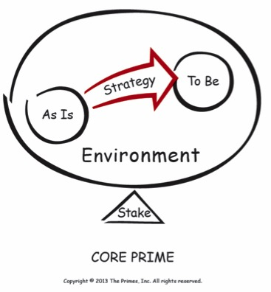
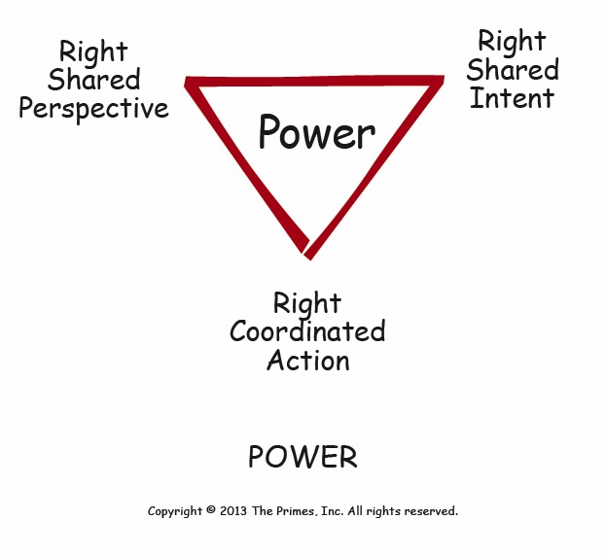
Session Report
The group began the session by reviewing and discussing the content from the last meeting in June. This content included:
Things we want to keep:
  Leverage credibility inside our own institutions
  Push frontiers on evaluation methods
  Provide dissemination activities, platforms, and outreach
  Share knowledge on all things evaluation
Things we want:
  Peer support
  Knowledge sharing
  Setting standards
Convergence:
  Leadership
  Learning
  Partnership
  Standards and evaluation practice
Requires more discussion:
  External focus
  Role in development
The Clearing team also outfitted the group with two frameworks: the CORE PRIME and POWER PRIME.

Slide 7
What makes creating vision hard?
Creating a vision is one of the most challenging tasks leaders take on. The Clearing outfitted the group with four characteristics that make visioning difficult:
Unanchored vision – Organization develops a vision that is not tied to their reason for existing
Drifting – Organization has lost its identity and is looking for a new one
Internal/External Extremes (Ecosystem) – Organization’s vision is either too narrow or too broad
Purpose/Interest Confusion – Driven by purpose; explore interests
The group then brainstormed and shared what makes creating vision hard for ECG in particular. Ideas included:
Incentives – goes over and above what we’re required to do on a daily basis AND Incentives – when we come here, we individually take away a lot of things we share across the board. At some level we’re satisfied with how we spend our time here. But we don’t have the incentives to push the boundaries. Until and unless we push ourselves to the next level – there’s no one at our headquarters who is pushing for this – nobody’s asking for this or asking what they get out of it
ECG profile is different in different orgs – each of us has a different profile in each of our orgs
Starting points differ – each of us is at a different place in our own institutional evolution
Scope of influence differs in different orgs – each of us has different resources, scope, in our organizations
Lack of agreement on objectives within ECG
Authorizing environment – we are self-created and self elected. AND Understanding of the relevance of ECG – a long time ago, there was clear relevance: joint share holders wanted to have one common framework for results measurement. Has gone away now

Slide 8
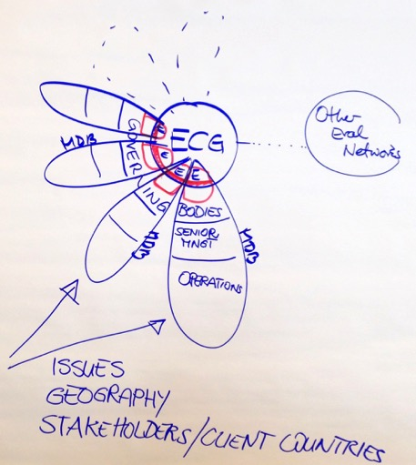
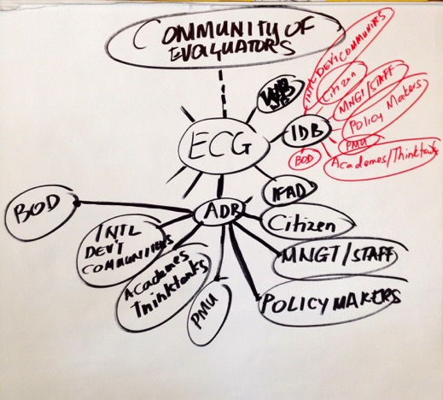
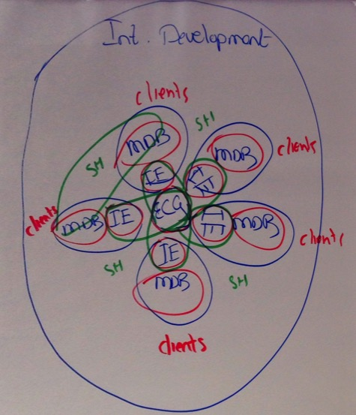
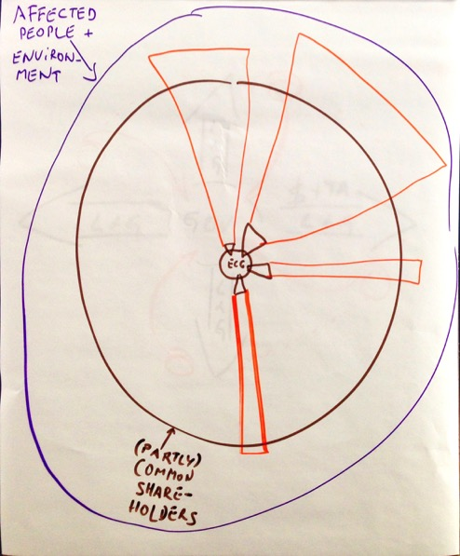
Laying the Foundation for Vision: Defining the ECG Ecosystem
Once the group understood that visioning is a challenging task, they then began to lay the foundation for the visioning conversation. The first step was to define the context and ecosystem in which ECG exists. After the groups presented their drawings, they concluded that they all see ECG’s ecosystem in fundamentally the same way.

Slide 9
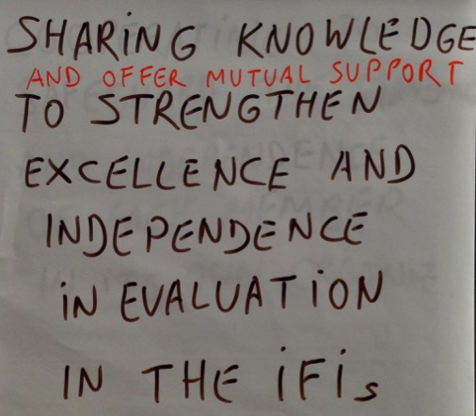
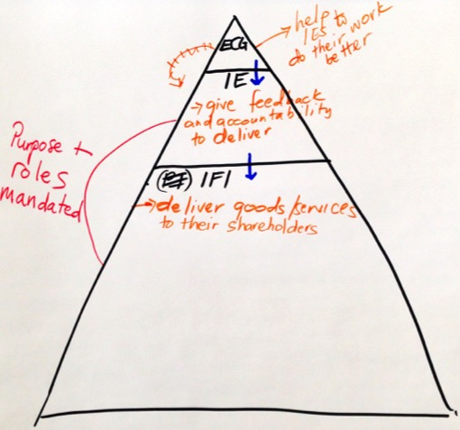
Roles within the Ecosystem
The group then answered the question, “What are the distinct roles within the ecosystem? Who owes what to whom?” Answers included:
ECG is accountable to each of its members – not to any external entity – each one of us is participating because we find something useful.
We are accountable to our institutions for high quality evaluations.
The institutions owe evaluation units sufficient resources and a learning attitude that they do something with our input to them
Role of ECG is to share experience, share best practices is the role
One group developed a vision statement (above, left): Sharing knowledge to strengthen excellence and independence in evaluation in IFIs.
  Cooperating to safeguard the standing and independence of each member in its own organization
One group drew the pyramid (above, right) to show the flow of information from ECG to the independent evaluation units (IE) to the international financial institutions (IFI)
The ECG exists to serve the independent evaluation units, not the other way around.
The group agreed that ECG’s core responsibility is to serve its members through networking, knowledge sharing, peer support, etc. In remaining responsive to members’ needs, the ECG will be able to positively impact other stakeholders in the IFIs and the evaluation community.

Slide 10
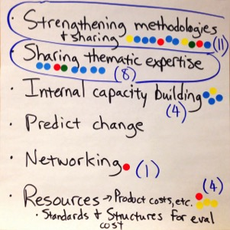
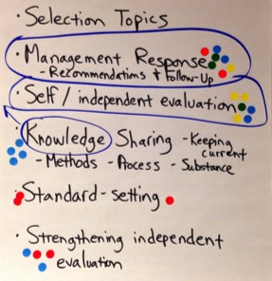
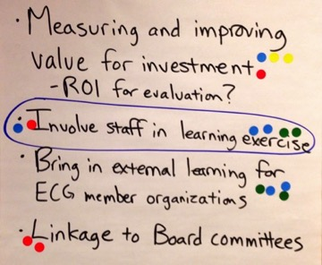
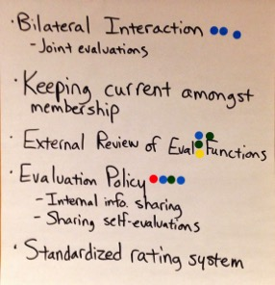
Identifying Points of Alignment
Once the group agreed the ECG exists to support its members, they identified what would be most helpful for each of them as members to gain from the ECG. They brainstormed a list and narrowed it to five topics:
Strengthening methodologies and sharing
Sharing thematic expertise
Management response – recommendations for follow-up
Self/Independent evaluations
Involve staff in learning exercises

Slide 11
Approach, Results, Courses of Action
Based on their areas of alignment for priorities for ECG, the group worked to design the approach, desired results, and course of action for each of these areas. The ECG Directors Group decided to take on the “Management response” topic. The participants broke into four groups to discuss approach, results, courses of action, and owner for the other four areas:
Strengthening Methodologies and Sharing
Sharing Thematic Expertise
Self/Independent Evaluations
Involve Staff in Learning Exercises
Strengthening Methodologies and Sharing
Approach
  Consider focusing on gender (or climate change) subject matter area rather than country programs (country program evaluation has been done in the past)
  Review work that has already been done methodologically and, of those methodologies, what is and isn’t being used and why
  Develop good practice standards (GPS) or methodological pieces based on direction and input from ECG members
  Link GPS to an event that engages staff
Result – GPS or methodological pieces for identified subject matter area
Course of Action
  Create a task force with defined timeline and output
  Prepare first output for June ECG meeting
  Complete stock taking and GPS by the end of the year
Owner – Rakesh Nangia, AfDB
Strengthening Thematic Expertise
Approach
  Conduct stocktaking to identify commonalities and expertise
  Ensure information shared is useful and aligns with ECG priorities – allow room for on demand expertise sharing
  Develop forms of exchange: thematic papers (e.g. micro-finance) to synthesize lessons, on-demand experience sharing, expert exchange
Result
  References of each other’s work can be one measurement
  “Cross support” between departments
Course of Action
  Assess pipeline/work landscape to identify the common areas ECG members evaluate
  Identify who has worked on the area and use him/her as the point of contact
  Work with Strengthening Methodologies and Sharing task force
Owner – Hans Lundgren, EvalNET

Slide 12
Approach, Results, Courses of Action
Self/Independent Evaluation
Approach – Focus on self evaluation in institutions, focusing on quality, use, and impact of self evaluation system
Result
  Better understanding of issues in our institutions
  Better understanding actions in progress to improve self evaluation
  Minimum standards of self evaluation, from detailed to high level
  Clear definition of the role independent evaluation units should play (harmonizing, aligning, etc.)
  Course of Action
Conduct a stocktaking exercise – What are the main features of the self evaluation systems as they exist? From that, what seems to emerge as common desirable features? Rather than a deep analysis, which gets to incentives, power structure, reporting lines, budgets, etc.
Develop functional standards, as opposed to thematic standards
Benchmark based on functional standards to help institutions make the case to their board and management to show the expectation for standards
Owner – Caroline Heider, IEG
Involve Staff in Learning
Approach – Rethink design of ECG and incorporate ways to involve staff in the other initiatives in the work program
Result - More staff engagement to enhance quality of evaluations
Course of Action
  At the ECG meeting, share presentations and include staff from hosting agency and other local staff. Create opportunities to participate online so other staff members can participate. If there is a time difference, record the sessions and upload them to the website
  Include staff engagement element in other parts of the work program and revisit ways ECG has effectively engaged staff in the past
Owner – Todor Dimitrov, BSTDB

