Slide 1
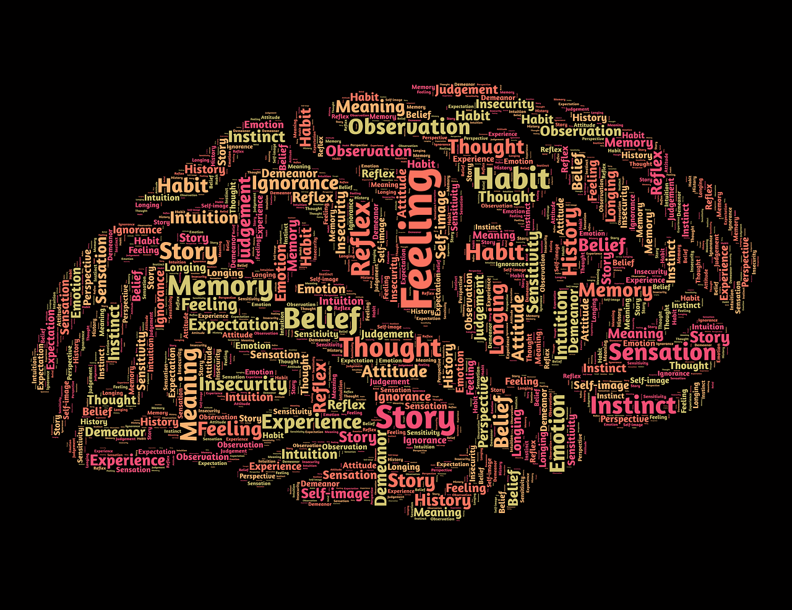
ECG
Spring meeting
Side event #2
10-12 March 2025
Leveraging neuroscience-based principles in evaluation communication
Dr Alexander Voccia
Sr Evaluation Communication & KM Specialist
Coordinator, Evaluation Communication Unit
[here]

Slide 2


Is communication important for evaluation?
However
We assume that through evidence we effect change and enhance quality
Evidence, on its own, has not driven change
Organizations that develop initiatives to change mindsets are
x2 more likely to succeed
70%
of change initiatives fail
Mindsets need to change

Slide 3

Understanding the mindset shift required
We need to move from evaluation phobia to evaluation embracing

Slide 4
Why IOE adopted a neuroscience-based approach
If results do not translate into change we want to see, then we need to shift production, generation and assimilation modalities
Better evaluations
Better engagement
IOE’s approach results from a dynamic and engaging process of triangulation that is based on together independence, credibility and utility.
Psychologically safe environments where people feel open to expressing themselves
People really look forward to your evaluation
Your evaluation approach is stress-free

Slide 5


Myth #: 1 Be clear about the goals
Clarity is key, but it does not ensure success, understanding, and interpretation by the listener.
Compassion-directed coaching is more effective at achieving results than goal-directed coaching.
Goal-directed coaching overactivates the fight-or-flight systems in the brain and the person becomes paralyzed and cannot act.
Is there space for compassion in your delivery of evaluation findings? Are people mirroring your anger and disdain rather than taking in the suggestions that you offer?
ioe.ifad.org

Slide 6


Myth #2: Tell people what not to do
Avoid telling people what NOT to do, and instead, focus on what needs to be done.
If an evaluand is suppressing a thought because they do not feel safe expressing it to you, they are likely to focus only on that thought rather than what you are saying – focus on creating a psychologically safe environment that is non-authoritarian.
Do you deliver findings in the negative? Do you create psychologically safe environments where people feel open to expressing themselves?
ioe.ifad.org

Slide 7


Myth #3: Hand over a negative appraisal if that is the truth
When people receive mixed or negative feedback, they trust the accuracy of the feedback less, and mistrust the qualifications of the person giving it.
People are more motivated to improve to the extent they perceive the feedback conversation to be focused on future actions rather than on past performance.
Avoid starting a conversation with what went wrong: if someone is self-protective, they will not hear you
Do people really look forward to your evaluation? Are they missing your helpful suggestions because they are too afraid?

Slide 8


Myth #4: Be transparent and speak the truth, even if this causes stress
When you are stressed, your body releases cortisol.
Cortisol causes a switch from ‘active thinking’ to habit, which causes people to go back to what they are used to doing, not allowing them to access new neural systems.
Stress changes the brain’s structure and function, resulting in less capacity to think, make decisions or change.
Is your evaluation approach stress-free? Are you enhancing the cognition of yourself and the other?
ioe.ifad.org

Slide 9
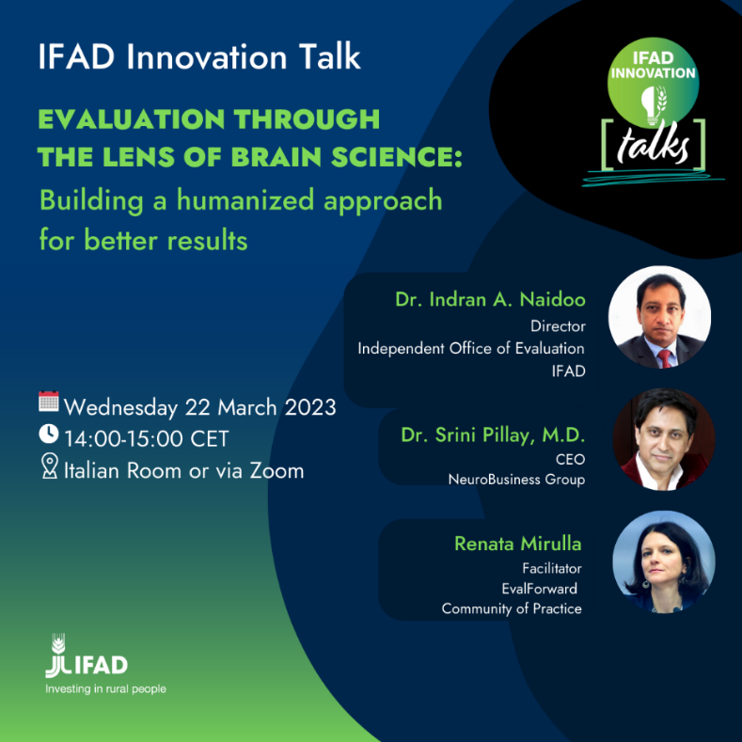
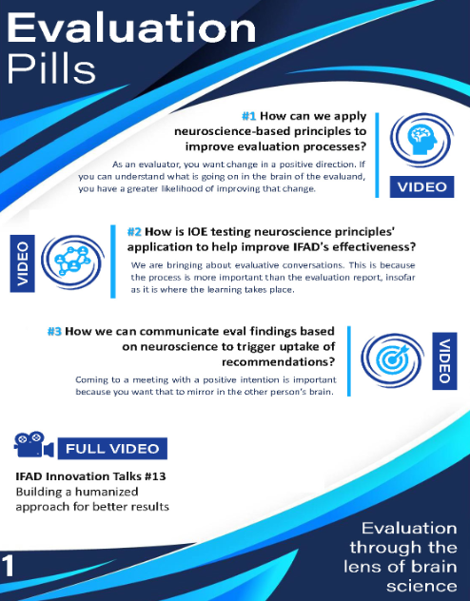


What we did: creating a neuroscience-based approach
Innovation
Talk
Evaluation
Pills
Evaluation
Manual
On-line
training
[here]
[here]
[here]
[here]

Slide 10

Action to engage: principles
The construct of all evaluation needs to accept engagement as a part of process credibility and seen as necessary for generating ongoing reflection as part of the learning process to build understanding.
IOE advances a process of principled engagement. IOE’s approach is based on dynamic and engaging process of triangulation that is based on together independence, credibility and utility.
IOE embraces and understands new content and methodologies that provide both real time information on change and impact.

Slide 11
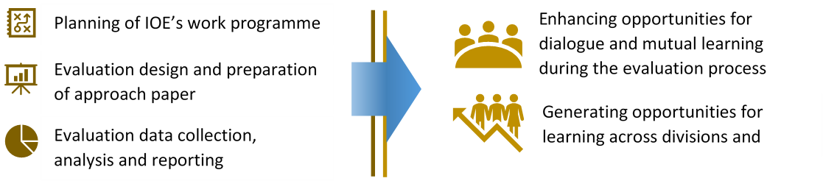
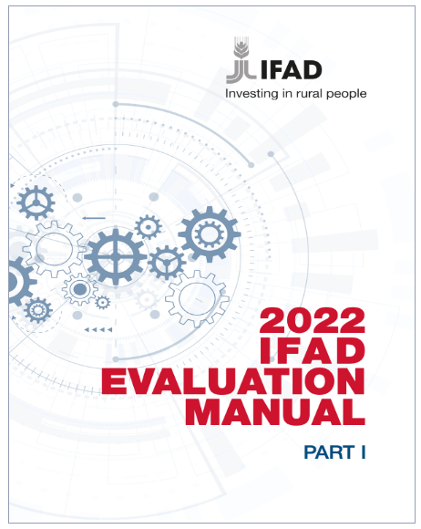
Action to engage: how it worked at IFAD
Institution-wide coverage (IOE and Management) to foster collaboration between self and independent evaluation
Include contemporary approaches to evaluation: Agenda 2030, Complexity and system thinking, Social Justice, Criteria OECD-DAC; ICT and Evaluation
Web-based training module to explain key elements of the Manual

Slide 12
For discussion
How do you reconcile the independence construct & desire to build engagement with the evaluand?
How can an evaluator foster positive change?
How important is the human element in evaluation?
10

