Slide 1
Evaluating ADB’s Private Sector Operations Strategic Approach and Results: Progress, Gaps, and Future Directions
ECG Spring Meeting
10 March 2025

Slide 2
Strategic Approach
S2020
Private Sector Development (PSD) and Private Sector Operations (PSO) together as one of five drivers of change. Target: PSD and PSO to account for 50% of ADB’s annual operations.
PSD = sovereign operations’ upstream work, PSO = PSOD’s downstream work
S2030
Focus on expanding PSO (target: PSO to comprise 1/3 of ADB operations by number of projects by 2024) and increasing long-term cofinancing (target: long-term cofinancing ratio of 2.5x by 2030)
7 Operational Priorities plus PSO as a cross-cutting additional focus
The PSO Plan
Evaluation Focus: Operational Plan for Private Sector Operations 2019-2024 (The PSO Plan) – a guiding framework and implementation plan for achieving S2030’s goals
Echoed S2030’s emphasis on development impact as a key objective while ensuring financial sustainability
Includes targets for expanding PSO, long-term cofinancing, diversifying operations into challenging sectors, frontier markets

Slide 3
Broad and Flexible but Weakly Prioritized Plan
Relevant, broad and flexible when it was launched, which allowed PSOD to respond to unexpected market changes
Lacks clearly articulated links between PSO inputs, outputs and expected development outcomes
Given region’s enormous gross domestic product and disparate evolving development needs across many DMCs, there is a need to be more purposeful and identify areas of operations with major development gaps
  Inconsistent use of diagnostics in CPS

Slide 4
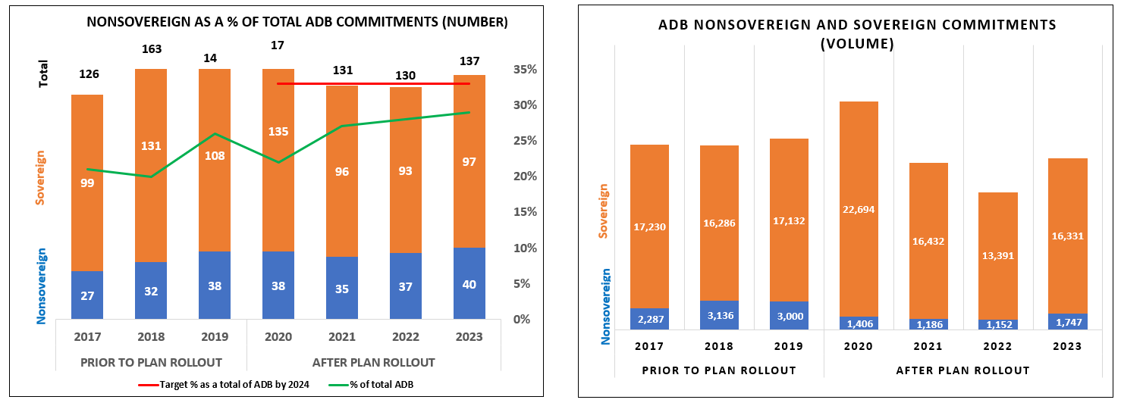
Modest Scaling Up, Declining volume

Slide 5
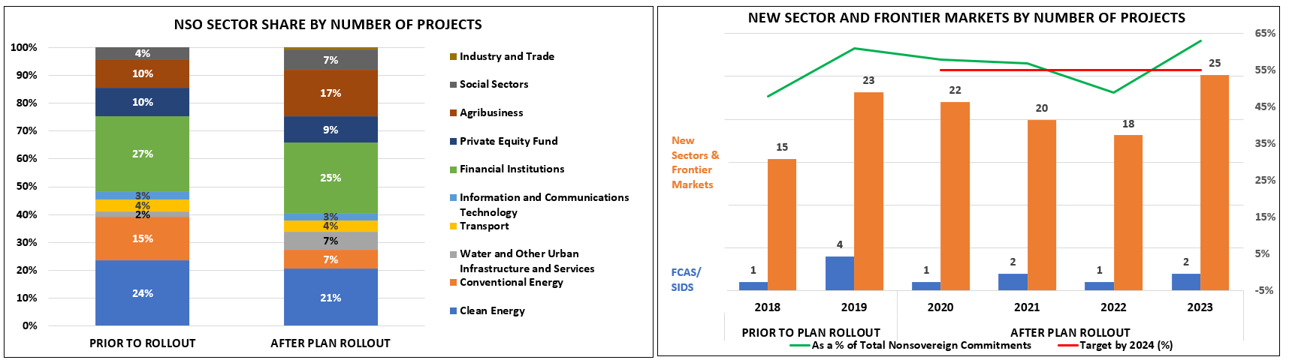
Increased Sector Diversification, Lagging FCAS/SIDS

Slide 6
On Track to Meet Long-Term Cofinancing Target
Close to the S2030 long-term cofinancing target of 2.5x by 2030
Absolute dollar cofinanced in 2023 represents modest 9% growth when compared with 2019
2023 cofinancing mainly achieved through parallel loans and parallel equity
Cofinancing includes funds from public and private sources, as well as direct and indirect mobilization
Opportunity to move towards a target based on private direct capital mobilization as per the MDB harmonized framework for calculating and reporting private investment mobilization

Slide 7
Scaling Up has been a Challenge
Business process reform initiatives have yet to improve staff productivity
  NSO Change Project, Credit Screening Tools still under implementation
Staff resources misaligned with goal of scaling up PSO
  Without significant improvement in origination international staff (IS) productivity (approximately 0.5 deals a year), 82-83 origination IS can only be expected to produce 41-42 projects a year
Lacks clear targets on scale, project origination and selection, financial return, project processing times and private capital mobilization

Slide 8
Recommendations
Prepare a new Plan to factor in the evolving development landscape, the updated ADB corporate strategy, and the New Operating Model context. The Plan should (i) include a more selective and differentiated operational approach to meet individual client needs by geography and sector; (ii) include a clear theory of change and a results framework aligned with the Private Sector Development Action Plan and the Corporate Results Framework with well-defined indicators (baseline and target) for gender equity theme, climate mitigation and adaptation, and FCAS and SIDS; and (iii) identify resource requirements that will be reviewed and discussed through the bank-wide work program and budget framework.
Better operationalize the new Plan through a One ADB approach, linking and aligning it to targeted long-term PSD outcomes in DMCs. The approach should be anchored on Private Sector Development Plans, as part of the CPS, and informed by diagnostics to identify priority areas and constraints, which will be addressed through upstream operations’ policy, regulatory, and institutional support and midstream advisory.
Implement measures to scale up NSO through better-aligned incentives and improved local project origination capacity. KPIs to align incentives should capture project volume in addition to the number of projects, project origination and selection, financial return measures, project screening and processing times, and mobilization volume based on MDB harmonized approaches.
Ensure the implementation of business process reform initiatives to enhance project selectivity, design, and process efficiency, including the execution and mainstreaming of the ex-ante development impact framework, credit screening tools, and NSO Change information management systems by the end of 2025.

Slide 9






Thank you
Independent Evaluation at ADB
Facebook
LinkedIn
Twitter
YouTube
Website
Email

