Slide 1
Institutional Change: Can Independent Evaluation be the bridge over troubled waters?
ECG Spring Meeting 2025

Slide 2
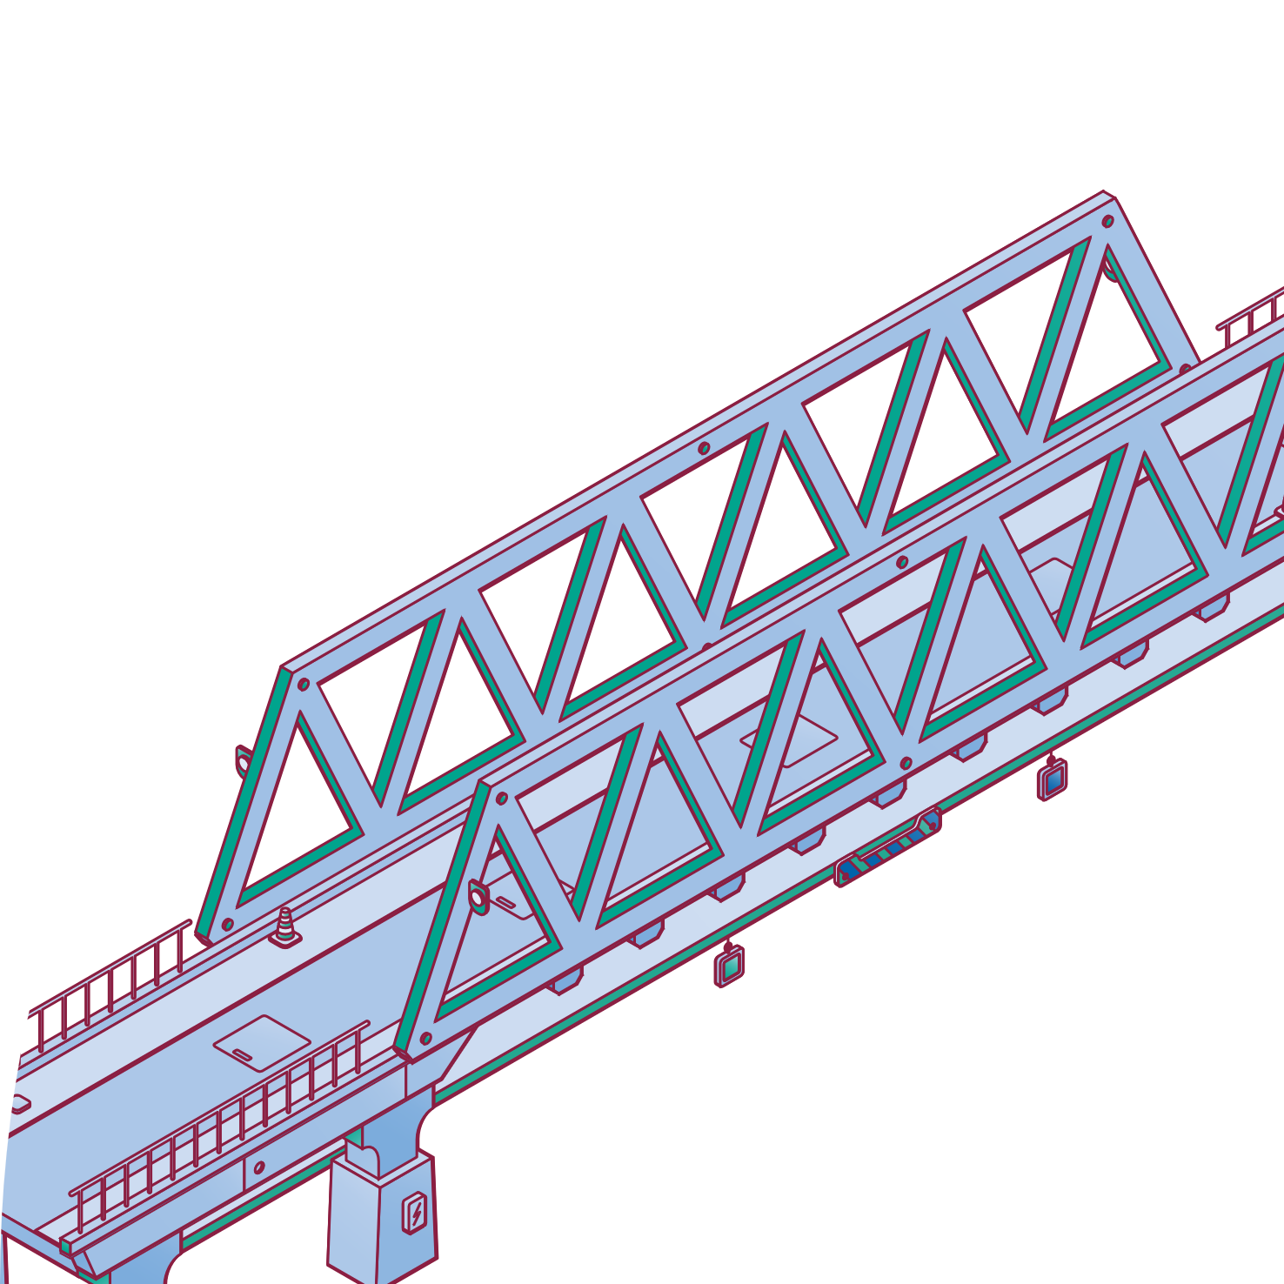
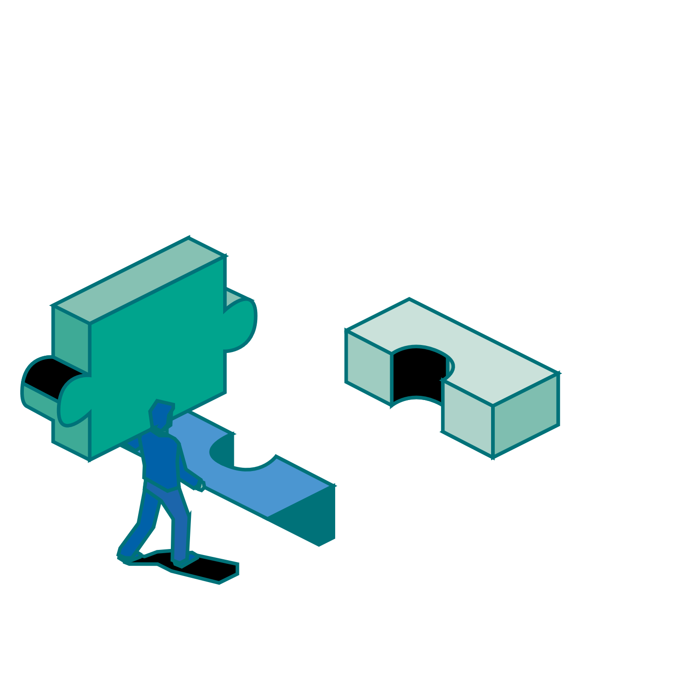
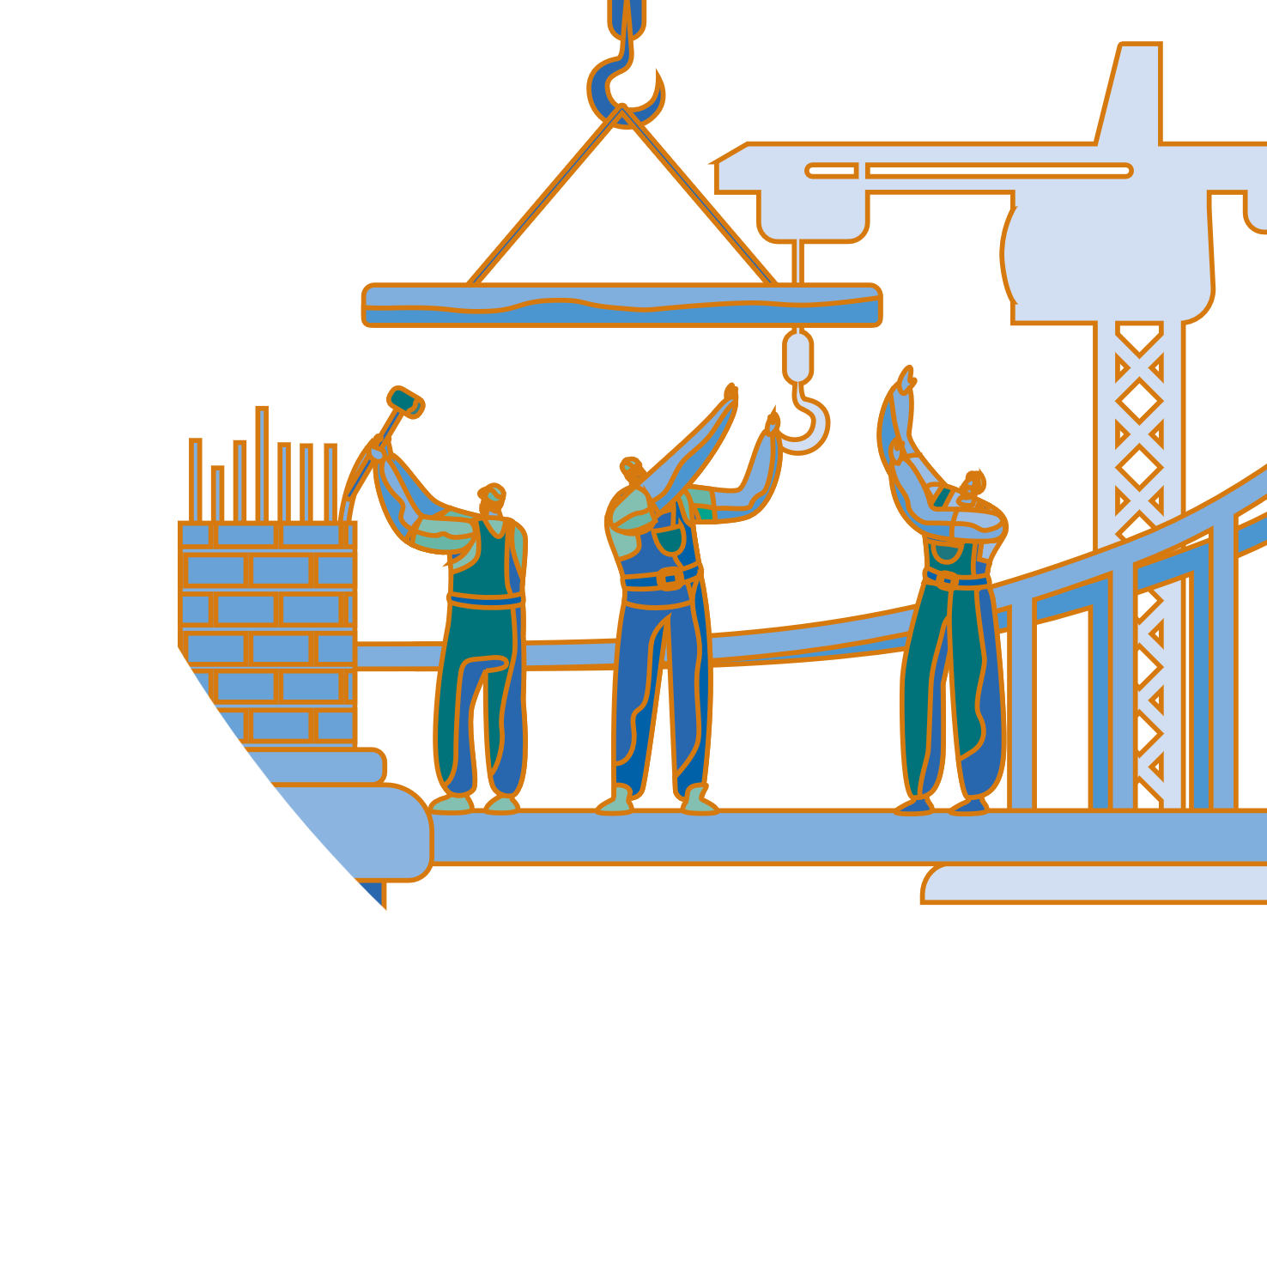
Table of Contents
Foundations of the bridge:
The anchors we have
1
2
The materials we choose
The methods and products we use
The construction
Walking the walk
Eyes on the horizon
What lies ahead
3
4

Slide 3
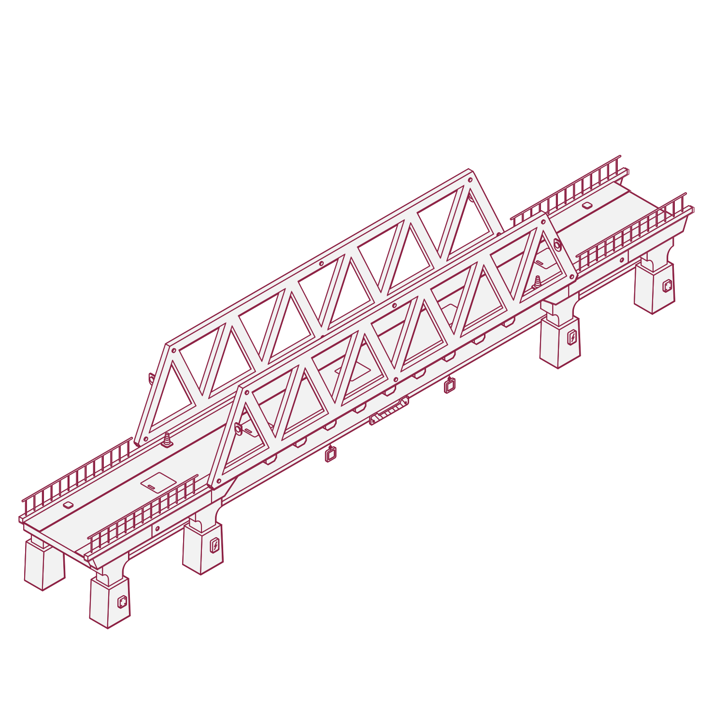
1
Foundations of the bridge
Foundations of the bridge contribute to resilience in the face of crisis
EBRD Evaluation Policy (2023) to guide evaluation principles and responsibilities in the organisation
Independent role bridging accountability & learning
Policies and principles may provide safeguard although management of issues which arise require deliberations
EBRD mandate focused on private sector might open opportunities for evaluating sensitive topics

Slide 4
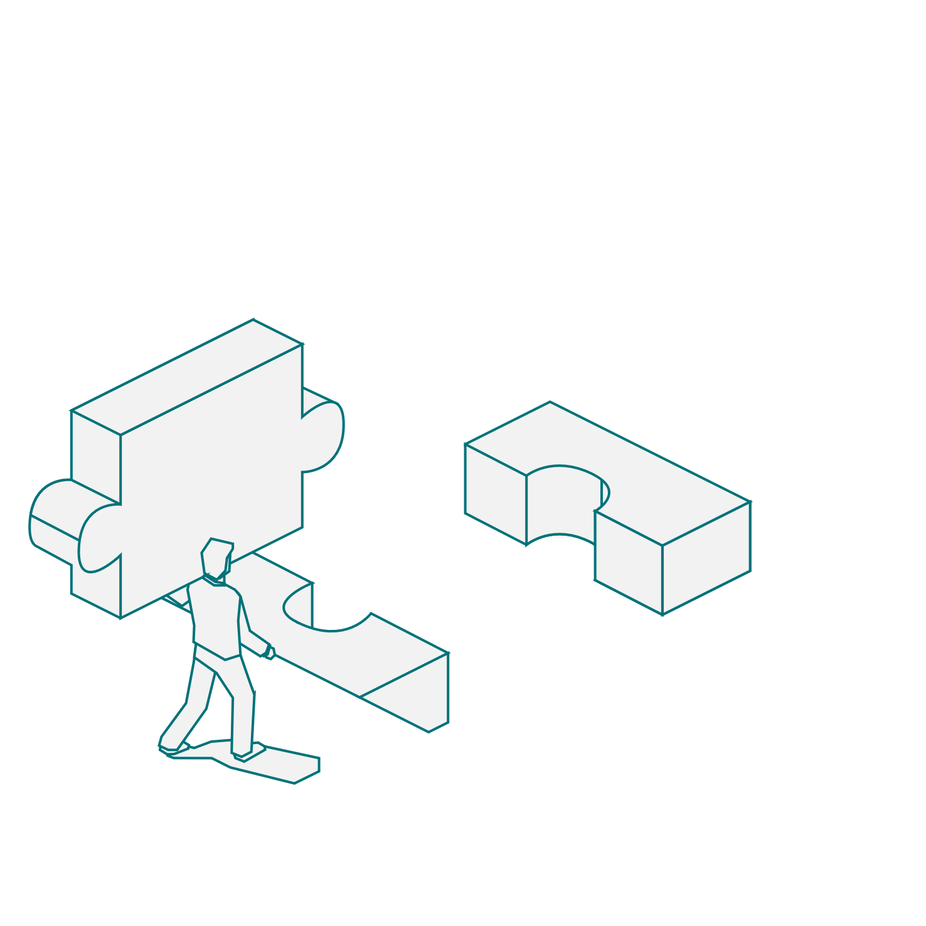
2
The materials we choose
Methods and products chosen for building the bridge help us navigate political dynamics
Selection of sensitive issues which many may consider avoiding means sticking to IEvD role of providing the facts, leaving the rest to the board (Ex: MREL)
Complex and politically sensitive evaluation themes require careful and novel methodological approaches (Ex: SCF)
Types of evaluations can lean into different utility opportunities (Ex: Rapid Assessment)

Slide 5
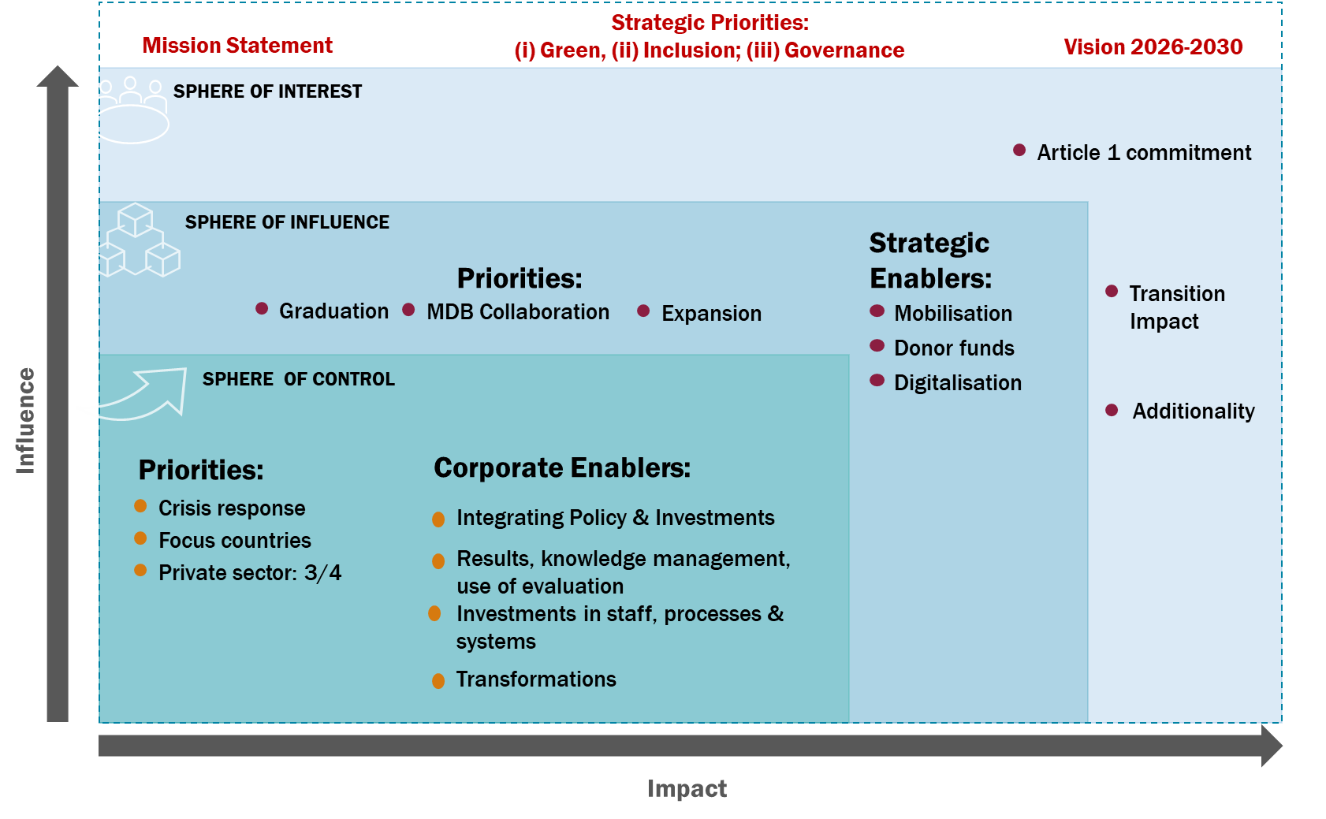
2
The materials we choose – Example of SCF
Three-spheres approach
stylised forward-looking theory of change
Bank’s actions and resources are either: (i) within its control; (ii) within sphere of influence; or (iii) sphere of interest
This model helps in prioritisation and assessing the actual progress

Slide 6
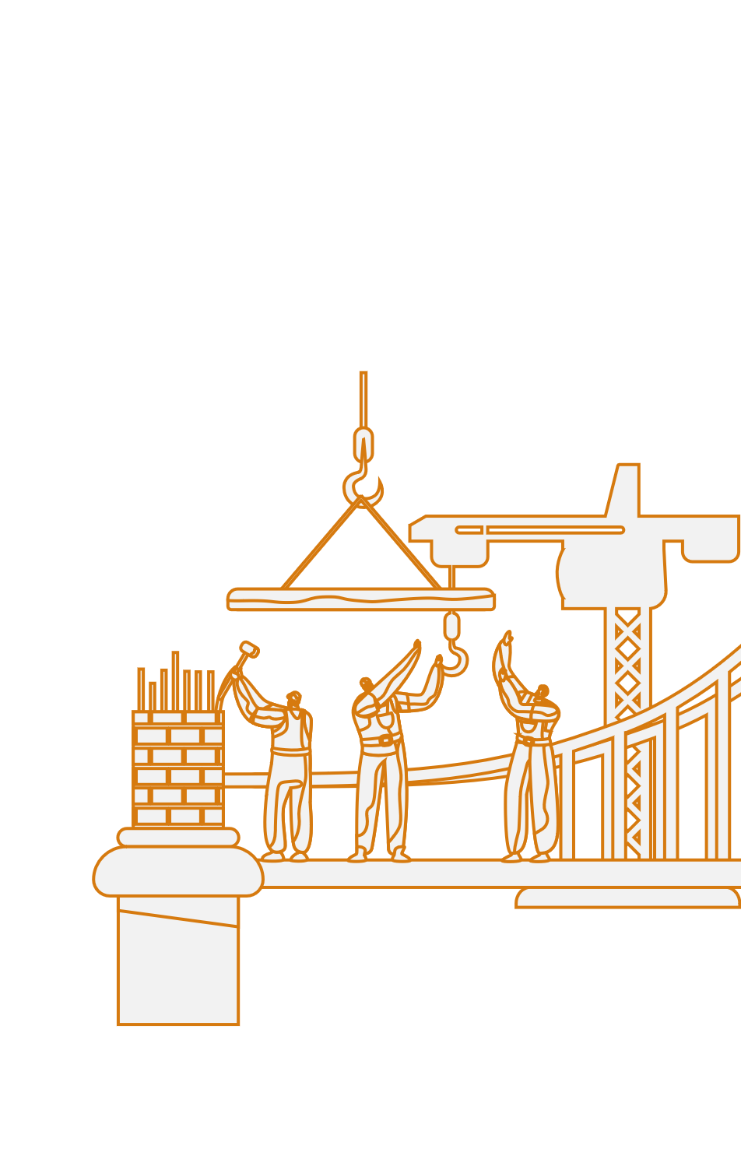
3
The construction
Constructing the bridge – managing evaluation process at a time of political sensitivity
Does political fragmentation generate more challenges to delivery? (Example: Gender)

Slide 7
4
Eyes on the horizon
Is independent evaluation a bridge, or in the water?
Should we expect increased political fragmentation to bring increased number of incidents that risk our delivery?
Linking independent evaluation to the institution’s operational risk framework?
How to remain the independent evaluation unit, without overstepping?

Slide 8
Institutional Change: Can Independent Evaluation be the bridge over troubled waters?
ECG Spring Meeting 2025

