Slide 1
Unlocking Tacit Knowledge: Strengthening Intuitional Memory in Evaluation
Darlene Christopher, Sr. Knowledge & Learning Officer
March 11, 2025
ECG Spring Meeting

Slide 2
Tacit Knowledge → The knowledge behind the knowledge
Notes:
tacit knowledge (e.g., "the know-how, intuition, and experience-based insights that are difficult to document but crucial for effective decision-making"). It is essential in a work environment, particularly in complex, knowledge-intensive fields like evaluation.
Today let’s explore the importance of tacit knowledge exchange and practical ways to facilitate it.

Slide 3
TODAY’S PRESENTATION
1
Importance of tacit knowledge
2
Examples from IEG
3
Resources

Slide 4
Found in databases and
documents
Explicit Knowledge
Found in our brains; contextual, hard to codify
Tacit Knowledge

Slide 5
LEARNING JOURNEY
JOIN IEG
FORMAL LEARNING
INFORMAL LEARNING
LEAVE IEG

Slide 6
Example 1: Knowledge Retention Interviews

Slide 7
Knowledge Retention Interviews
Embedded in Onboarding / Offboarding
Ensures business continuity
Mitigates risk

Slide 8
Process
Staff departure announced
Interview
Summarize
Share
Announcement of staff departure initiates the process
Private interview conducted following template
Knowledge is summarized and validated
Summary is shared with successor

Slide 9
Example 2: Evaluator Community of Practice

Slide 10
CHARTER
Background and Purpose
Domain
IEG major evaluation TTLs have a variety of responsibilities – managing budgets, researching topics, designing evaluation approaches, overseeing portfolio analysis, leading teams, engaging with counterparts, analyzing evidence, writing reports, and engaging in outreach. It is a complex, demanding job that takes years to master. In the context of IEG’s efforts to increase our value to the institution and continuously improve, the CoP will provide TTLs a forum to exchange ideas, ask questions, and learn from each other.
The CoP will be an informal knowledge-exchange forum that addresses knowledge gaps, encourages innovation and collaboration. Formal learning is out of scope.
By the end of FY24, IEG TTLs will have learned from each other and shared successful practices across IEG.
The experiences and skills of IEG Evaluation TTLs to include managing budgets, researching topics, designing evaluation approaches, overseeing portfolio analysis, leading teams, engaging with counterparts, analyzing evidence, writing reports, and engaging in outreach.
Key partners: IEG Knowledge and Communications colleagues, especially the IEG Academy team. Potential partners include HR and OPCS learning teams.
Strategy
Membership
Operating Model
Behaviours
Membership is comprised of TTLs and Co-TTLs of IEG major evaluations and CPEs (current and past TTLs).
Evaluators who join IEG will be invited to the CoP and the Community Manager will maintain a list.
Sponsor: Tim Johnston (<1 hour/month)
Leader(s): Jenny Gold and Heinz Rudolph
(2 hrs/month)
Community manager: Johanna Janukatys
(4 hrs/month)
KM advisor: Darlene Christopher (2 hrs/month)
Members will share knowledge and experience, to improve their evaluation skills and encourage synergy across units. We will build trust, solve problems, and share resources.
Meetings will be informal conversations on specific questions or topics, with light touch facilitation where all are encouraged to participate and share.
Members will share resources and exchange information asynchronously in a shared space.
People
Content & Programming
Platform & Other Convening Venues
Resources
Measurement & ROI
Content priorities will be selected by the CoP Leaders based on member survey and timely topics. Meeting invitations will be sent by CoP leaders.
Initially, the CoP will meet monthly for a 1-hour exchange.
Hybrid meetings with a Teams link.
Teams space for meetings, sharing files and news.
$1k for coffee/tea/beverages
Staff time
Desired outcome: A community of engaged evaluators who meet regularly to exchange ideas
Metrics: # of core members, # of events scheduled, # of members attending
Reporting metrics: Annually to Sponsor and managers of key roles. Posted in Teams.
Practice
Adapted from examples from Syngenta, Mars, the World Bank CoP Strengthening Initiative, Étienne Wenger, and CMX Community Canvas.

Slide 11
Evaluator Community of Practice
Fosters collaborative problem-solving
Sounding board for new systems, procedures
Knowledge sharing and learning

Slide 12
Resources

Slide 13
Interview Questions
Role Specific Questions:
What knowledge was most important to you in this role for the first 100 days? Which people and resources were the most helpful for you to come up to speed?
What are the key skills and abilities needed for this role, and why?
Who do you rely most in your role for specific tasks?
What has been the biggest challenge you have faced in recent years?
Knowledge Specific Questions:
Are there moments during the year when you need special knowledge? If yes, which and when and for which of your projects/teams?
What knowledge sources do you often rely on in your decision-making? Please give us concrete examples for each area of your work.
Identifying Risks and Opportunities
What are the most pressing issues that need to be immediately resolved in the next 30-45 days after your succession?
What would you see as the highest risk and highest value activities for the next 6 months? Is there any advice you could offer your successor on this?
What would be the worst thing that could happen to someone on this role? And how can it be prevented?
Training and Learning
In this section the interviewee should identify specific skills that need be acquired through a formal training or on the job-learning opportunities.
What are some training opportunities did you benefit to acquire needed skills for this position?
What are some training or formal learning opportunities do you recommend the successor to take advantage of in light of this position requirements and future needs in this role?
Are there any useful job-aids/materials/on the job learning opportunities that the successor should look into?
Closing questions. (If time permits)
Looking back over your time in the role, is there one story you can share which summarizes the challenges and nuances of the position?
What is the best possible advice-gift that you could leave for your successor?

Slide 14
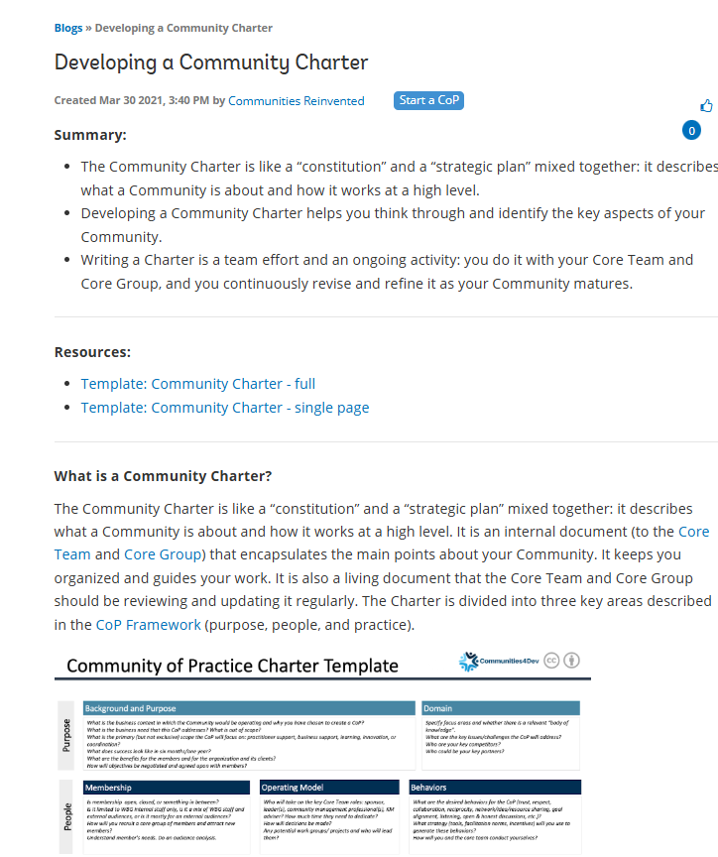
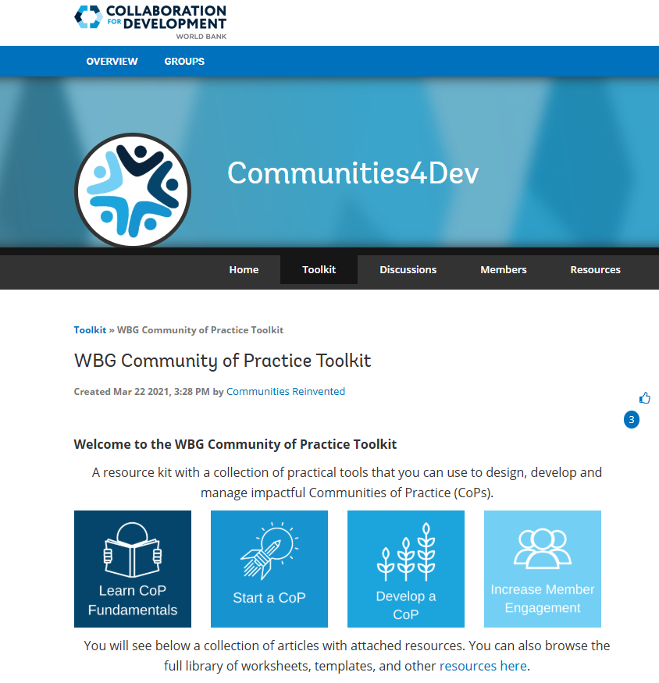
WBG Community of Practice Toolkit
Developing a Community Charter
Example 1: Knowledge Retention Interview

Slide 15
Thank you
http://ieg.worldbankgroup.com

