Slide 1
Evaluating support for climate in a changing environment
Lessons from the EIB Group Climate Bank Roadmap evaluation
Theme 3 - Climate
Presentation to ECG Spring meeting – March 2025
Tania Rajadel

Slide 2
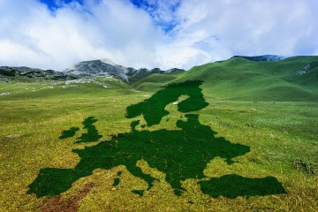
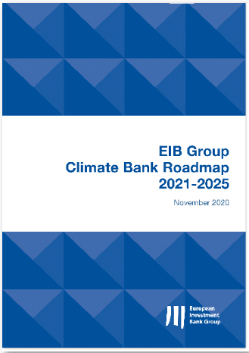
Towards net-zero
European Union policy
EU objective to be climate-neutral by 2050
European Green Deal
EIB Group Climate Bank Roadmap (2021-2025)
EIB Group repositioning as the ‘EU Climate Bank’
Operational framework for the Group (2021-2025)
=> Objective of the evaluation
Inform the upcoming revision of the Climate Bank Roadmap for 2026-2030

Slide 3
A broad-reaching Climate Bank Roadmap
Evaluation Added-value
High-level commitments & operational priorities
Operational frameworks
Engagement with clients
Institutional set-up
High-level commitments
EIB Group to support €1 trillion of green investments over 2021-2030
50% of EIB annual financing to be green as of 2025
Paris-alignment of all new EIB Group operations as of 2021
Complementarity with prior assessments
Mid-term review (2023)
Internal assessments of frameworks & tools
Corporate evaluation
Strong focus on institutional elements
Role of the Climate Bank Roadmap as a corporate document
Operational priorities
11 focus areas
Just transition
Product refinements & innovation
Advisory service offer
Eligibilities
Frameworks & tools
Low carbon & Paris alignment
Climate risk assessment
Green tracking & reporting
Governance & implementation frameworks
Organisational change

Slide 4
a changing context
Engagement with Services
External
International context
EU context
Greater focus on European energy security & independence
More emphasis on competitiveness
Internal
New leadership
Updated corporate orientations (e.g. EIB Group Strategic Roadmap)
Evolving plans for the next iteration of the Climate Bank Roadmap
Continuous engagement with EIB Group Services throughout the evaluation
Strong engagement with core services leading the revision of the Climate Bank Roadmap
Regular status update meetings with the evaluation reference group & other relevant internal stakeholders
Early sharing of findings & recommendations

Slide 5
High-level Findings & recommendations
Flexibility & agility
The Roadmap helped to establish the EIB Group as the EU climate bank
But attempt to serve multiple purposes led to some shortcomings
2026-2030 Roadmap to focus on high-level strategic directions for the climate bank
while outlining operational and technical frameworks separately to provide more flexibility to adapt to evolving contexts
Simplification & efficiency
The Roadmap’s implementation framework mobilised the Group around a common objective
But the set up was complex and resource-intensive
Simplify the Roadmap implementation framework & streamline reporting requirements
Prioritisation & impact
Set high-level operational priorities
Based on
where market gaps are the greatest,
where it can be the most impactful,
while making the best use of its resources
The Group significantly increased green financing
But meeting ambitions on adaptation & expanding support to a circular economy & biodiversity remains challenging

Slide 6
Upcoming Climate Bank evaluations
EIB Group support for a greener industry
EIB support for the blue economy
EIB energy lending policy
EIB transport lending policy
EU climate ambitions
Impact to include focus on
EU security & independence
Competitiveness
Affordability
2025
2026
2027

