Slide 1
EVALUATION
Building an AI Strategy for Evaluation – Challenges and Trade-offs

Slide 2
Introduction
AI is evolving rapidly, offering new opportunities for evaluation teams.
AI raises the bar in quantity, in quality and most importantly – in expectations
How can small, resource-constrained teams develop an AI strategy that is impactful, future-proof, and feasible?
Many questions, few answers
Goal: Share experiences and launch a collective reflection among ECG members.

Slide 3
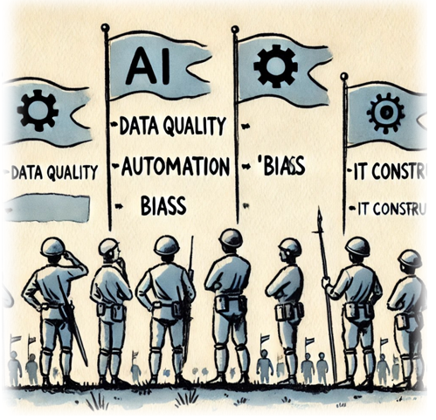
1. Picking the right battles
Challenge: Small evaluation teams have limited time, expertise, and budgets for integrating AI into their workflows.
Key Questions:
How do we avoid chasing AI trends that are dead end streets and may not yield real impact?
Which elements of the evaluation workflow are the most suited for AI?
Should we focus on automation, deeper insights, or both?

Slide 4
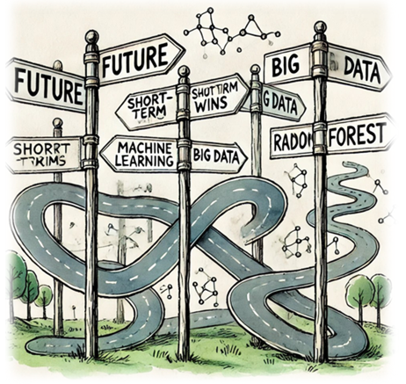
2. Future-proofing in a rapidly evolving landscape
Challenge: AI tools and methodologies evolve quickly and can become rapidly outdated —how do we invest wisely?
Key Questions:
Should we adopt AI incrementally or aim for a long-term strategy?
How do we ensure flexibility while maintaining institutional stability?
Can we build on lessons from other similar disciplines (consultancies, research)?

Slide 5
3. Balancing AI and traditional data analysis
Challenge: AI promises efficiency, but traditional methods remain reliable.
Key Questions:
Where does AI add the most value, and where do traditional techniques still outperform?
Should AI complement or replace existing analytical workflows?
How do we balance experimentation with AI while maintaining evaluation rigor?
Is current investment in traditional methods will become sunk cost on the long run?

Slide 6
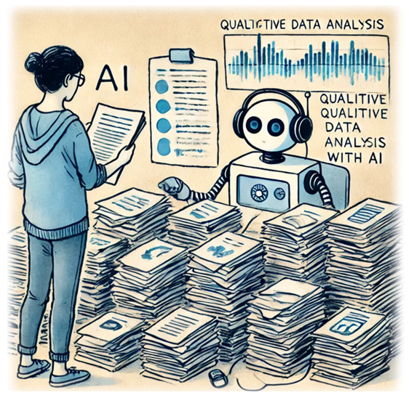
4. AI for Qualitative Data – Changing Workflows
Challenge: Evaluators deal with large amounts of qualitative data (documents, interviews, surveys) – an area where AI promises a lot
Key Questions:
To what extent can AI reduce the manual burden of qualitative analysis?
Is our qualitative data ready for AI or we need extra investment to make it so?
How do we ensure AI-generated insights are credible and transparent?
What are the risks of AI misinterpreting qualitative data?

Slide 7
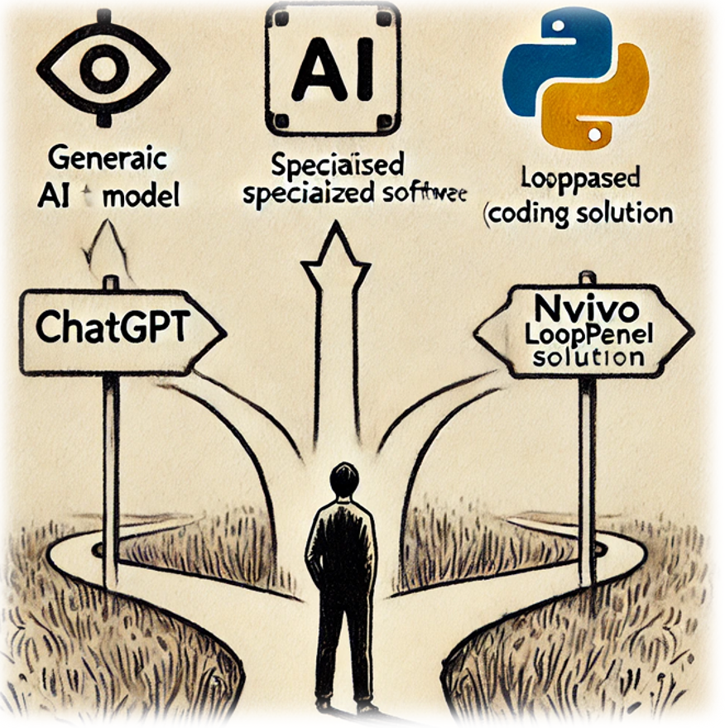
5. Choosing the right AI tools
Challenge: Different tools offer different strengths—where should we focus?
Key Questions:
Should we use generic LLMs (e.g., ChatGPT), specialized software (e.g., NVivo, Looppanel), or in-house solutions (e.g., Python scripts)?
How to allocate and manage the resources needed for experimentation?
How do we ensure interoperability with existing evaluation systems?

Slide 8
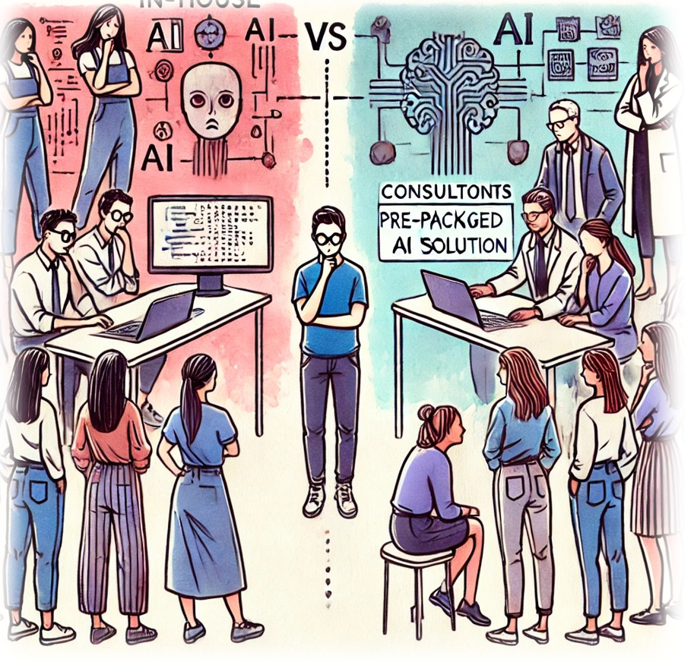
6. In-house vs. outsourcing – where to invest resources?
Challenge: AI expertise is scarce in evaluation teams—should we develop it internally?
Key Questions:
Which AI capabilities should be developed in-house, and which should be outsourced to external consultants?
How do we balance skill-building with efficiency?
What is the best way to outsource AI support?

Slide 9
7. Institutional IT constraints and AI adoption
Challenge: MDBs often operate in highly controlled IT environments with limited flexibility.
Key Questions:
How do we navigate slow approval processes for new AI tools?
Are the generic, bank-wide AI solutions suitable for evaluations?
What workarounds exist for testing AI within institutional constraints?

Slide 10
8. Confidential data and AI – managing risks
Challenge: Many AI tools rely on cloud-based processing, creating data security concerns.
Key Questions:
How do we use AI while maintaining confidentiality standards?
Are on-premises or private AI solutions a viable alternative?
How do we manage legal and ethical risks in AI-driven evaluations?

Slide 11
9. Training and capacity building
Challenge: Help to develop the necessary AI literacy for non-expert team members
Key Questions:
How to identify the elements of the base curriculum?
How to balance between providing hands-on tools vs a roadmap to navigate the AI landscape?
How to foster collaboration and information sharing?

Slide 12
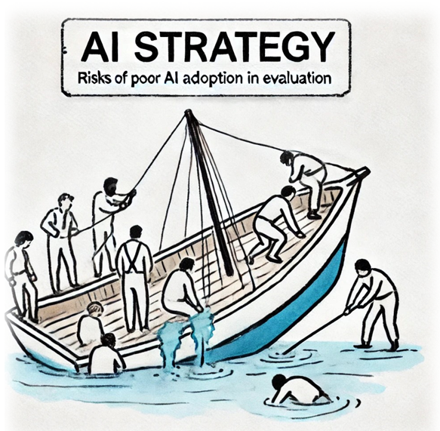
10. Risks of not getting it right
Challenge: Poor AI adoption can waste resources, create misleading insights, or damage credibility.
Key Risks:
Delaying investment in the right tools → falling desperately behind the curve
Inefficient resource allocation → wrong tools may drain budgets
Poor implementation → Institutional erosion of trust in AI
Lack of explainability → AI-generated findings may not be transparent or defensible

Slide 13
Conclusions – Moving forward
Call for joint reflection:
What important aspect is missing from the above?
Where do we stand?
Can the ECG support its members in facing these challenges?
What further discussions or collaborations are needed?

