Slide 1
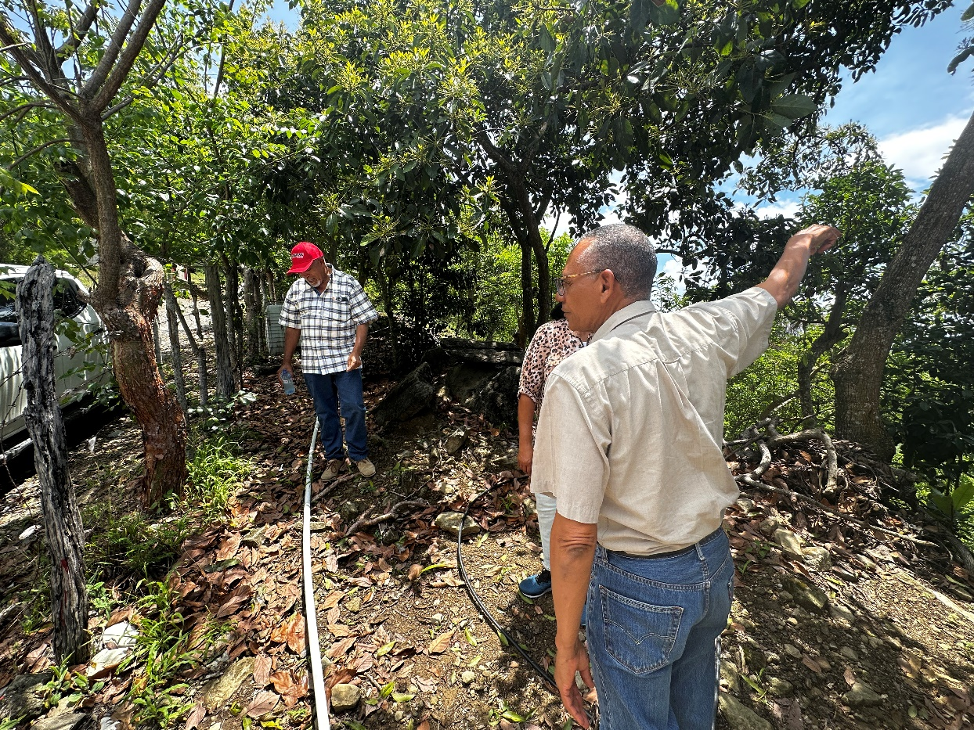
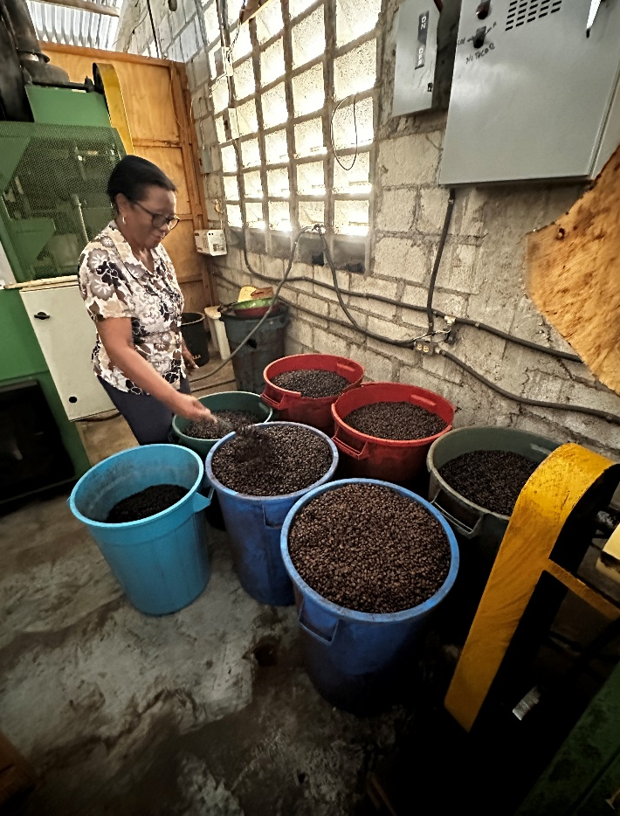
Project cluster evaluation: IFAD’s support to rural enterprise development:
Key findings and lessons
ECG
Spring Session
Rome,
10 March 2025
Notes:
Thank you Chair

Slide 2
Introduction
Evaluation conducted in 2021-2022;
Aim to generate learning with project-level evaluations, through comparative analyses of a small number of projects.
4 Projects in 4 Countries: Ghana (West Africa), Cameroon (Central Africa), Bangladesh and Nepal (Asia region).
Projects specially designed to support enterprises development, not selected for a generalization purpose.
Evidence sources: interviews with various projects’ stakeholders and key informants; focus group discussions with beneficiaries; direct observations during field visits; phone surveys with beneficiaries of matching grants; and documentation.
Notes:
Introduction
IOE has undertaken a project cluster evaluation (PCE) on rural enterprise development, with the aim to enhance learning aspects at projects level through comparative analyses of a small number of projects sharing common features.
The PCE covered four projects in Bangladesh, Cameroon, Ghana and Nepal. Projects were selected as they have a clear focus of supporting rural enterprises development.
The evaluation drew evidence from various sources.

Slide 3
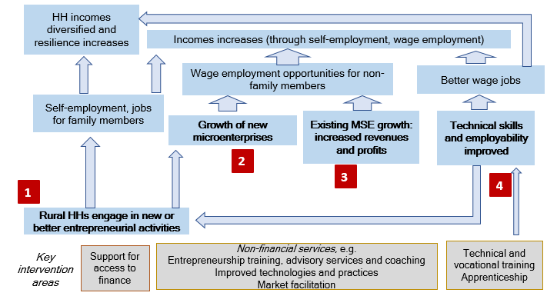
Analytical framework
Pathways of IFAD’s support to rural incomes increased
Notes:
Analytical framework
This figure shows the analytical framework applied.
Projects implicitly or explicitly support multiple pathways to achieve the purpose of income enhancement and employment creation, including:
1- Microenterprises for self- and family member employment.
2- Growth of new microenterprises generating wage employment opportunities.
3- Growth of existing micro (and/or small) enterprises linked with increased employment.
4- Technical and vocational education and training and apprenticeships
Ultimately, supports to enterprise development is a mean to achieve increased and sustained rural incomes.

Slide 4

Key finding-1: Lack of approaches clarity
Lack of clarity on:
  Nature or profile of enterprises to promote
  Approach to follow for which target groups
  Involvement of other market’ actors
  Consideration to capacity development
Contrasted approach to identify participants in terms of:
  Selection of “entrepreneurial poor” participants
  Sequenced approach to identify interested youths
Notes:
Key finding-1 on approaches
The evaluation found that interventions lacked clarity on how enterprises were expected to increase incomes and employment and for whom. Designs assumed that the enterprises created and supported through interventions would generate employment, but lacked clarity on:
(i) whether the target enterprises were “survivalist” or one-person enterprises with growth potential;
(ii) the role of other market actors that could serve as intermediaries.
Lastly, insufficient consideration was given to the extent to which projects should aim to improve individuals’ skills, employability and the quality of jobs, as opposed to expecting all participants to operate an enterprise.
Attention to gauging entrepreneurial aptitude to screen and identify participants was inconsistent. In some countries, the target group was broadly defined as the “entrepreneurial poor”, but participation was largely based on self-selection and the payment of token fees. In other countries, screened potential participants was done using a sequenced approach, starting with information dissemination and support to interested, combined with an assessment of their entrepreneurial potential.

Slide 5
Key finding 2: Supports and results
Numerous supports to pre-entrepreneurial activities and to micro enterprises, for income diversification and risk mitigation.
Improving productivity was not guided by sufficient market analysis of the assessment of the growth potential
Increases in entrepreneurs’ knowledge and technical skills was a main driver in increased revenue from entrepreneurial activities
Increased level of self-employment among some key target groups, such as youth, and created new or improved income opportunities for existing entrepreneurs, diversifying income sources
Improvements in productivity contributed to the enterprises’ growth to a lesser extent; and inconsistent improvement of management practices.
Notes:
Key finding-2 on results
Overall, project strategies were more suited to creating or strengthening pre-entrepreneurial activities and very small microenterprises than to targeting and supporting enterprises with more growth potential. Applied approaches supported income diversification and risk mitigation for entrepreneurs rather than enabling larger employment. Projects’ scope and strategies focused on improving productivity and were not sufficiently guided by sound market analysis or an assessment of the growth potential for rural employment generation.
Strengthened entrepreneurs’ knowledge and technical skills led to improved productivity and services, which was a main driver for increased revenue from entrepreneurial activities. In some sectors, the projects successfully introduced new skills, technologies and tools. Projects increased the level of self-employment among some key target groups, such as youth, and created new or improved income opportunities for existing entrepreneurs.
To a lesser extent, improvements in productivity contributed to growth of enterprises. The adoption of new or improved management and business practices was inconsistent, and synergies between non-financial and financial support were minimal.

Slide 6
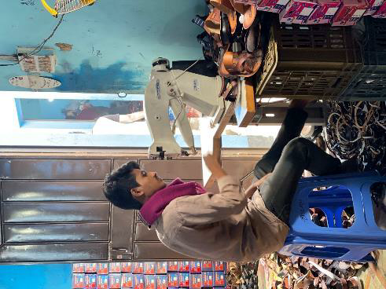
Key finding 3: Access to finance challenges
Insufficient allocation of credit funds
Integration of microenterprise funds into larger funds, but no linkages with other non- financial supports, and unclear value addition
Modest results for loans access due to (i) risks, (ii) inadequate approaches, (ii) insufficient efforts to promote innovative products.
Matching grant facility: useful for first time borrowers, but bias as mostly access by well established enterprises.
Financial eligibility criteria: constraints to new enterprises created.
Notes:
Key finding-3 on financing issues
The allocation of credit funds was not sufficient to respond to the needs of rural MSEs and there was inadequate consideration of financial institutions’ incentives and capacity. Where the project’s credit funds were integrated into a larger existing microenterprise loan programme, linkages with other non-financial services were not evident, and the value addition in this case was unclear, given that the liquidity of partner microfinance institutions was not a critical issue.
Access to loans, especially for new clients, were modest. The reasons for this included: (i) common challenges and risks in supporting start-up enterprises; (ii) financing modalities not sound considering contextual issues; and (iii) insufficient deliberate efforts to promote improved or innovative products and services responsive to needs.
Matching grant facility promoted was originally intended to help first-time borrowers to build relationships with financial institutions, but in the actual implementation a good proportion of grant recipients were relatively well-established enterprises with a credit history. The credit facility also underperformed owing to factors such as, participants’ inability to meet loan eligibility criteria and the reluctance financial institutions.

Slide 7
Key finding 4: Factors affecting results
Factors influencing effective support to enterprise creation
  Selection and screening process
  Sequencing and intensity of advisory and follow-up support
  types/sectors of enterprises vis-à- vis the specific context
introduction of new technologies and practices was effective in improving the performance of existing enterprises
Uptake influenced by observable benefits in a short terms, their affordability; the profiles of entrepreneurs; and access to finance
Missed opportunities to link technology promotion to enterprise development.
Adoption of new or improved management practices lower than adoption of technical practices.
Notes:
Key finding-4 on explanatory factors
A range of factors influenced the results of support to enterprise creation, or the survival and growth of existing enterprises. These included: (i) balancing attention given to inclusiveness and entrepreneurship potential at the selection stage; (ii) the sequence and intensity of advisory and follow-up support; (iii) the types or sectors of enterprises vis-à- vis the specific context; and (iv) education/literacy level of participants.
The introduction of new technologies and practices was effective in improving the performance of existing enterprises through improved productivity.
The level of technology uptake was influenced by immediate observable benefits; the affordability; the profiles of entrepreneurs; and access to finance, among other factors. Overall, opportunities were missed to link technology promotion to enterprise development more systematically.
Across projects, the adoption of new or improved routine management practices was lower than the adoption of technical practices.

Slide 8
Key finding 4: Sustainability prospects
Supports contributed to strengthening institutional frameworks and mechanisms to support MSE development in Ghana and Cameroon.
Support by another international organizations was also key for institutional strengthening in Cameroon.
Most promoted new enterprises were at their early stages of development, so it was too early to determine how many will continue beyond project support.
Activities not directly supported were likely to be continued, without the project.
Similarly, for economic activities that do not require highly technical knowledge and skills, investment funds or working capital with reasonable returns.
Pre-existing enterprises are also more likely to be sustained.
Notes:
Key finding-4 on sustainability aspects
Projects contributed to the development of institutional frameworks and mechanisms to support MSE development, in two countries. In one country, with the long continuous substantial investment by IFAD, the structures for decentralized service delivery for MSE support are well- established and institutionalized (e.g. through business advisory centres at district level). However, the ability of various institutions to effectively and efficiently deliver services varies. In another country, support by an international organizations was also key for institutional strengthening
Prospects for the survival and future growth of enterprises are mixed. Most new enterprises remained at their early stages of development, and thus, too early to determine how many will continue beyond project support. Many activities of voluntary participants not directly supported by the project were likely to continue. Similarly for economic activities that do not require highly technical knowledge, skills, and investment funds. Some such activities respond to consistent demand by the local populations (e.g. hairdressing, repair services), even if the margin for growth was very limited. Finally, pre-existing enterprises were more likely to be sustained.

Slide 9
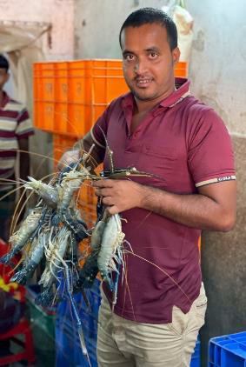
Key lessons
Strategies need to consider the profiles, skills, capacity and resources of entrepreneurs, with a clearer understanding on impact pathways
Creating and growing enterprises requires systematic, longer-term support.
Productivity improvement contribute to increased revenues, but additional support is needed for enterprise upgrading.
Efforts to improve rural entrepreneurs’ access to finance must be based on the assessment of their needs, as well as policy and institutional bottlenecks
Notes:
Key lessons.
The evaluation concluded with key lessons, among others, the followings:
- Strategies need to consider the profiles, skills, capacity and resources of entrepreneurs, with a clearer understanding on impact pathways
- Creating and growing enterprises requires systematic, systemic and longer-term support.
- Productivity improvement contribute to increased revenues, but additional support is needed for enterprise upgrading.
- Efforts to improve rural entrepreneurs’ access to finance must be based on the assessment of their needs, as well as policy and institutional bottlenecks

Slide 10
Thank you for your attention

