Slide 1
Evaluation Perspectives:
Insights on ADB’s Evolving Climate Change Landscape
ECG Spring Meeting, Rome (virtual)
11 March 2025
Shimako Takahashi
Independent Evaluation Department (IED)
Asian Development Bank

Slide 2
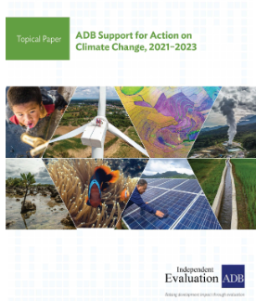
Topical Paper: ADB Support for Action on Climate Change, 2021-2023
Update on ADB’s support for climate action during 2021–2023
Focuses on:
Strategic and institutional shifts,
ADB’s climate portfolio, and
Progress towards climate outcomes.

Slide 3
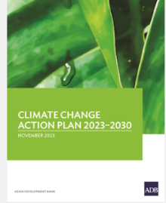
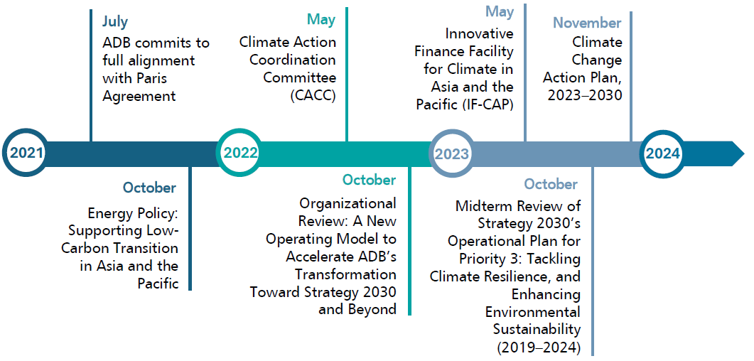
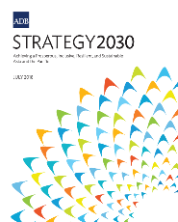
Evolution of ADB’s Approach to Climate Change, 2021–2023

Slide 4
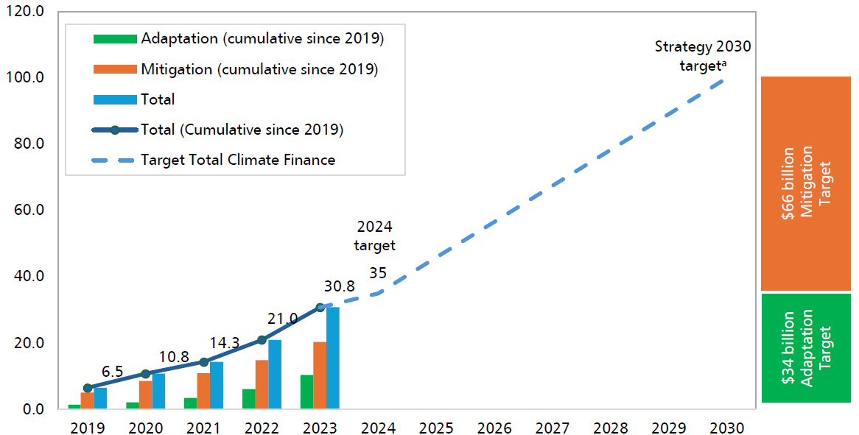
ADB Cumulative Financing for Climate Change ($ billion)

Slide 5
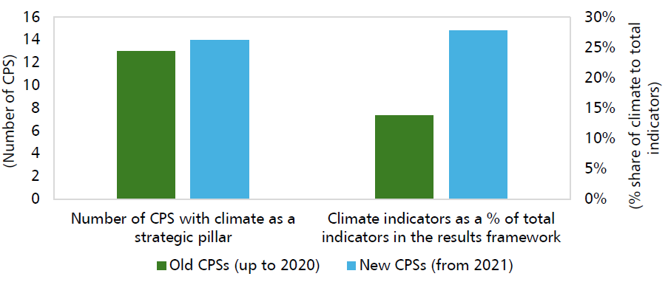
Climate Focus and Results Frameworks in Country Partnership Strategies
ADB's climate strategies have intensified through Country Partnership Strategies (CPSs).
The Climate Change Action Plan is influencing CPSs through the requirement of
a country climate investment plan.
Climate indicators for outcomes and outputs have increased.

Slide 6
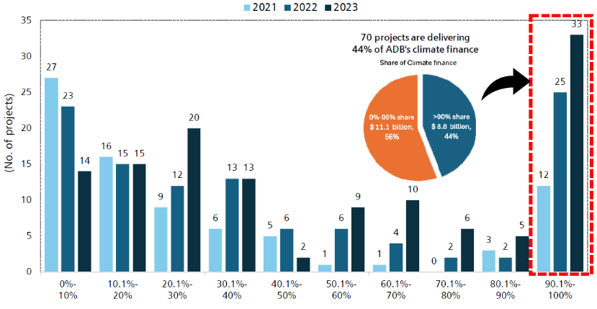
Share of Climate Finance in ADB Investments, 2021–2023
ADB needs to go beyond the achievement of financing targets to include outcomes achievement and lesson learned.

Slide 7
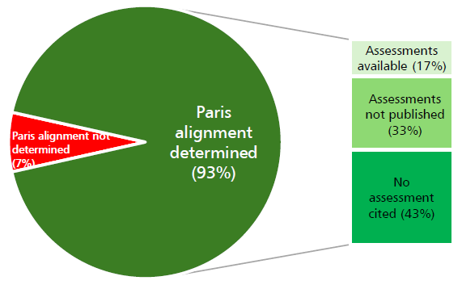
Work in Progress
Efforts to enhance and embed climate expertise within ADB are underway.
ADB’s system for ensuring Paris alignment requires further improvement to become fully operational.

Slide 8
Conclusion
ADB as the region’s climate bank needs to go beyond
the achievement of financing targets to include outcomes
achievement, learning, and knowledge.
A system for aligning ADB operations with the Paris Agreement
has been established but it is not yet fully operational.
Efforts to enhance climate expertise across ADB are underway.
Broader and more targeted support is needed for sector operations
and the private sector.

Slide 9






Thank you!
Independent Evaluation at ADB
Facebook
LinkedIn
Twitter
YouTube
Website
Email

