Slide 1

Revising the Good Practice Standards
A Roadmap
Proposed by ECG GPS Working Group co-leads
Office of Evaluation and Oversight, Inter-American Development Bank (OVE/IADB)
Independent Evaluation Group, World Bank (IEG/WB)

Slide 2
Agenda
Where do we stand and what are the areas of agreement
Proposed Steps for revising the GPS
Role and responsibilities
Questions for discussion

Slide 3
Where do we stand
Big Book on Evaluation Good Practice Standards (November 2012)
ECG Spring Meeting Washington D.C. (June 2022)
ECG Fall Meeting WashingtonD.C. (November 2022)
ECG Spring Meeting Abidjan (March 2023)
ECG Fall Meeting Abidjan (October 2023)
Kick-off meeting ECG GPS update (December 2024)
ECG Spring Meeting London (March 2024)
Stocktaking Exercise (June 2015)
ECG Fall Meeting Tegucigalpa (November 2024)
Paper: The Private and Public Sector Good Practice Standards: A Background and Comparison (2013)
GPS recognized as key part of defining ECG’s purpose; recognized need for initial assessment on the extent of the review
Strategic Reflections Group: GPS integral part of ECG’s ToC; Agreement on preparing a roadmap proposal for updating the GPS
GPS update process launched; all ECG members join the GPS Working Group
To help define ECG’s future strategic role
Revision of GPS stems from discussion on rethinking ECG’s long-term strategy in view of the changing context
Powerpoint presented by GPS Working Group (EIB, IsDB, CABEI): Preliminary thoughts on the need to update the ECG Good Practice Standards (GPS)
Agreements on general purpose, format and scope of revised GPS; suggestions on update process

Slide 4
What are the areas of agreement (1)
Purpose
  The GPS are a reference framework:
    To discuss the role of evaluation and of evaluation functions with ECG member institutions' Boards and Management
    To guide the practice of evaluation in ECG member institutions
Format
  The updated GPS should be principle-based, high-level standards that remain valid over time
  The updated GPS document could be shorter than the GPS Big Book with references to more detailed guidance
  The coverage should be broader but with a better balance across topics

Slide 5
What are the areas of agreement (2)
Scope
  Clarity on purpose, intended uses and audiences of the GPS
  Background and context: evolving institutionalization of evaluation, harmonization, potential for collaboration between ECG member institutions and mutual reliance
  Principles for the institutionalization of evaluation in ECG member institutions (with emphasis on independent evaluation (principles of independence; the link with self-evaluation)) and principles for evaluation practice
  Principles for evaluation practice covering the main modalities of evaluation: public sector (project) evaluation, private sector (project) evaluation, country program evaluation, sectoral and thematic evaluation, evaluation synthesis
  Importance of covering different financial instruments (e.g. PBL, INL, RBL, equity, guarantees) as well as non-financial activities (e.g. policy dialogue, technical assistance, advisory and analytical work); attention to synergies between the two
  Importance of (potential) harmonization between public and private sector evaluation
  Importance of (revised) OECD-DAC criteria (include coherence); consider additional issues such as additionality, comparative advantage
  Reflect on inclusion of cross-cutting issues (e.g. gender, environment, fragility, security)
  Importance of responsible use of data, technology and data analytics (with particular attention to artificial intelligence)
  Updates of bibliography, terms and definitions, acronyms and abbreviations

Slide 6
2. Proposed Steps for Overall GPS Update Process
Concept Note | Reviews and consultations | Draft Revised Good Practice Standards | Review rounds and finalization | Publication and dissemination
Develop Roadmap Develop Concept Note Prepare ToR for consultants | Review ECG member documentation and relevant external publications Consult with ECG members and Management of ECG member institutions Develop concise stocktake report on current GPS use | Develop annotated outline of updated GPS Prepare first draft of revised GPS | Multiple iterations of revised GPS based on feedback from GPS Working Group, ECG meeting and Management of ECG member institutions | Finalize and publish revised GPS Develop and implement plan for launch and dissemination

Slide 7
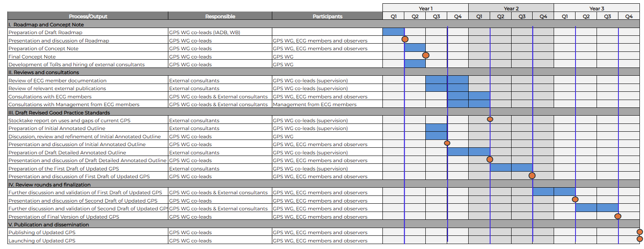

Proposed Timeline
We are here

Slide 8
Roles and responsibilities
ECG members (and observers). At each ECG meeting the GPS Working Group co-leads will provide an update on the GPS process and will take on board guidance from the ECG meeting.
GPS Working Group. The Working Group will oversee the process and provide technical feedback on intermediate products.
The GPS Working Group co-leads, IADB and WB, will manage the overall implementation process, oversee the work of the consultants, and prepare draft (intermediate) documents for review by the Working Group and the ECG meeting.
To the extent needed and feasible, thematic sub-Working Groups will be established to discuss specific sections of the GPS.
A team of 2-4 consultants will be contracted for conducting the review and consultation tasks and drafting the revised GPS. The team will include at least one expert specializing in public-sector evaluation and another in private-sector evaluation.

Slide 9
Questions for discussion
Are there any additional points you would like to share regarding the purpose, scope and format of the revised GPS?
Are you in (broad) agreement with the process?
How (and to what extent) should we involve representatives from Management and the Boards in the process? Should we involve other stakeholders in the process?

Slide 10

Thank you

